Slide 1

Primary Resource

Slide 2
Reversible and Irreversible Changes

Slide 3
On the next few pages are some examples of reversible changes

Slide 4
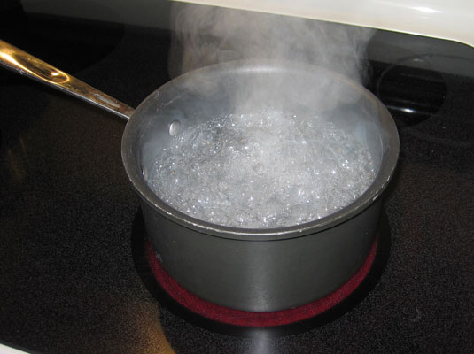
All changes of state are reversible including:​
- melting​
- boiling​
- evaporating​
- condensing​
- freezing
Do you know what all these words mean?

Slide 5
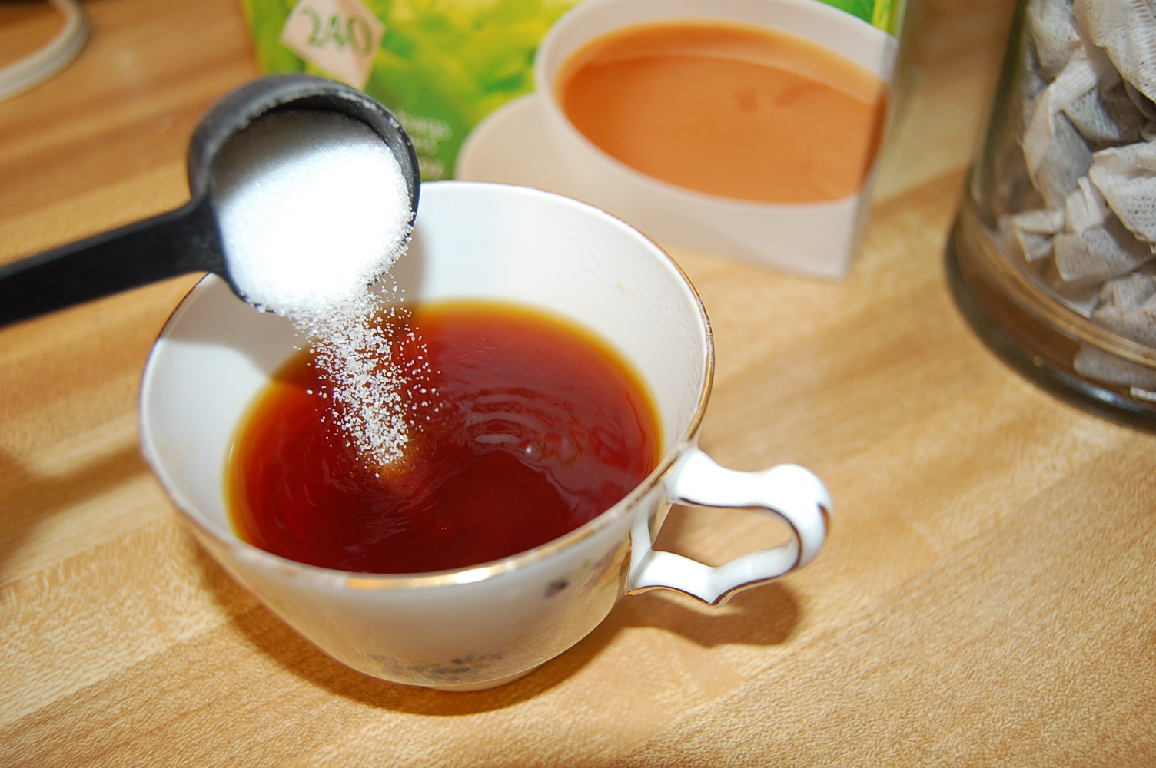
Mixing and dissolving are reversible changes
E.g.
Dissolving sugar in tea. You can get the sugar back by evaporation.
Mixing salt and sand. You can separate them by sieving

Slide 6
On the next few pages are some examples of irreversible changes

Slide 7
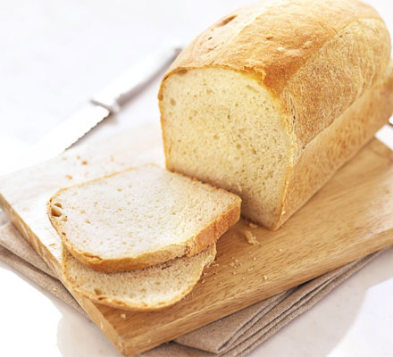
Cooking
E.g. Making a loaf of bread. The flour, yeast, oil, water and salt are mixed together and then heated in the oven. They react together in a way that means you can't 'unmake' the loaf again afterward.
All cooking is like this.

Slide 8
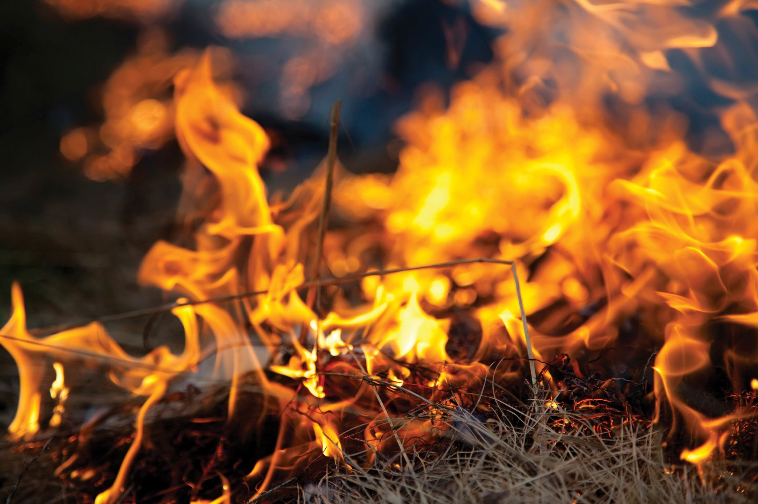
Burning
E.g. When green grass burns into black ash it is impossible to get the green grass back again

Slide 9
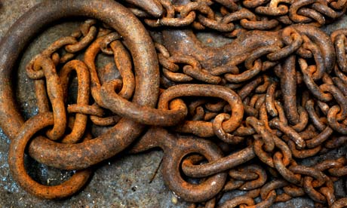
Chemical reactions where the substances react together to form new substances
E.g. Rusting
Iron + Oxygen -> Iron Oxide
It is impossible to get the un-rusted iron back again.

