Slide 1

Primary Resource

Slide 2
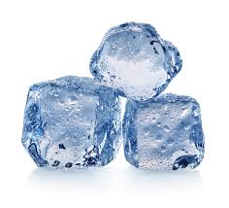

Why do solids hold their shape?
Why do liquids flow?

Slide 3
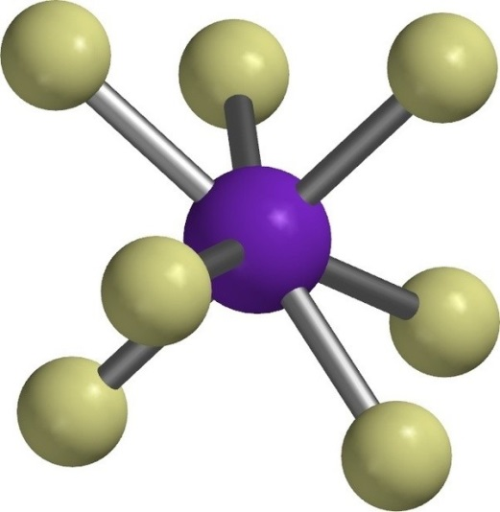
Materials are made of tiny particles that are far too small to see. Particles are made of atoms.

Slide 4
Solids
In a solid, the particles are held tightly together with strong bonds between them. These particles do not move easily so a solid keeps its shape.
Liquids
In a liquid, the particles are not held so tightly together because they have weaker bonds between them. This makes them more free to move around so liquids can flow. But a liquid can’t hold its shape unless it is in a container.
Gases
Describe how you think the particles in a gas behave.
Then have a go at drawing what you think gas particles look like.
Then check your understanding by having a look online at gas particles.

