Slide 1

Primary Resource

Slide 2
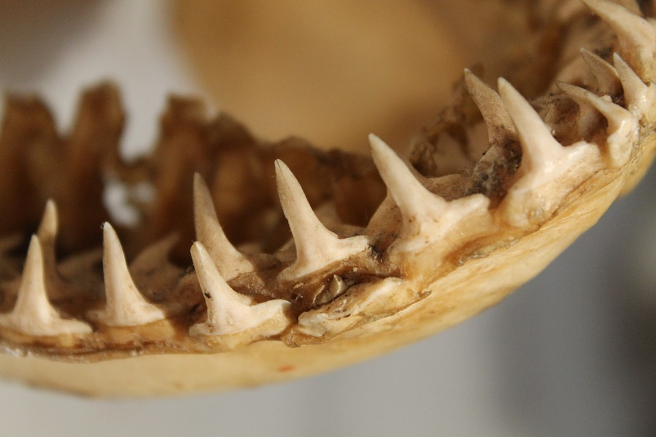
Excuse me, are these your teeth?
No? Who do you think they belong to?

Slide 3
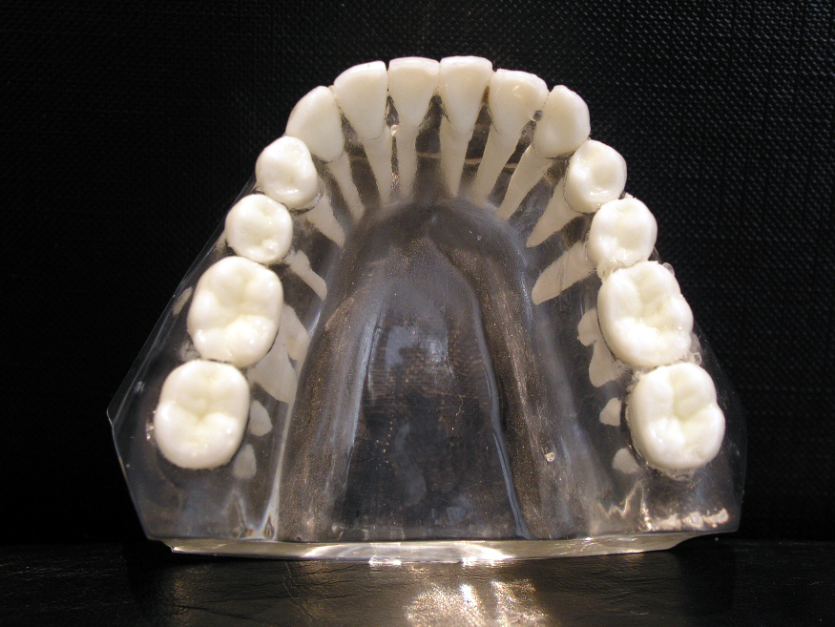
Feel your teeth with your tongue.
Do all your teeth feel the same?

Slide 4
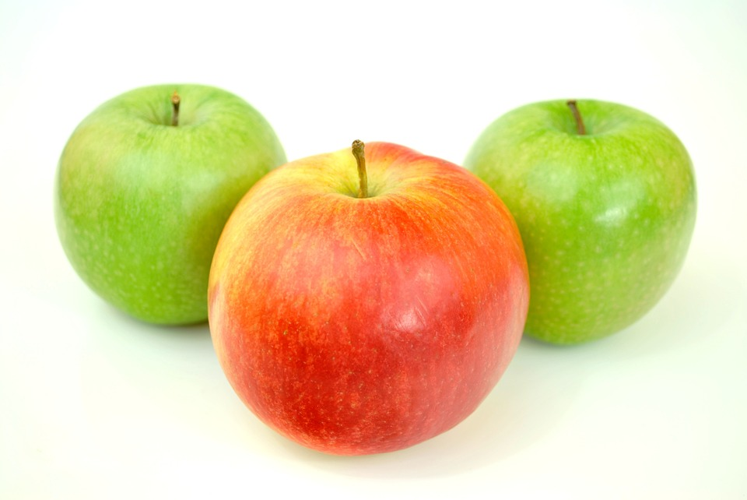
Why do you think they are a different shape?
Discuss with the people around your table.
Take a bite of your piece of apple. What happens in your mouth?

Slide 5
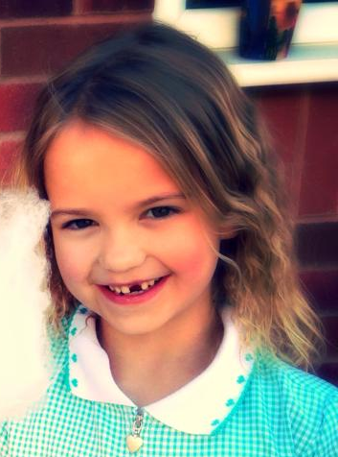
Take a second bite – but this time try to only chew it with your front teeth – if you have them!
Make sure it’s chewed up small enough to swallow – it may take a while!

Slide 6
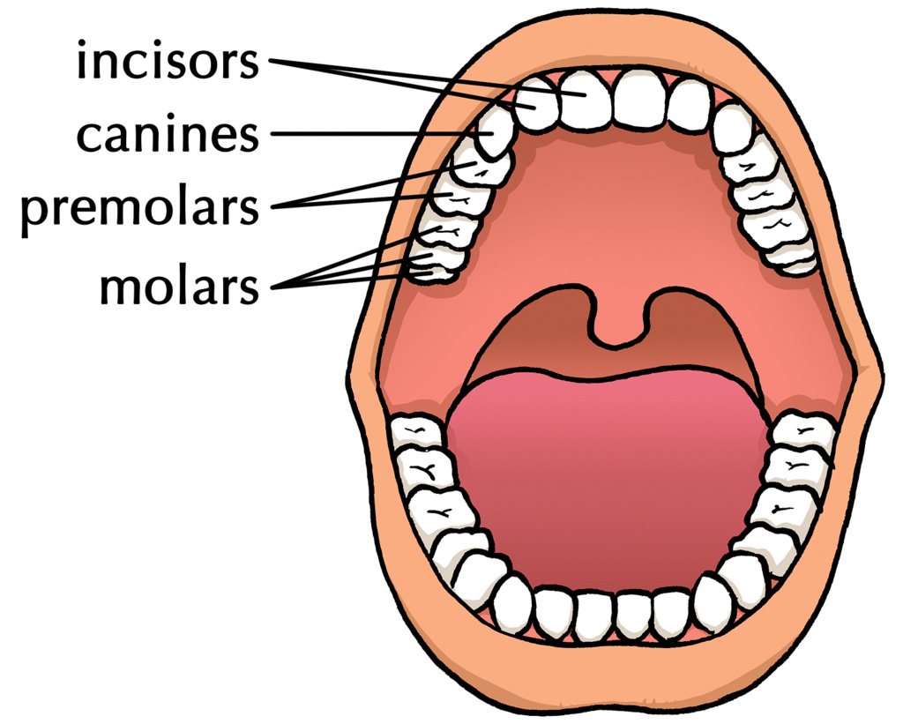
The different teeth in your mouth have different jobs to do.
Your incisors are not meant to grind the food up which is why it felt so odd to only chew with them.

Slide 7
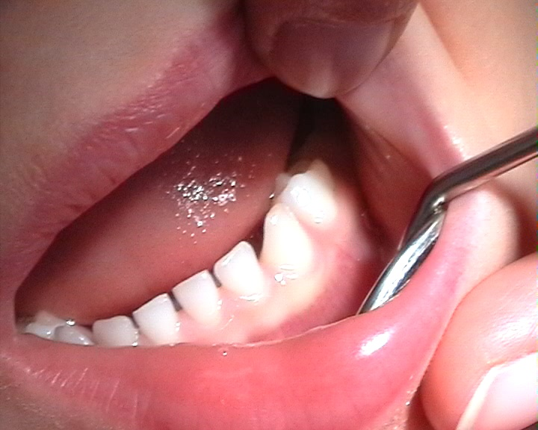
I don’t need to worry about taking care of my baby teeth as I get new ones anyway!
True or false?
False!
Poor dental care could cause other problems like gum disease and could also damage adult teeth (which are lying under the baby teeth waiting to emerge).

Slide 8
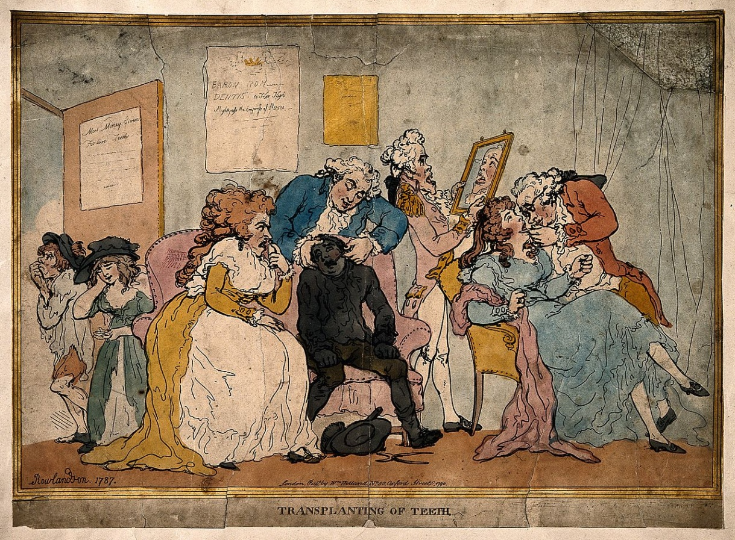
What should you do to keep your teeth healthy?
Jot down ideas.

Slide 9
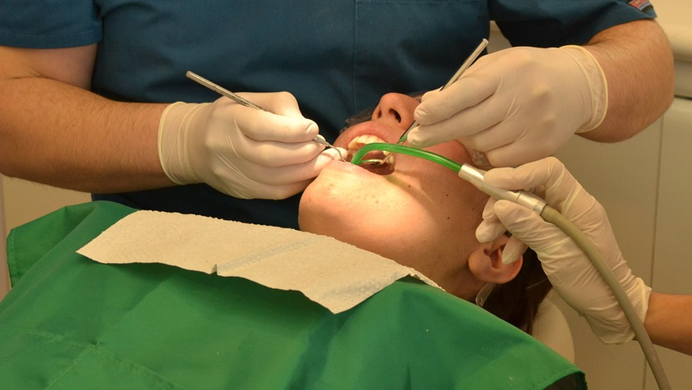
Brush your teeth twice a day
Avoid lots of sugary drinks and sweets
Visit the dentist regularly
http://kidshealth.org/en/kids/teeth-movie.html

