Slide 1

Primary Resource

Slide 2
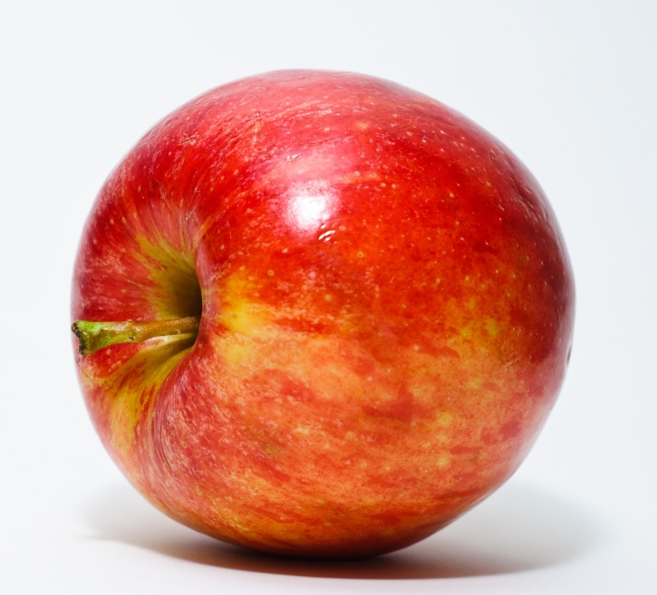
What do you want to know about our digestive system?

Slide 3
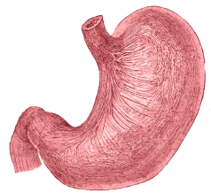
Once you’ve chewed your food, how long do you think it takes to get to your stomach?
Take a small bite of a cracker and chew it up… Wait for it….

Slide 4
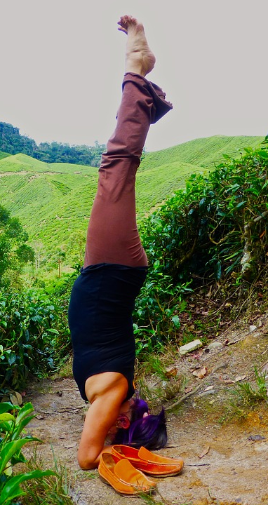
6 Seconds!
What if you were upside down – would it take a different amount of time?
Still about 6 seconds!

Slide 5
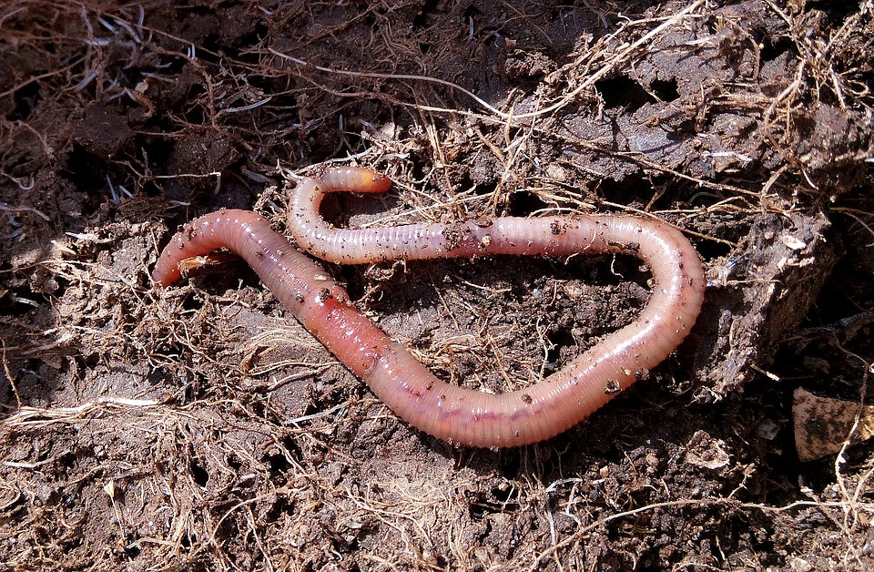
Food is moved along the oesophagus (food pipe or gullet) between the mouth and the stomach by the muscles around it. They move in a worm-like motion called peristalsis and push the food towards the stomach.

Slide 6
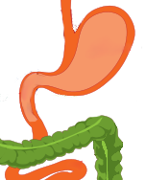
oesophagus
The Stomach
The acids and enzymes in the stomach break down the food. The muscles surrounding it contract to help churn up the food.
stomach
small intestine (ileum)

Slide 7
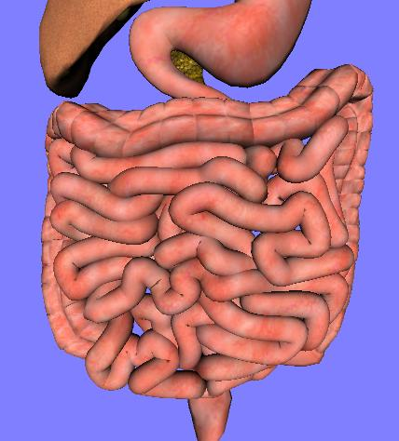
The Small Intestine
The partially digested food then moves from the stomach to the small intestine. It takes about 20 minutes for your chewed up food to travel from your mouth to here. The small intestine does most of the work – almost all of the digestion and absorption of nutrients and minerals happens here. The remains of the food move along the intestine by peristalsis, just like it does through the oesophagus. It is about 7 metres long!

Slide 8
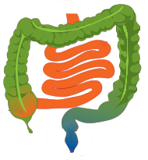
large intestine
The Large Intestine
If the small intestine is 7 metres long, how long do you think the large intestine is?
It is actually only 1.5 metres long. It is called the large intestine because it is a lot wider than the small intestine. It is the final stage of the digestive system. The last of the water is absorbed, and the waste hardens and forms faeces (poo).
small intestine

Slide 9
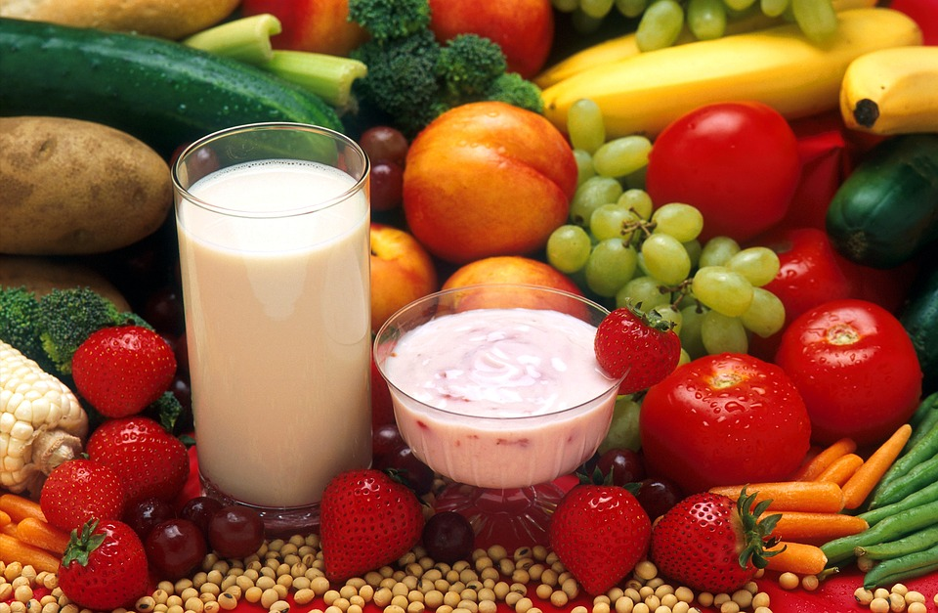
What is the result of a healthy digestive system?
A healthy body!
Your digestive system turns the food you eat in to the fuel that your body needs.

