Slide 1
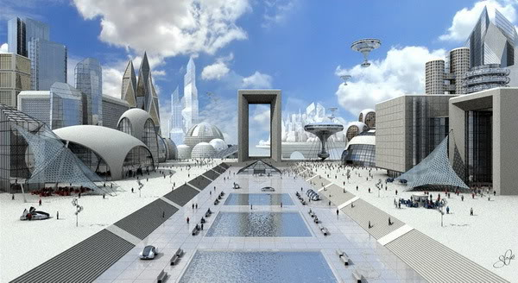
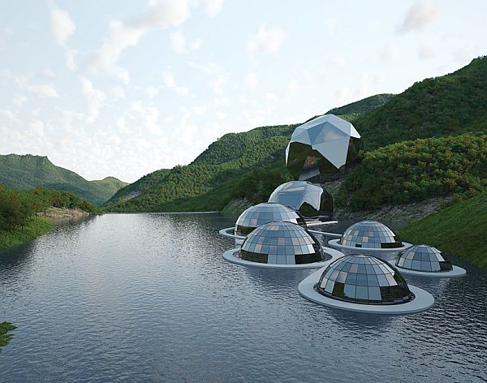
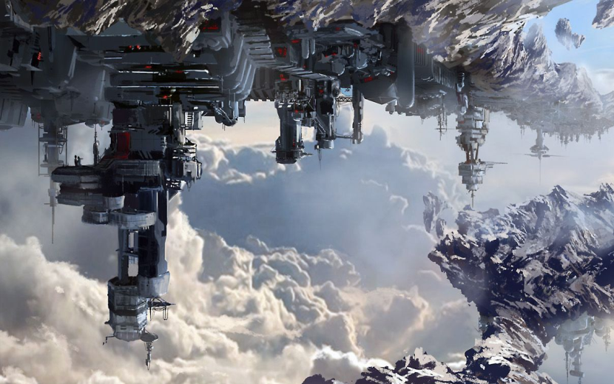
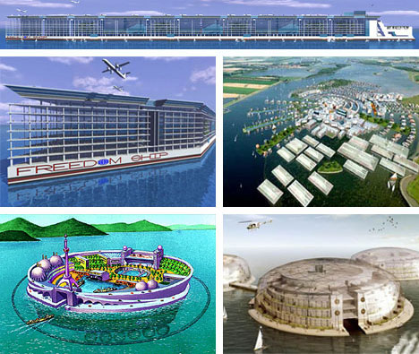
What do you think settlements might be like in the future?

Slide 2
Earth relocation
It is the year 3014, the citizens of Earth are relocating to Mars. We are building new cities using the lessons we have learnt from our time on Earth about sustainability and community.
You are in charge of the advertising department for the relocation.
You need to create a poster for the people of Earth persuading them to move to the new city. You must tell them why this city is a good choice, how it is sustainable and include a picture.

Slide 3
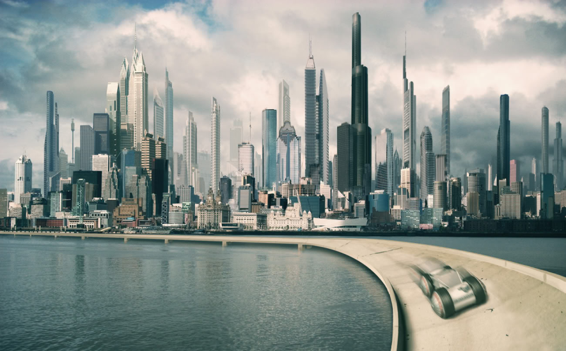
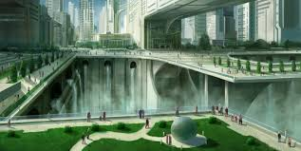
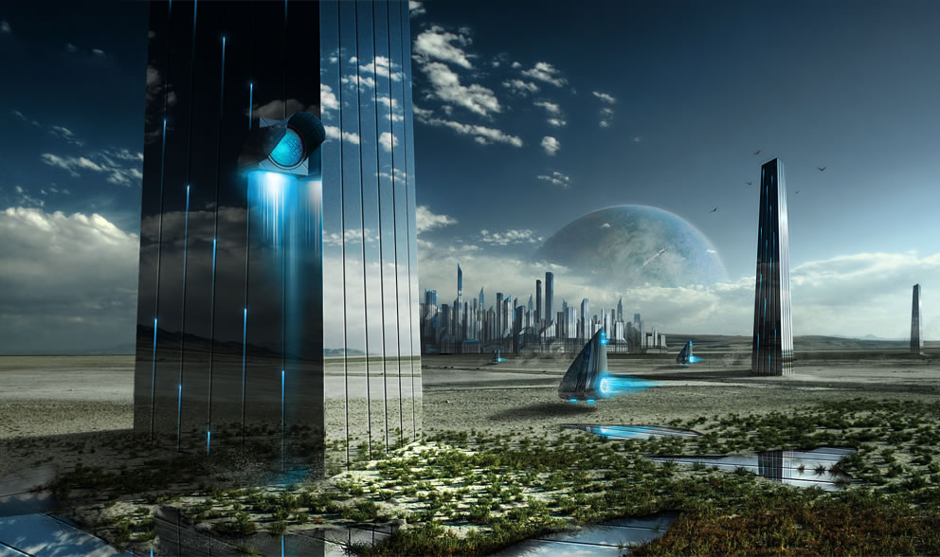
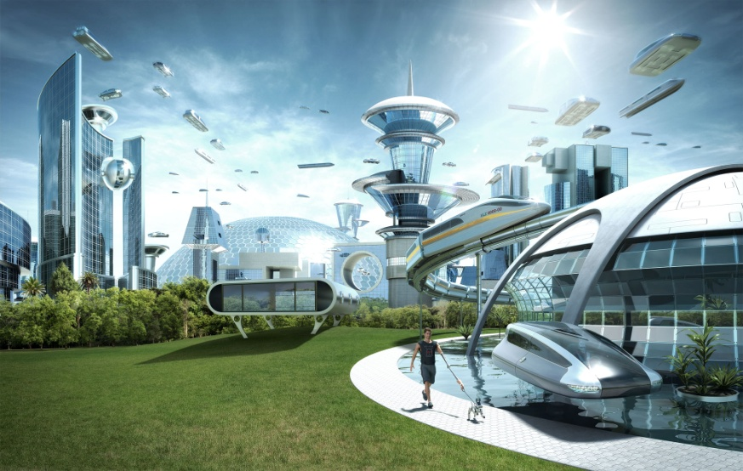
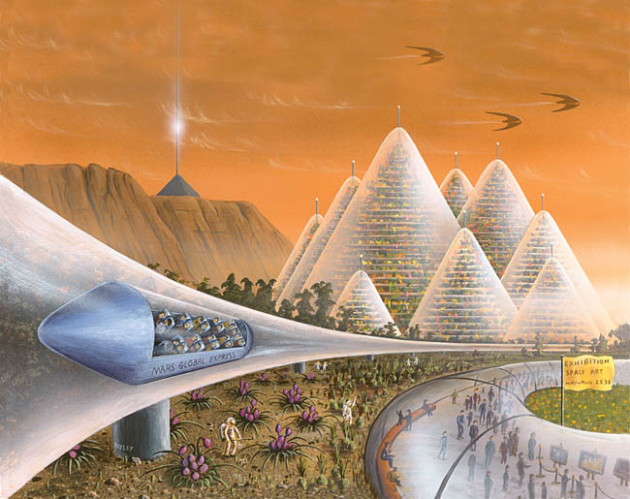
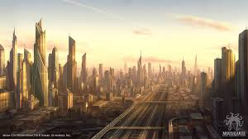

Slide 4
Entertainment
Housing
Transport
Community
Nature
Energy
Jobs
Waste

