Slide 1
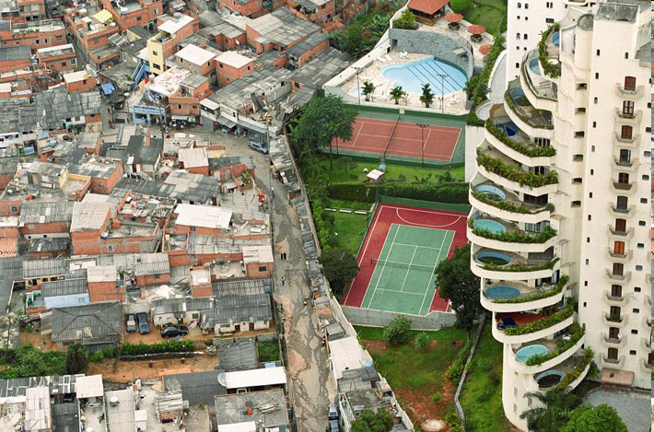
Notes:
Print this slide
You have 3 minutes to draw what you think is on the other half of this picture

Slide 3

Life in the Favela
What we will learn today:
Understand what a favela is and what it would be like to live in a favela.
Explain some of the positives and negatives of living in a favela.

Slide 4
What is a favela?
A favela is a collection of shacks built on waste ground, without permission.
Most of the people came from rural areas to work in cities.
About 3 million people in Brazil live in favelas.
Rocinha is Brazil’s largest favela, in Rio de Janeiro.
Now watch the short video clip “http://www.bbc.co.uk/education/clips/zgp4d2p”

Slide 5
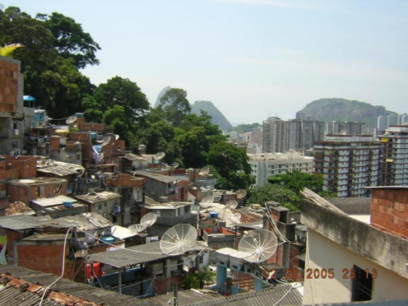
Things to think about….
What would it be like to live there?
How is it different to where you live?

Slide 6
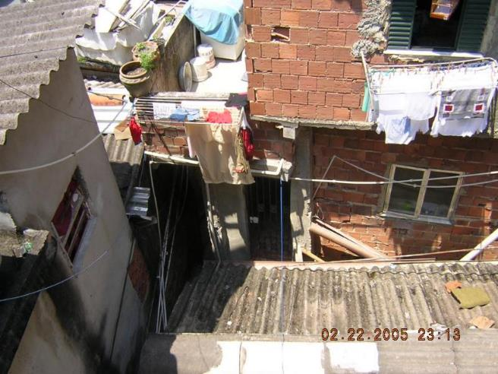
Describe what their living conditions are like.
What is similar / different to your life?

Slide 7
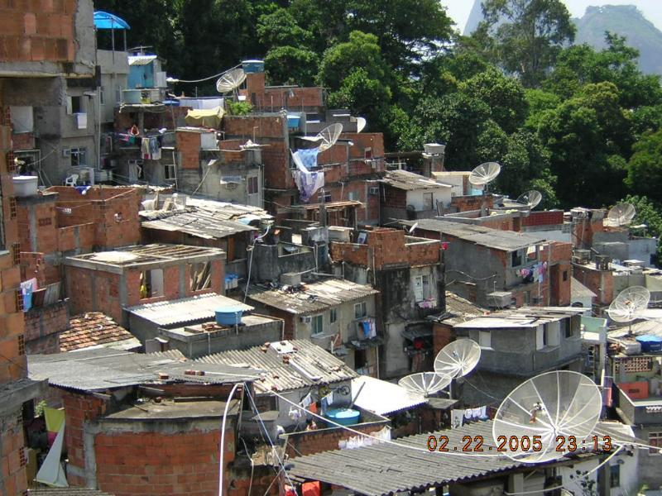
Sorting task:
On your cards are statements about life in a favela.
You are going to sort them into two piles:
‘Problems’ and ‘Positives’
Extension Task:
Rank the statements from which you think is the worst - best.

