Slide 1

Name 5 things that people might look for when choosing where to live…

Slide 2
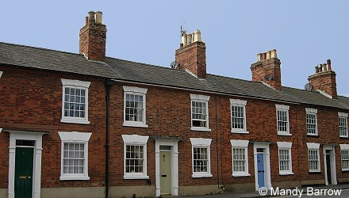
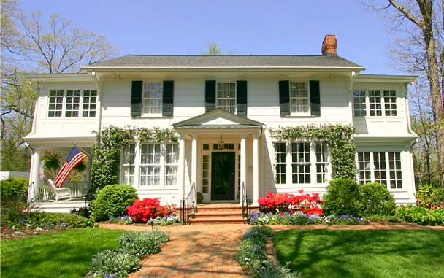
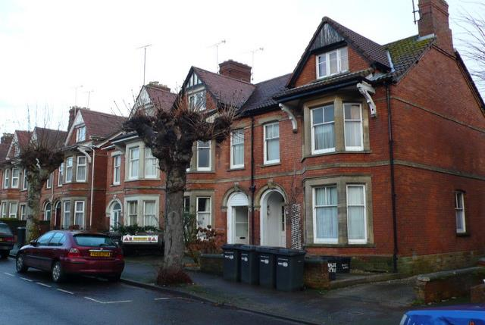
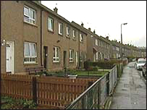
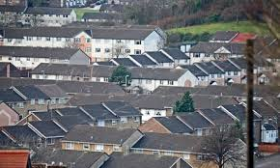
Where should Dave move to?
Lesson Objectives:
- To be able to decide the area that is best for Dave to move to.
- To understand what factors affect people’s choice of settlement.

Slide 3
Recap: What is each zone like?
CBD – Central Business District
This is the centre of the town where people go to shop, work and have fun. It will have lots of offices, malls, theatres, etc. There isn’t much housing at all.
Industrial Zone
This is where all the factories are, as well as warehouses. It tends to be quite polluted and not very nice to look at. No-one wants to live here.
Inner City
This is the nearest and cheapest residential (housing) area to the CBD. It has mainly apartments or small terraced houses. No garages or large gardens here!
Inner Suburbs
Houses get a bit bigger as you move further out from the centre. There is more space, so houses tend to be semi-detached and might have garages or larger gardens. More families live here.
Outer Suburbs
The outskirts of the town have the biggest houses that are the most spread out as land is cheaper. You might also find out-of-town shopping centres here.

Slide 4
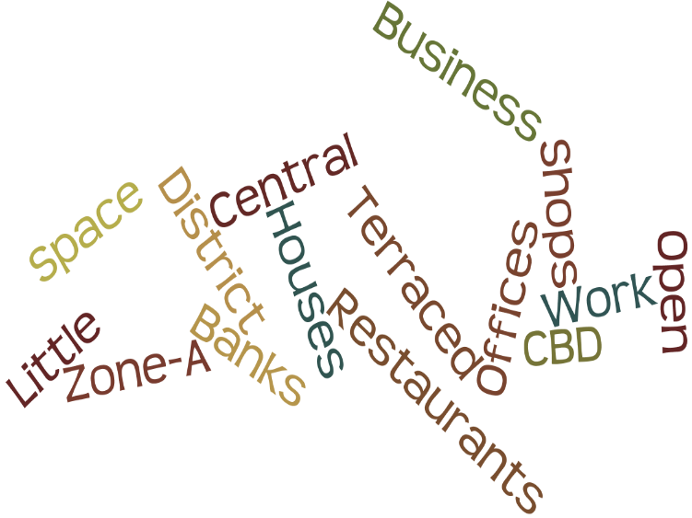
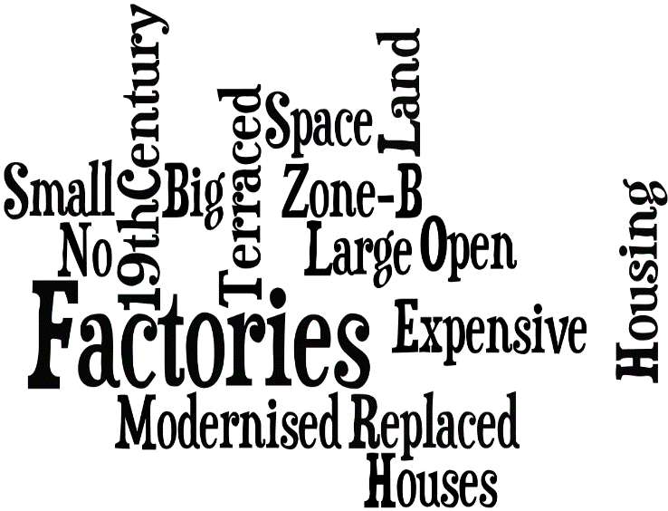
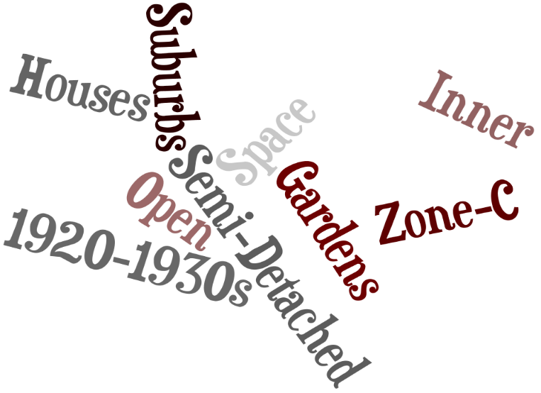

Zone D
- Outer Suburbs
Zone C
- Inner Suburbs
Zone B
- Inner City
Zone A
- CBD

Slide 5

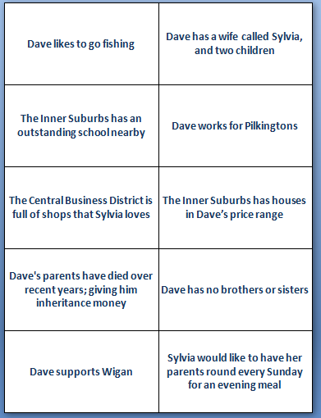


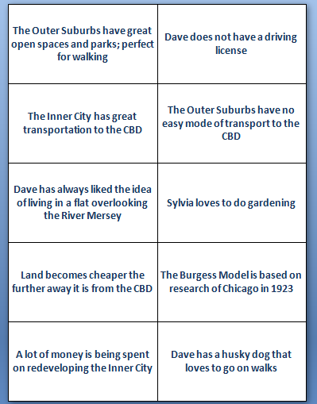
Lesson Objectives:
- To be able to decide the area that is best for Dave to move to.
- To understand what factors affect people’s choice of settlement.
Notes:
Dave is moving to St. Helens but doesn’t know which zone to move to. So we are going to help him decide by learning about his life and applying our knowledge of the Burgess model and zones.

Slide 6

http://www.online-stopwatch.com/classroom-timers/
Task Time
Your task is to sort out the information cards.
YOU decide how you want to sort them.
Which zone do you think Dave should move to and why?
There is no right or wrong answer; just your opinion!
Lesson Objectives:
- To be able to decide the area that is best for Dave to move to.
- To understand what factors affect people’s choice of settlement.

