Slide 1
Land use in Cities

Slide 2
What does ‘land use’ mean?
How is land used in cities?
Look at the photos on the next few slides and make a spidergram of how land is used in cities. You can add your own ideas too!

Slide 3
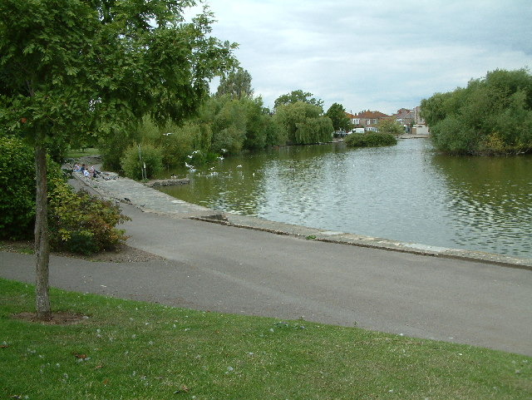

Slide 4
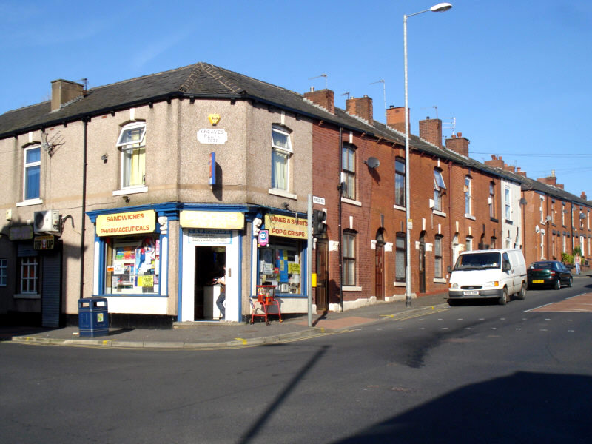

Slide 5
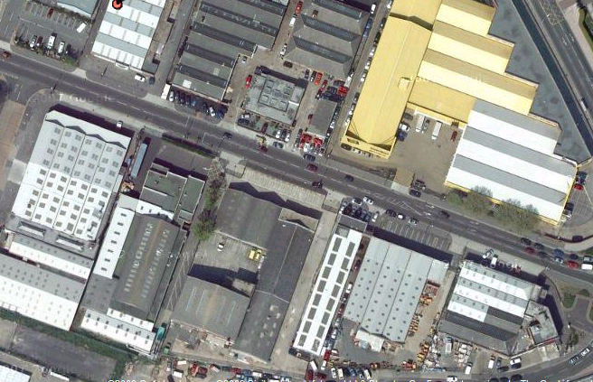

Slide 6
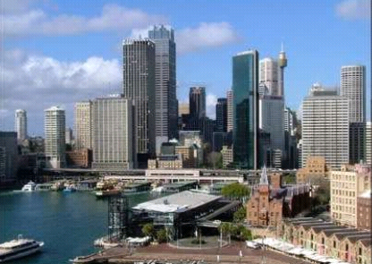

Slide 7
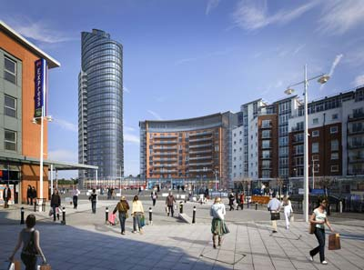

Slide 8
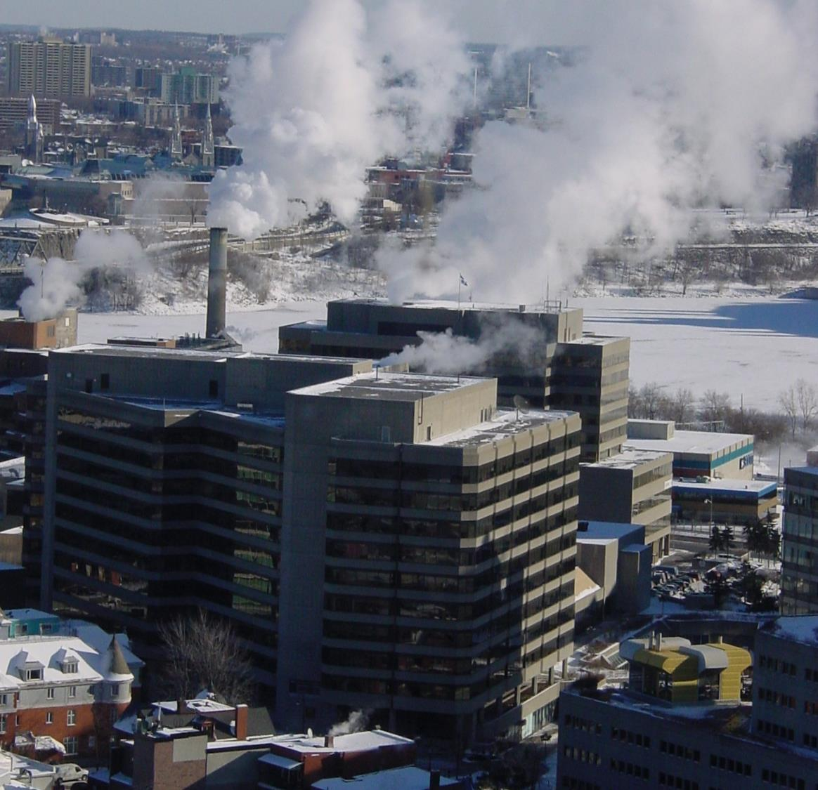

Slide 9
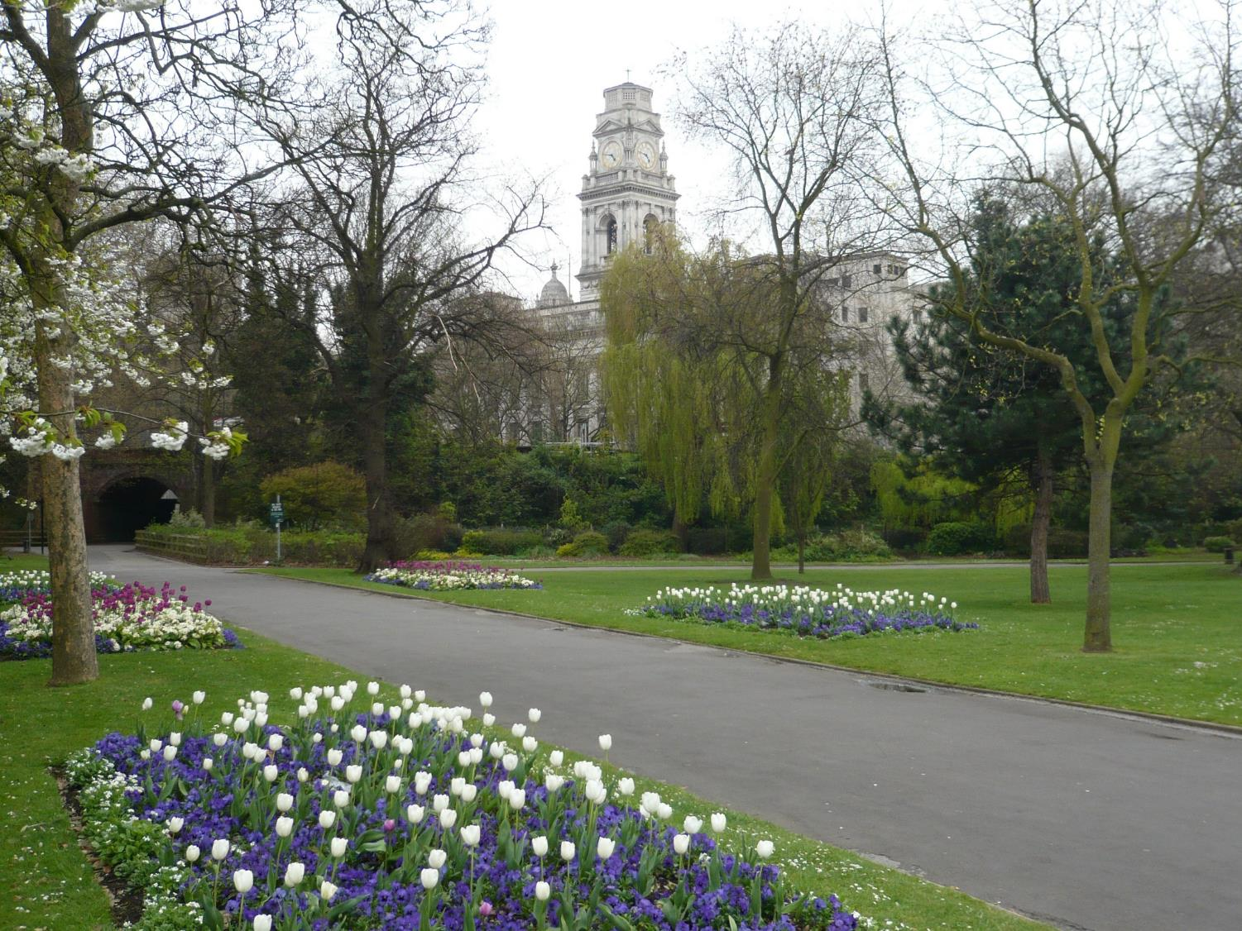

Slide 10
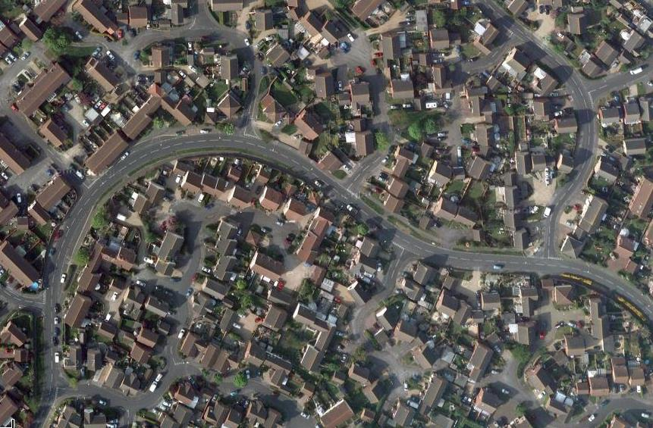

Slide 11
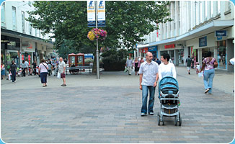

Slide 12
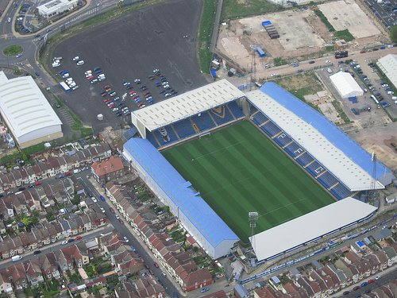

Slide 13
How is land used in urban areas?
All these difference land uses can be put into categories.
Can you complete the table below? If you are unsure about the meaning of some words, there are definitions on the next slide.
Commercial | Industrial | Open Space | Entertainment | Residential
Shops
Dockyards
Parks
Offices
Flats
Banks
Factories
Cinemas
Houses
Restaurants

Slide 14
Key words
Urban – A built up area (area with lots of buildings), with a high population, for example a town or city.
Land use – The way in which land is used.
Urban land use – The way land is used in a town or city.
Commercial – e.g. shops, offices, banks
Residential – different types of housing such as terraced, detached, flats.
Entertainment – e.g. bowling, cinema, restaurants
Open space – e.g. parks, lakes
Industrial – e.g. factories, dockyards, warehouses
Services – schools, hospitals, government buildings, etc.

Slide 15
Land use can be divided into 5 different zones.
In some cities,the pattern looks like this….
Outer Suburbs
Inner City
Industrial Zone
Central Business District
Inner Suburbs

Slide 16
Urban land use can be divided into 5 different zones
CBD – Central Business District
Industrial Zone
Inner City
Inner Suburbs
Outer Suburbs

Slide 17
What is each zone like?
CBD – Central Business District
This is the centre of the town where people go to shop, work and have fun. It will have lots of offices, malls, theatres, etc. There isn’t much housing at all.
Industrial Zone
This is where all the factories are as well as warehouses. It tends to be quite polluted and not very nice to look at. No-one wants to live here.
Inner City
This is the nearest and cheapest residential (housing) area to the CBD. It has mainly apartments or small terraced houses. No garages or large gardens here!
Inner Suburbs
Houses get a bit bigger as you move further out from the centre. There is more space, so houses tend to be semi-detached and might have garages or larger gardens. More families live here.
Outer Suburbs
The outskirts of the town have the biggest houses that are the most spread out as land is cheaper. You might also find out-of-town shopping centres here.

Slide 18
1. Leisure and entertainment facilities
2. Large detached houses with garages
3. Very few driveways
4. Most expensive houses
5. Shops and offices
6. Semi-detached houses with gardens
7. Newest
8. Grew in response to increased car ownership
9. High-rise flats may now replace some run-down areas
10. Parks and open spaces
11. Lots of public transport links
12. Oldest
13. Tall high density buildings
14. Cheapest housing
15. Land is cheaper
16. Terraced housing
17. Some garages
18. Modern out-of-town shopping centres
19. High value land
20. Industry
Notes:
Match up to fit the 5 zones. Cut and stick in to books.

Slide 19
Match it up!
Colour code the statements on the Land Use Worksheet to fit the 5 categories:
- CBD -
- Inner City -
- Industrial Zone -
- Inner Suburbs -
- Outer Suburbs -
Remember to use a key.

Slide 20
1. Leisure and entertainment facilities
2. Large detached houses with garages
3. Very few driveways
4. Most expensive houses
1. Leisure and entertainment facilities
2. Large detached houses with garages
3. Very few driveways
4. Most expensive houses
5. Shops and offices
6. Semi-detached houses with gardens
7. Newest
8. Grew in response to increased car ownership
5. Shops and Offices
6. Semi-detached houses with gardens
7. Newest
8. Grew in response to increased car ownership
9. High-rise flats may now replace some run-down areas
10. Parks and open spaces
11. Lots of public transport links
12. Oldest
9. High-rise flats may now replace some run-down areas
10. Parks and open spaces
11. Lots of public transport links
12. Oldest
13. Tall high density buildings
14. Cheapest housing
15. Land is cheaper
16. Terraced housing
13. Tall high density buildings
14. Cheapest housing
15. Land is cheaper
16. Terraced housing
17. Some garages
18. Modern out-of-town shopping centres
19. High value land
20. Industry
17. Some garages
18. Modern out-of -town shopping centres
19. High-value land
20. Industry
Notes:
Match up to fit the 5 zones. Cut and stick in to books.

