Slide 1
How were early settlements chosen?
Lesson objectives;
To develop a knowledge of the site factors that early settlers looked for.
To understand how site factors continue to influence settlement developments.
To be able to apply different site factors to decide the best place for a settlement.
To be able to describe the different natural site factors, that influenced early settlers.
To be able to give the meaning of the word ‘site’ in relation to settlement.

Slide 2
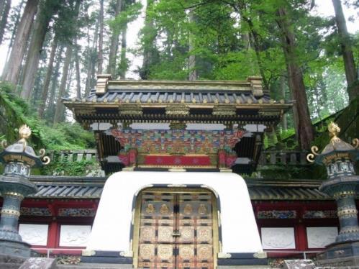
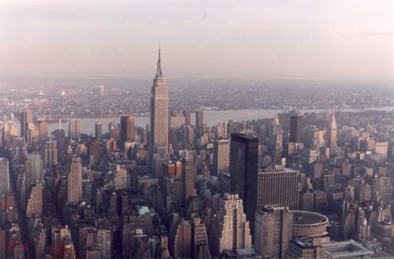
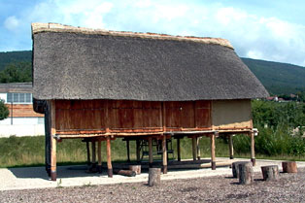
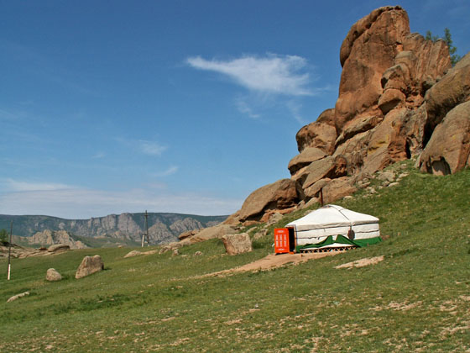
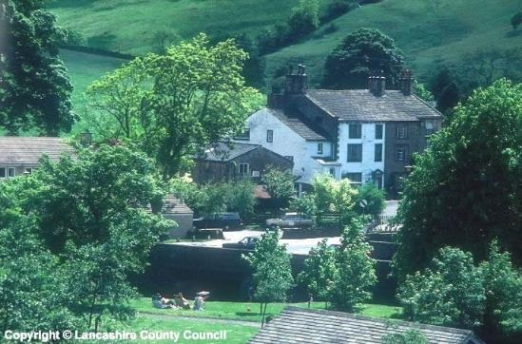
What do all these photos have in common?
They are all places where people live (settlements)!

Slide 3
Starter
Key words
Early settler- someone who created the first places where people live.
Natural- things that are not man made, e.g. trees
Settlement- a place where people live, e.g. town, city, village.
You are an early settler before the times of nice homes with running water and heating.
What natural factors would influence where you would build your settlement?
Think!
There is no running water, bricks, Internet, electricity, etc.
Where are you going to get water from?
Where are you going to get heat for cooking and keeping warm?
Where are you going to get building materials?
What does the land need to be like to build on?
How are you going to get food?
Forests (trees) for fire wood.
Natural factors influencing settlement site.

Slide 4
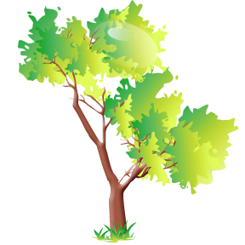


Natural site factors
Extension: Which of these is not important today and why?
The site is the actual place where a settlement such as a village or town grew up.
Building materials
Needed wood or stone. Useful to be near a wood or rocky hill side.
Shelter
A south-facing slope will have more sun and protection from the wind. Trees can also provide protection.
Protection
Good views from the hill top give you warning if you are about to be attacked.
Water
Needed for drinking, cooking and washing. Too much can cause flooding.
Wood
Need for fires to keep warm and to cook on.
Rivers
Easy to cross either on foot or by a bridge.
Flat land
Easier to build on, grow crops and travel to other towns.
Notes:
Question- Would any of these not be relevant today? What would people be looking for now, when choosing somewhere to live?

Slide 5
Scenario
Key words
Fertile- soil with good food in for plants
Grazing- Animals eating grass
Early settler- Someone who started the first places to live.
Imagine you are an early settler (e.g. Roman) and are looking for a place to live.
1. Look at the images in the following slides and write down the natural advantages (good site factors) and disadvantages (bad site factors) of each.
2. Decide and explain which site you would choose.
You are able to give at least 2 natural advantages and disadvantages of each site.
You are able to describe the natural advantages and disadvantages of each site.
You can give at least 2 reasons for your chosen site.
You can fully explain the natural advantages and disadvantages of each site. You compare the sites to evaluate which one is the best for a settlement.

Slide 6
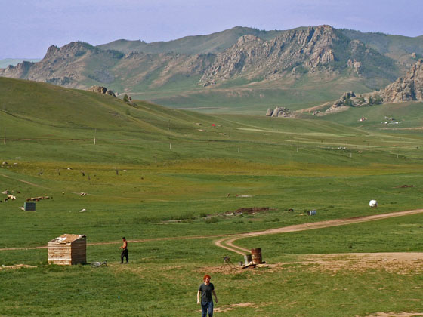
Most of the land here is flat with the hills behind. A small river runs through the land. The land is great for grazing cattle but the soil is not very fertile.
A
Rocky hillside
River runs through hills
Hard ground
Some flat land

Slide 7
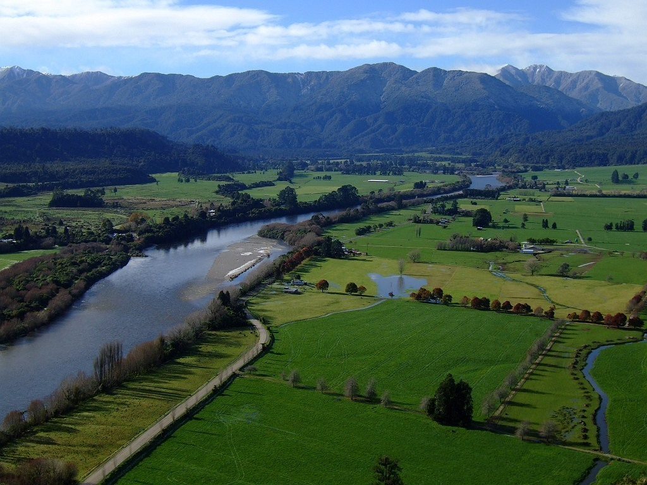
The land is very flat. There is a river next to the land. The land has very good soil. There are hills not too far away.
B
Hilltop (not south facing)
River
Flat land
Rich soil
Notes:
Ask- How could the flooding problem be overcome.

Slide 8
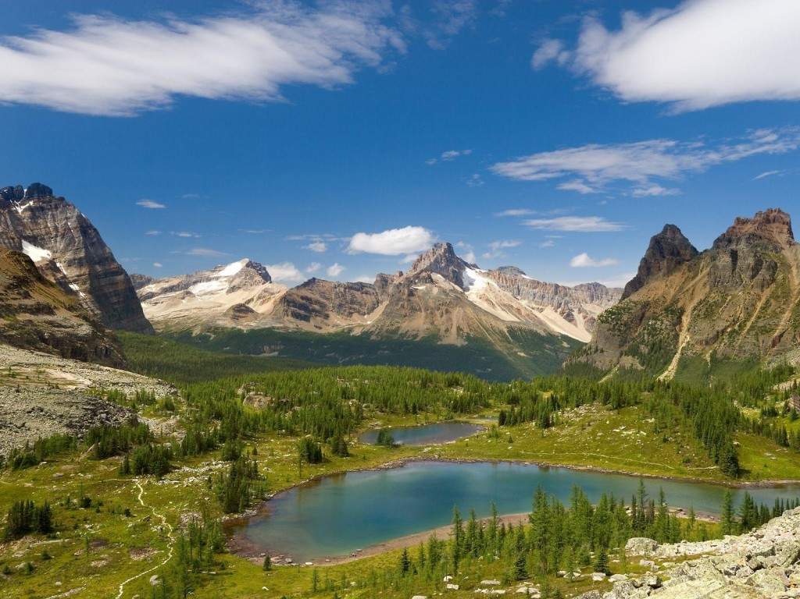
The land is here is very hilly and the ground is hard. There are lots of areas of trees and a large lake which receives fresh water from the mountains.
C
South facing
Mountains
Areas of forest
Poor soil
Lake

Slide 9
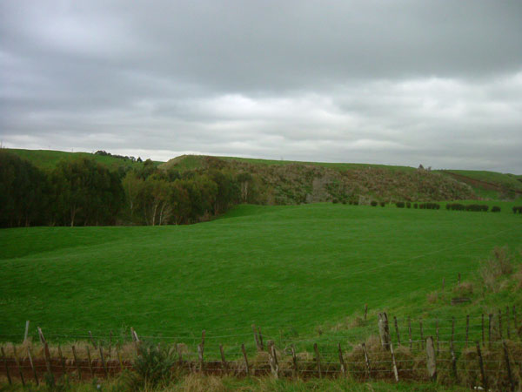
The land is very flat. The area is very open and there is only a small area of forest.
D
Area of forest
Good fertile soil
Flat land

