Slide 1
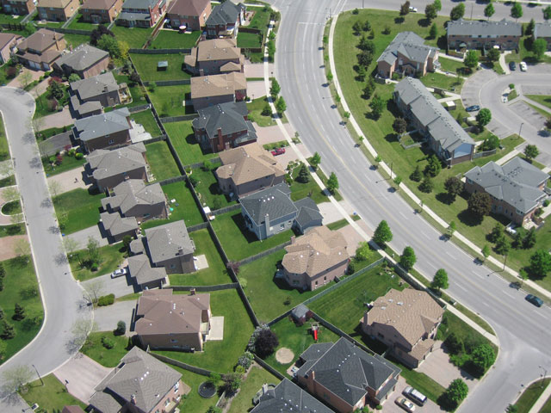
Settlement Patterns and Hierarchy
Learning Objective
To be able to identify 3 different settlement patterns

Slide 2
How can we divide settlements by size?
Settlement Hierarchy?
        In Claremont School Mr Molloy (Head teacher) is very important because he makes decisions which affect everyone else. Put the following people in order of importance on the school hierarchy:
Deputy heads
Pupils
Head teacher
Teachers

Slide 3
The Settlement Hierarchy
Put these four different types of settlement into order of importance:
  hamlet, city, village, town
Extra: Explain which type of
settlement is at the top and
why it is most important.
Which type is at the bottom?
Why is it the least important?
Stick in your books

Slide 4
Settlement patterns
A settlement pattern is the shape of the settlement.
The shape of early villages and towns was usually influenced by the surrounding area.
We are going to learn about 3 settlement patterns.

Slide 5
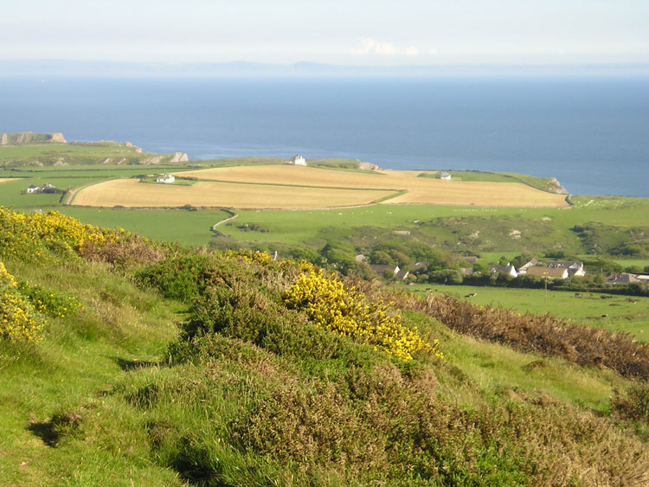
Dispersed pattern
Buildings are spread out.
People who live here need a lot of land to earn a living.

Slide 6
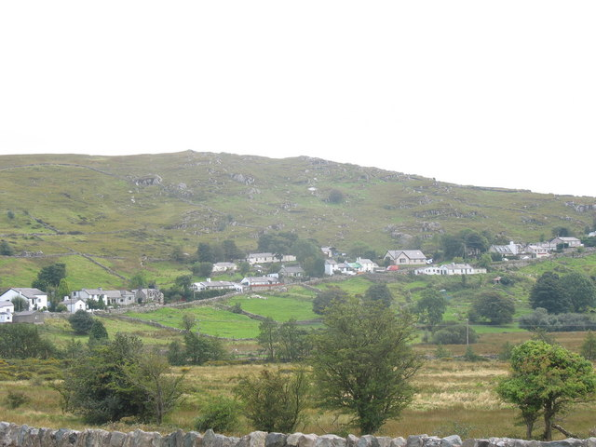
Linear pattern
Houses are built in a line, often because they are surrounded by steep hills.

Slide 7
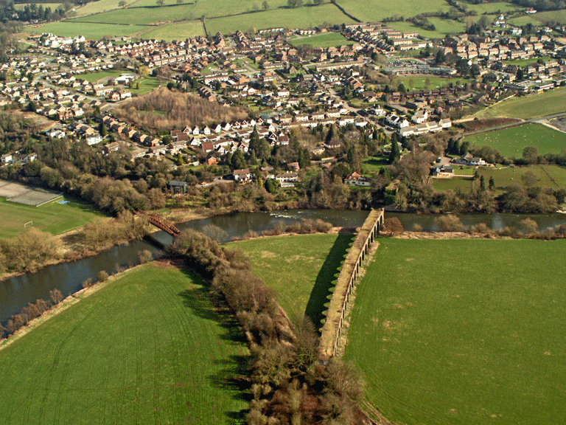
Nucleated pattern
Buildings are grouped together for protection.
It is a common pattern in flatter, lowland areas.

Slide 8
Quick Test
Dispersed pattern- spread out around the classroom.
Linear- get into a straight line.
Nucleated- huddle together.

Slide 9
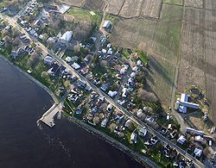
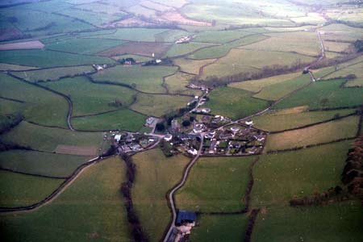
Task
Match up the term to the correct definition and map.
What settlement patterns are the photos showing? Suggest reasons why they are these shapes.
Photo A
Photo B

