Slide 1
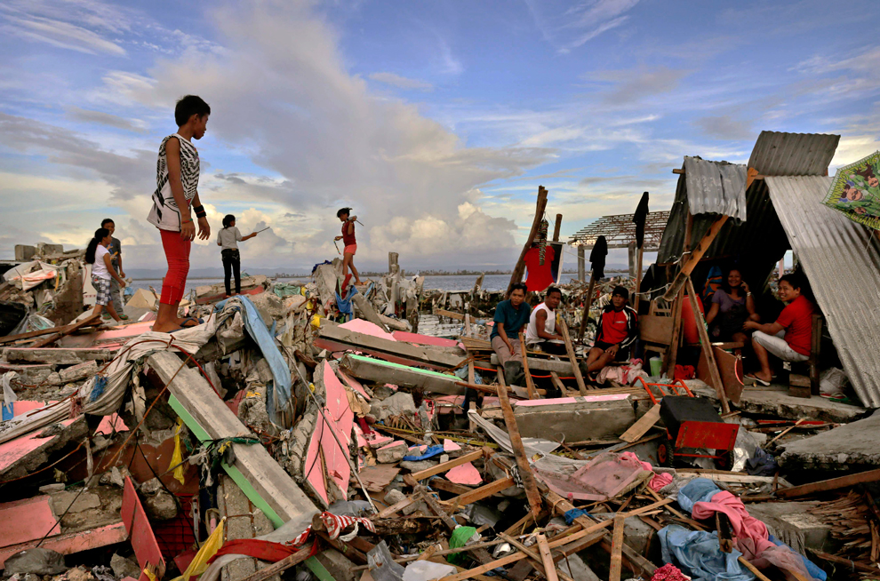
?
I am searching for…
I feel…
Why…?
Where is…?

Slide 2
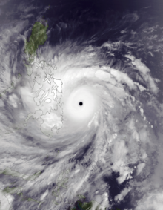
Comparing Hurricane Katrina and Typhoon Haiyan
Objective:
To compare the effects of Hurricane Katrina and Typhoon Haiyan and to evaluate which storm had the biggest effect and why.

Slide 3
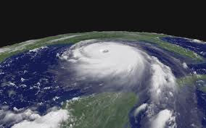
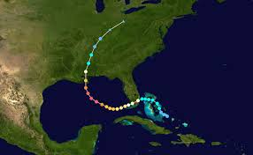

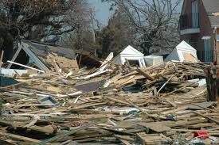
Hurricane Katrina
23/8-20/8/2005

Slide 4
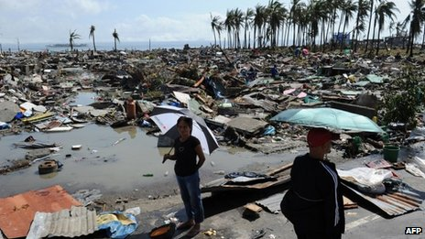
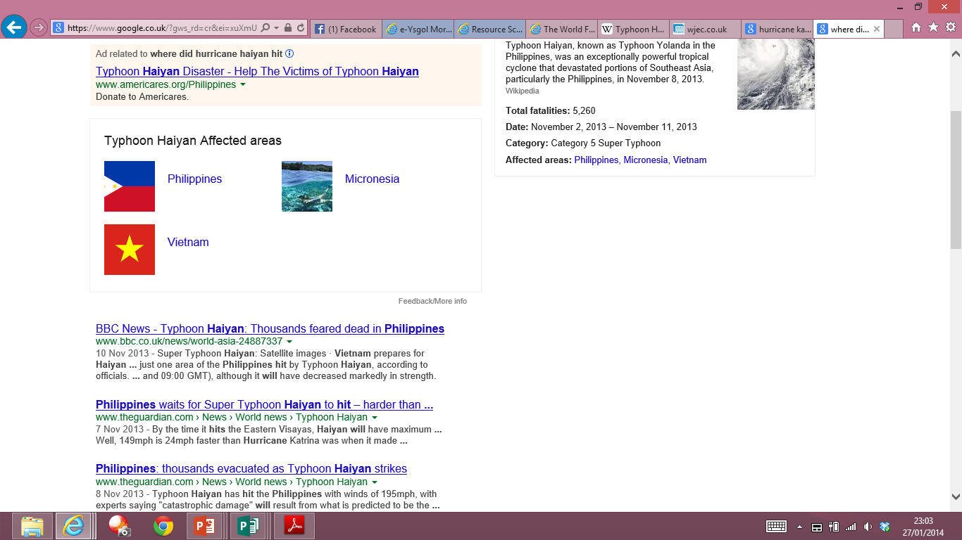
Typhoon Haiyan
3/11-11/11/2013

Slide 5


Discovering More About the Countries:
Fact Files
Use the information in the back of your atlas to complete the table on your worksheet.
Geography Challenge!
Use the information to compare the two countries.
Remember to use the success criteria on the sheet to help!
Words to help:
The USA has...
In the Phillipines,...
The two places are different because...
Both places are similar because...
poorer richer less developed
more developed less more
higher lower similar

Slide 6




Comparing the Effects of Katrina and Haiyan
We can share effects into three categories:
Economic Social Environmental
(money) (people) (nature)

Slide 7

Quick Quiz:
Economic, Social, Environmental?
Notes:
Economic

Slide 8
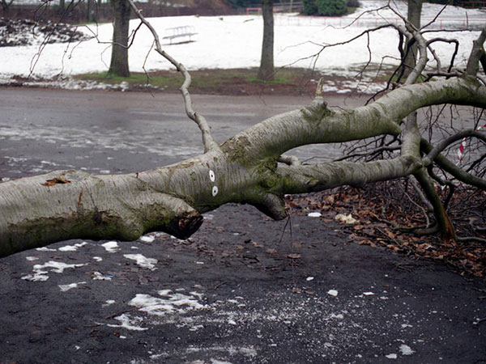
Quick Quiz:
Economic, Social, Environmental?
Notes:
Environmental

Slide 9
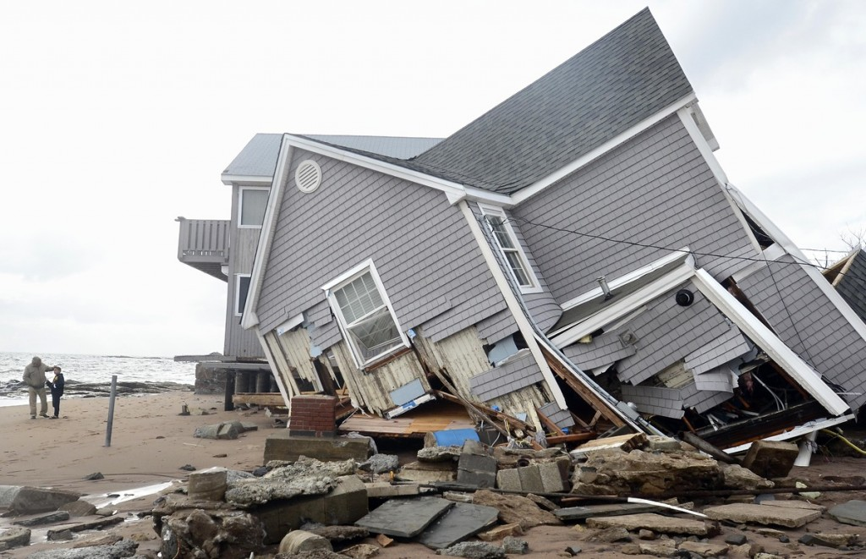
Quick Quiz:
Economic, Social, Environmental?
Notes:
Social/Economic

Slide 10

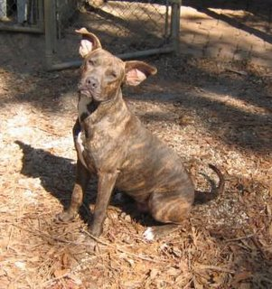
Quick Quiz:
Economic, Social, Environmental?
Animals Dying
Notes:
Environmental

Slide 11
Quick Quiz:
Economic, Social, Environmental?
People dying
Notes:
Social

Slide 12

What were the effects?
You have two fact sheets, one on Katrina and one on Haiyan.
Read your article and highlight the social, economic and environmental effects in different colours.
Note the information in your table.

Slide 13

Opinion Task:
In your opinion, which storm was worst? Why?
Try and explain why the two places were affected differently. (Use your fact file to help)
In my opinion, ..................................... was the worst storm because.................................................................................................................................................................................................................................................................................................................................................................

