Slide 1
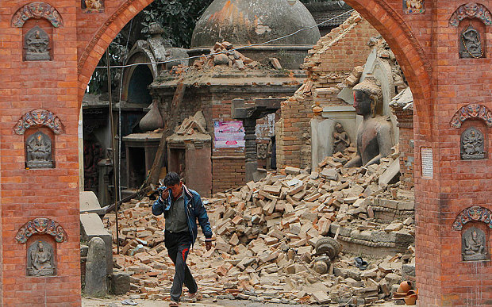
Nepal Earthquake, April 2015

Slide 2
These photos show people affected by the Nepal earthquake which struck on April 25th 2015.
Discussion questions
For each photo on the next slide:
Can you describe what is happening in the scene?
Who is in it?
What do they think is going on?
What do they think the people might be feeling?
What kinds of help and support do these people need?
* Think about both emotional and practical needs: first aid, medical treatment, knowledge about loved ones, water, shelter, food, essential supplies.

Slide 3
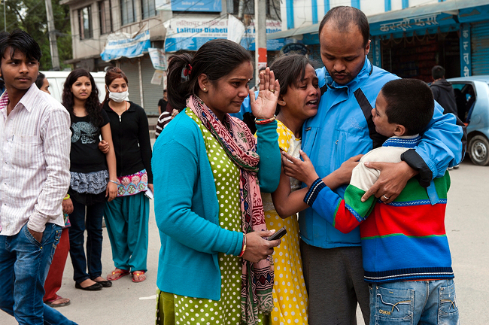
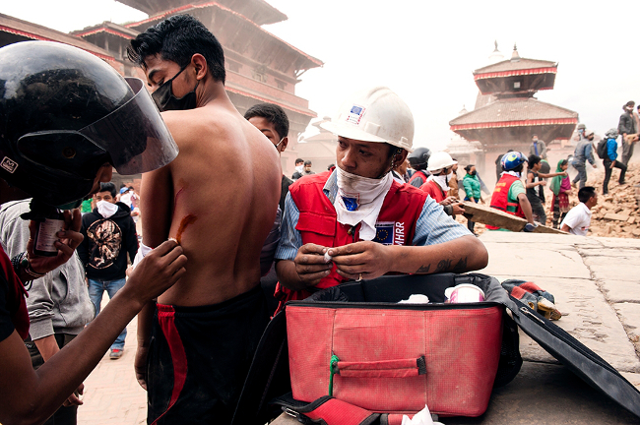
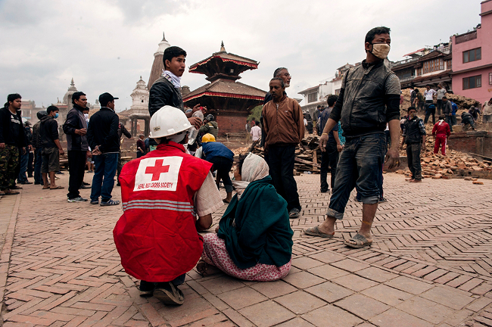
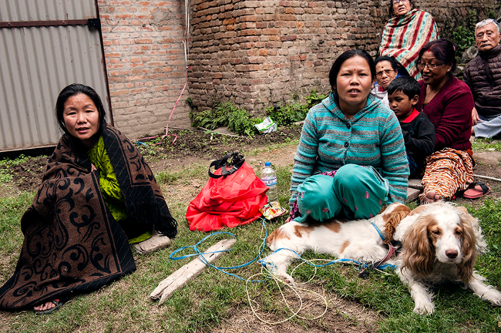

Slide 4
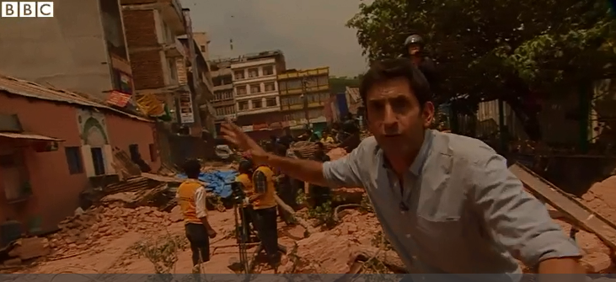
http://www.bbc.co.uk/news/world-asia-32475030
What has shocked this BBC reporter?
http://www.bbc.co.uk/news/world-asia-32475030

Slide 5
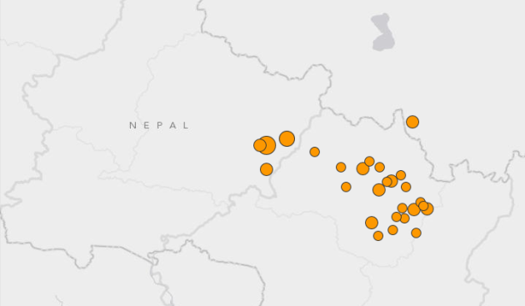
Aftershocks have continued in the hours after the quake hit; the locations of all of the earthquakes are shown with orange dots.

Slide 6
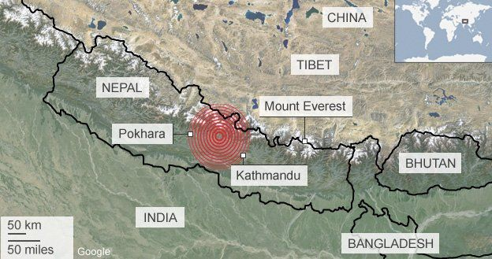
Where was the earthquake?
Key words:
Asia
Nepal
West of Mount Everest
North of India
In the Himalayas
Using the map, describe the location of the earthquake
Sentence starter
The earthquake on the 25th of April 2015 happened in . . .
Notes:
http://www.bbc.co.uk/newsround/32492843
If time watch this as well
http://www.bbc.co.uk/news/world-asia-32475030

Slide 7
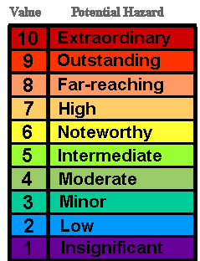
How are earthquakes measured?
The Richter Scale
The power of an earthquake is called the magnitude.
Earthquakes are measured by a seismometer and graded according to the Richter Scale.
This earthquake measured 7.9 on the Richter scale

Slide 8
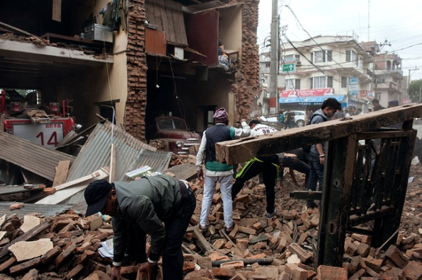
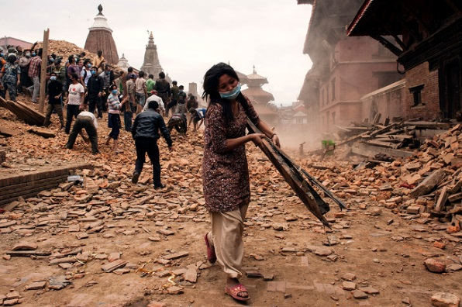
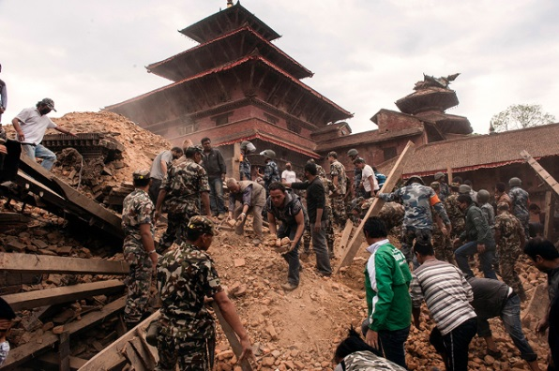
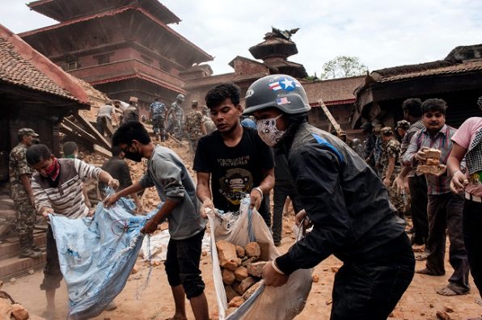
Notes:
These photos show civilians, members of the armed forces and international aid teams helping to clear the rubble from collapsed buildings in the wake of the Nepal earthquake, which struck on April 25th 2015.
Discussion questions
What motivates people to help others during and after a crisis?
Is it just trained professionals who can help?
How does preparing for an emergency help people respond in the event itself?

Slide 9
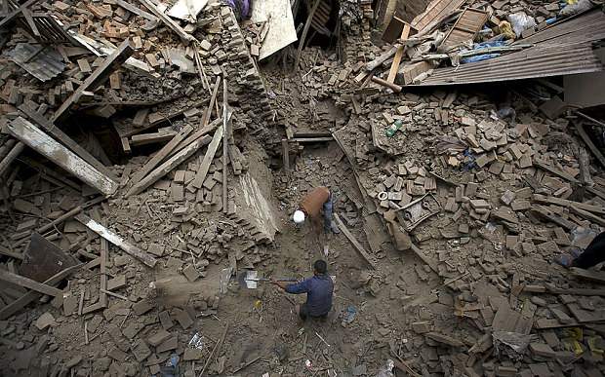
How has the earthquake impacted humans?
Notes:
https://www.youtube.com/watch?v=946BfN-OI-Q

Slide 10
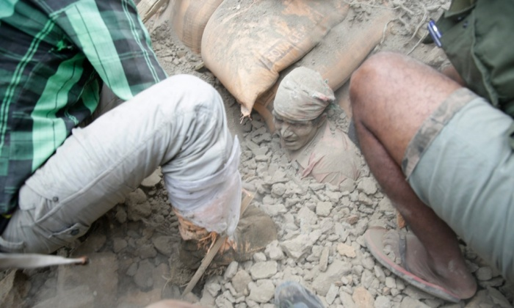
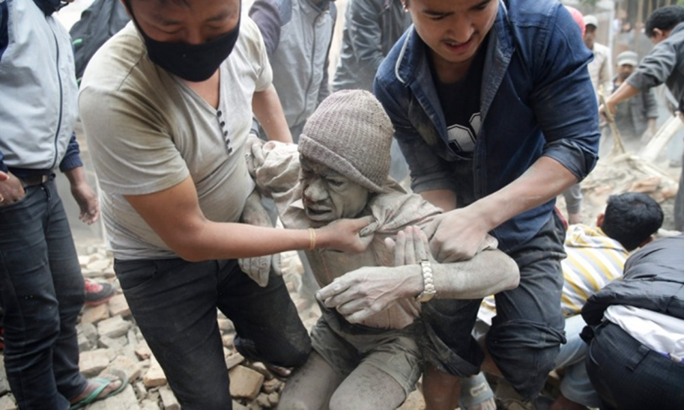
How has the earthquake impacted humans?
A survivor being pulled to safety.

Slide 11
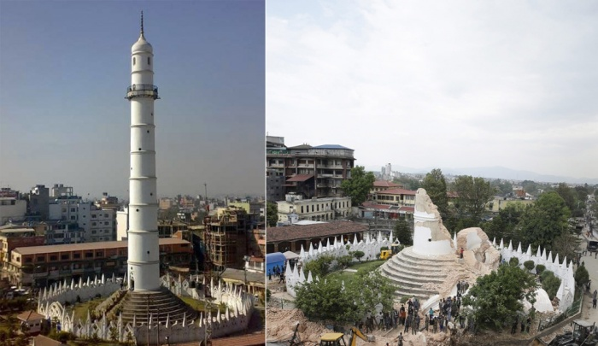
How has the earthquake impacted humans?

Slide 12
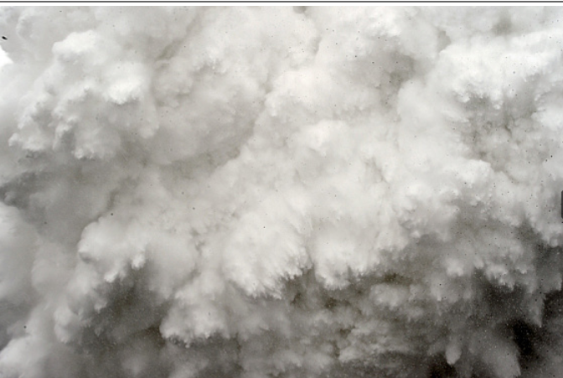
How has the earthquake impacted humans?

Slide 13
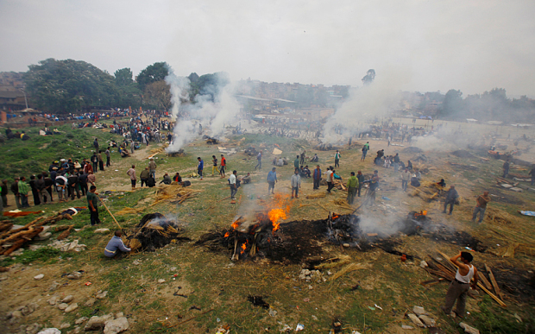
How has the earthquake impacted humans?

Slide 14
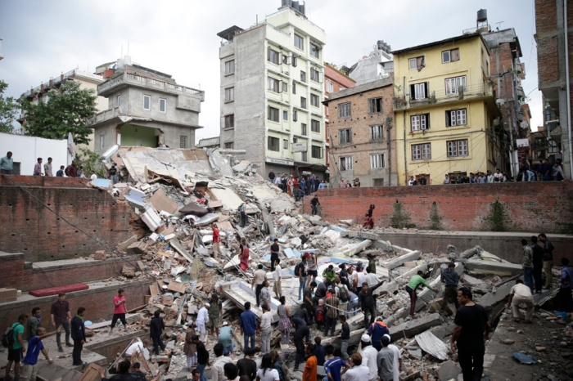
How has the earthquake impacted humans?

