Slide 1
Scale and distance
Learning Objectives:
I can use scale to measure the distance between places on a map.

Slide 2
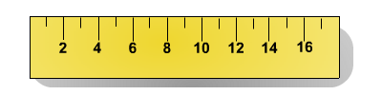
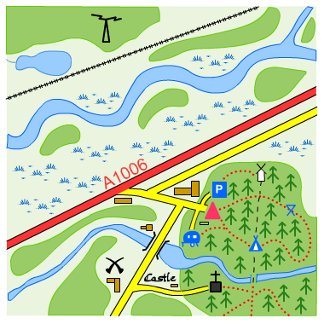
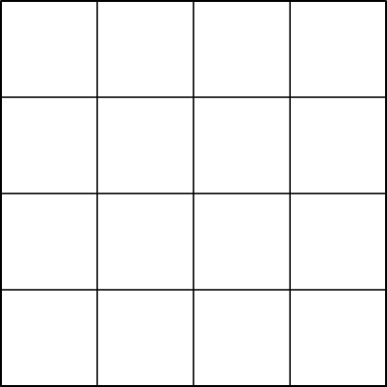

What is a scale?
Scale is the ratio of the size of objects on a map compared to their size in the real world.
For example on a map with the scale 4 cm : 1 km, four centimetres on the map represents one kilometre in the real world.
4 cm:1 km

Slide 3
How do you use the scale on a map?
Any method of estimating distance on a map requires the use of a scale.
On this map each grid box is 4 cm wide and long.
Using the scale, we know each grid box represents 1 km in distance on the ground.
How far is it from A to B if each grid square is 1 km?
A
B
scale of this map:
4 cm : 1 km
A to B is a distance of 4 km.

Slide 4
Map measuring
It is more difficult to estimate the distance between two points if they are on a diagonal.
X
What is the distance between X and Y?
Y
Using a ruler, measure the distance between the two points.
This distance is 12 cm on the map.
How far is it between X and Y in real life?

Slide 5
Calculating distance using a scale
The scale on the map is 4 cm : 1 km which means that:
X
Y
4 cm : 1 km
8 cm : 2 km
12 cm : 3 km
16 cm : 4 km
If the distance on the map is 12 cm, how many kilometres is it in real life?

