Slide 1
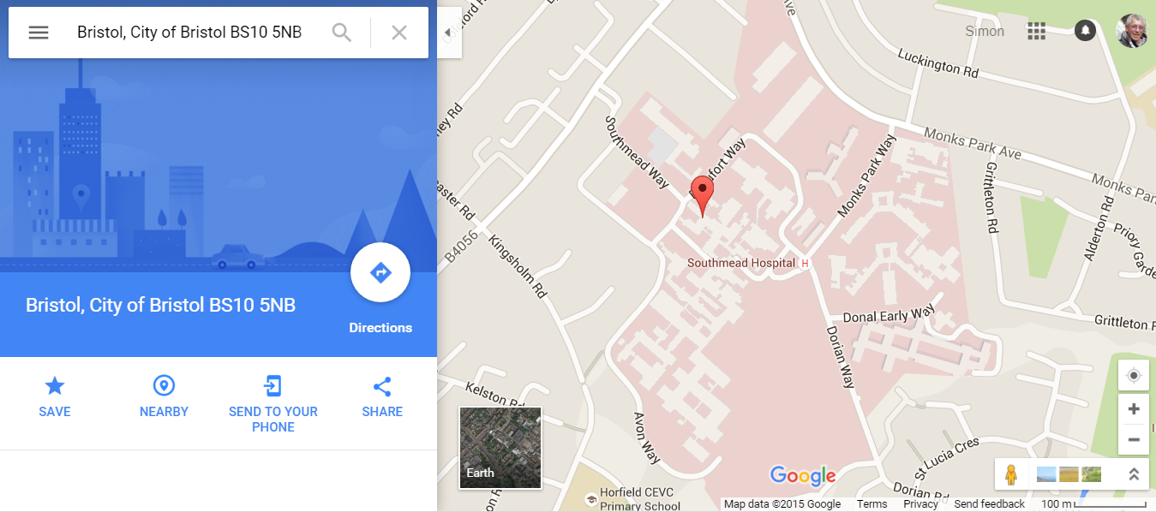

Finding distance using Google Maps
Enter your postcode
to get start point
This will give you a marker like this
Click on the small arrow
as shown in the red circle
to collapse the side bar

Slide 2
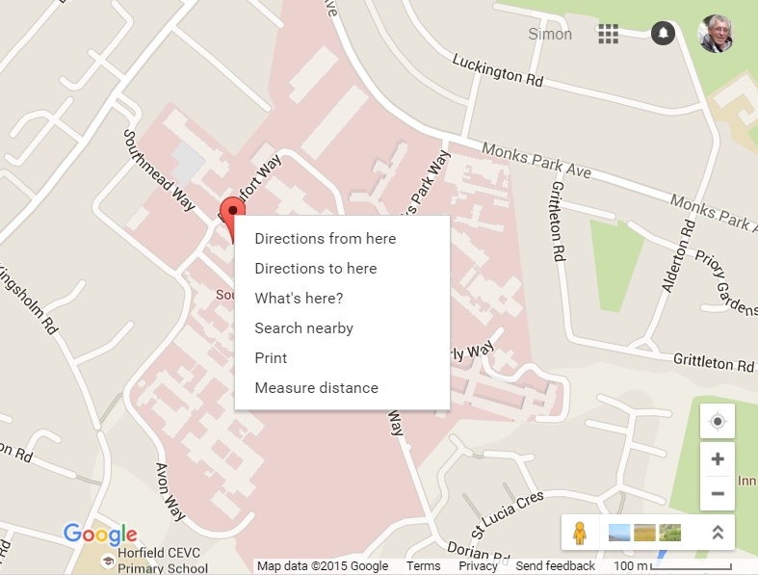
Right click on
marker to access menu
Select ‘Measure
distance’
Click on the
map to start
measuring

Slide 3
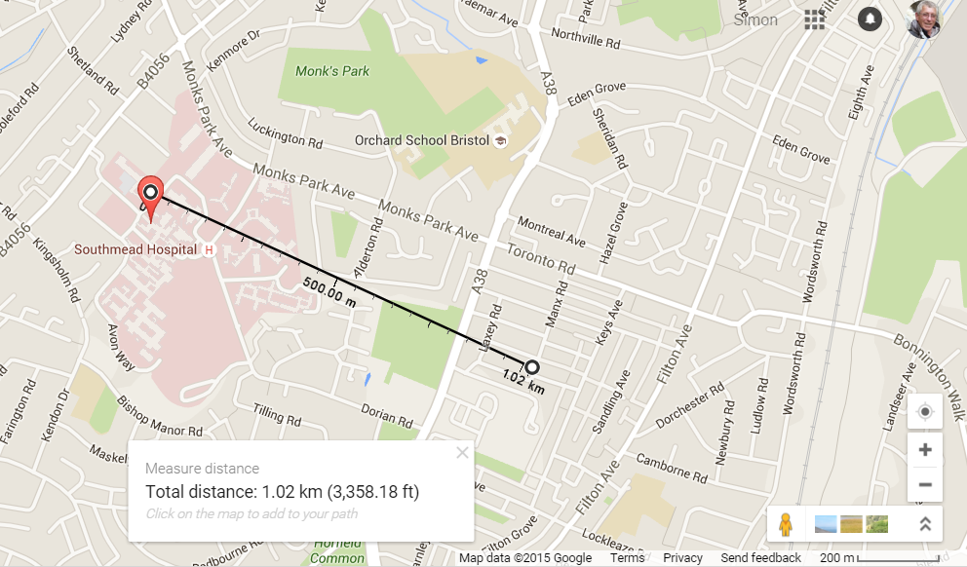
Your map should now show a line with two black circles on the ends. Practice dragging
the circle at the opposite end to your marker to a different location and note how the
distance changes.

Slide 4
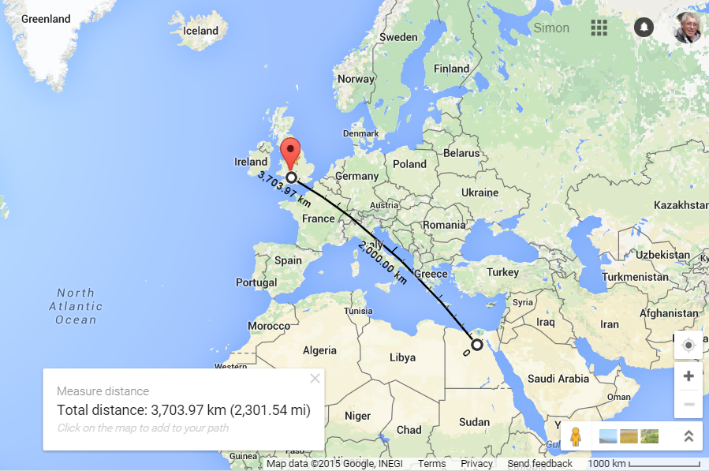
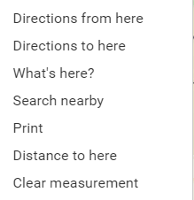
Right click on the
line to clear distance
measurement.
Zoom out on
map to show
the country you
need.

Slide 5
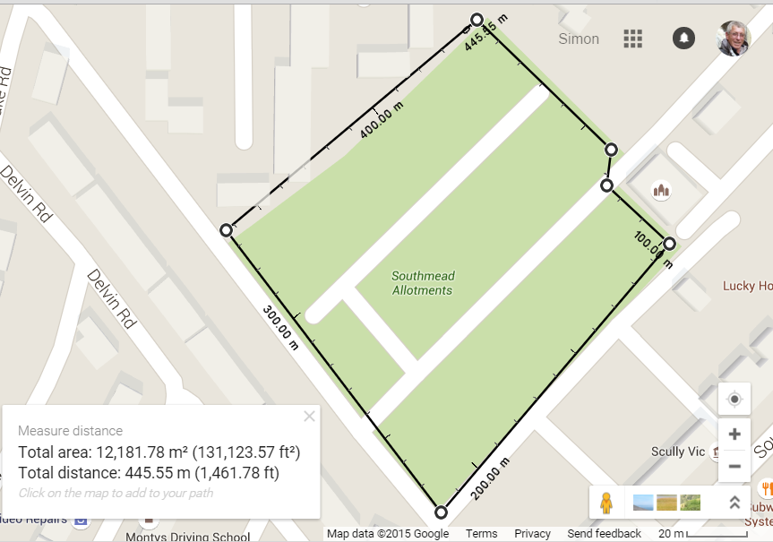
By clicking more
than once you can
get additional
measurements to
follow a path.
If you finish back
on the starting point
You can get an area
measurement as well

