Slide 1
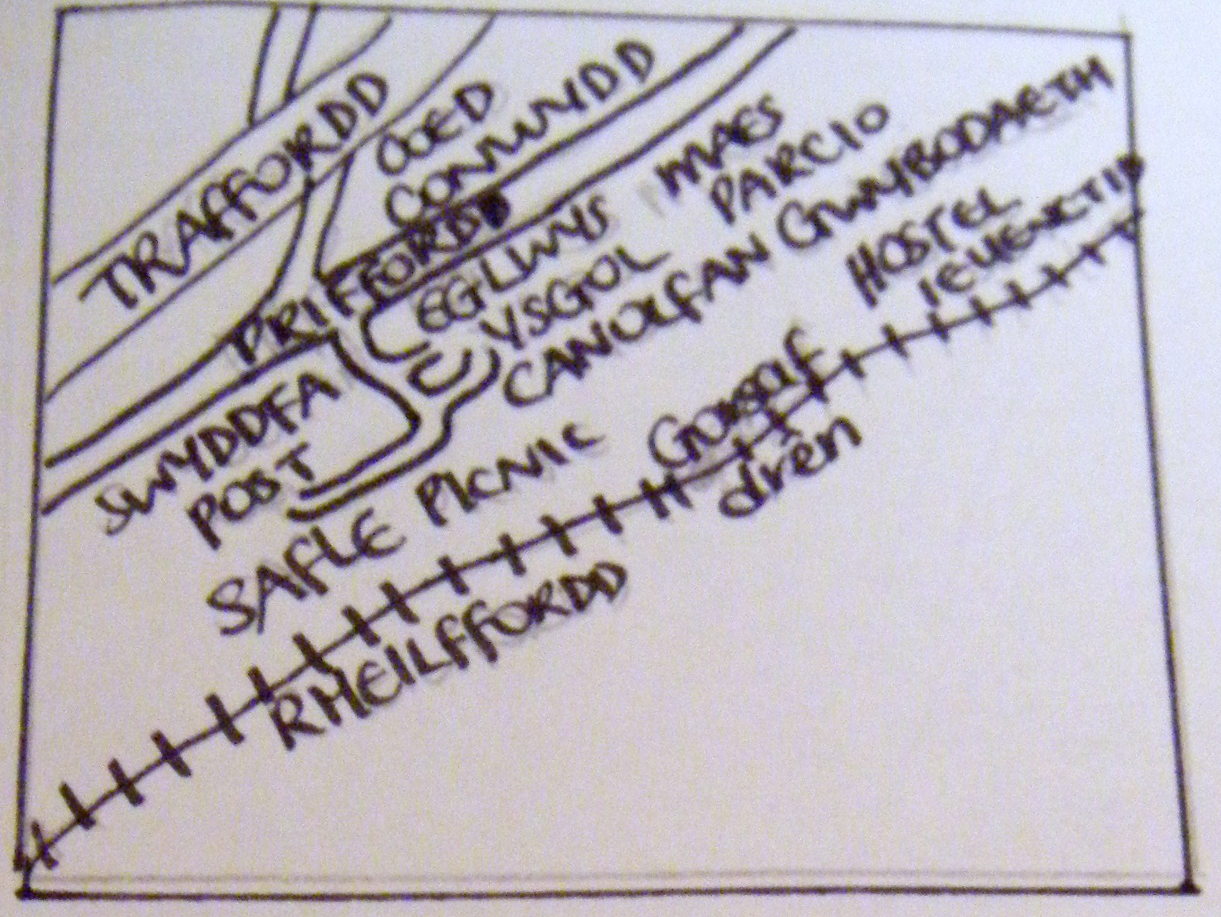
Notes:
Ask your child if there are any problems with this map. Could refer to: not tidy, no ruler, no compass direction, no title, no symbols and key. Could also refer to: too many words, can’t pinpoint location of places, difficult to read, no colour, etc.

Slide 2
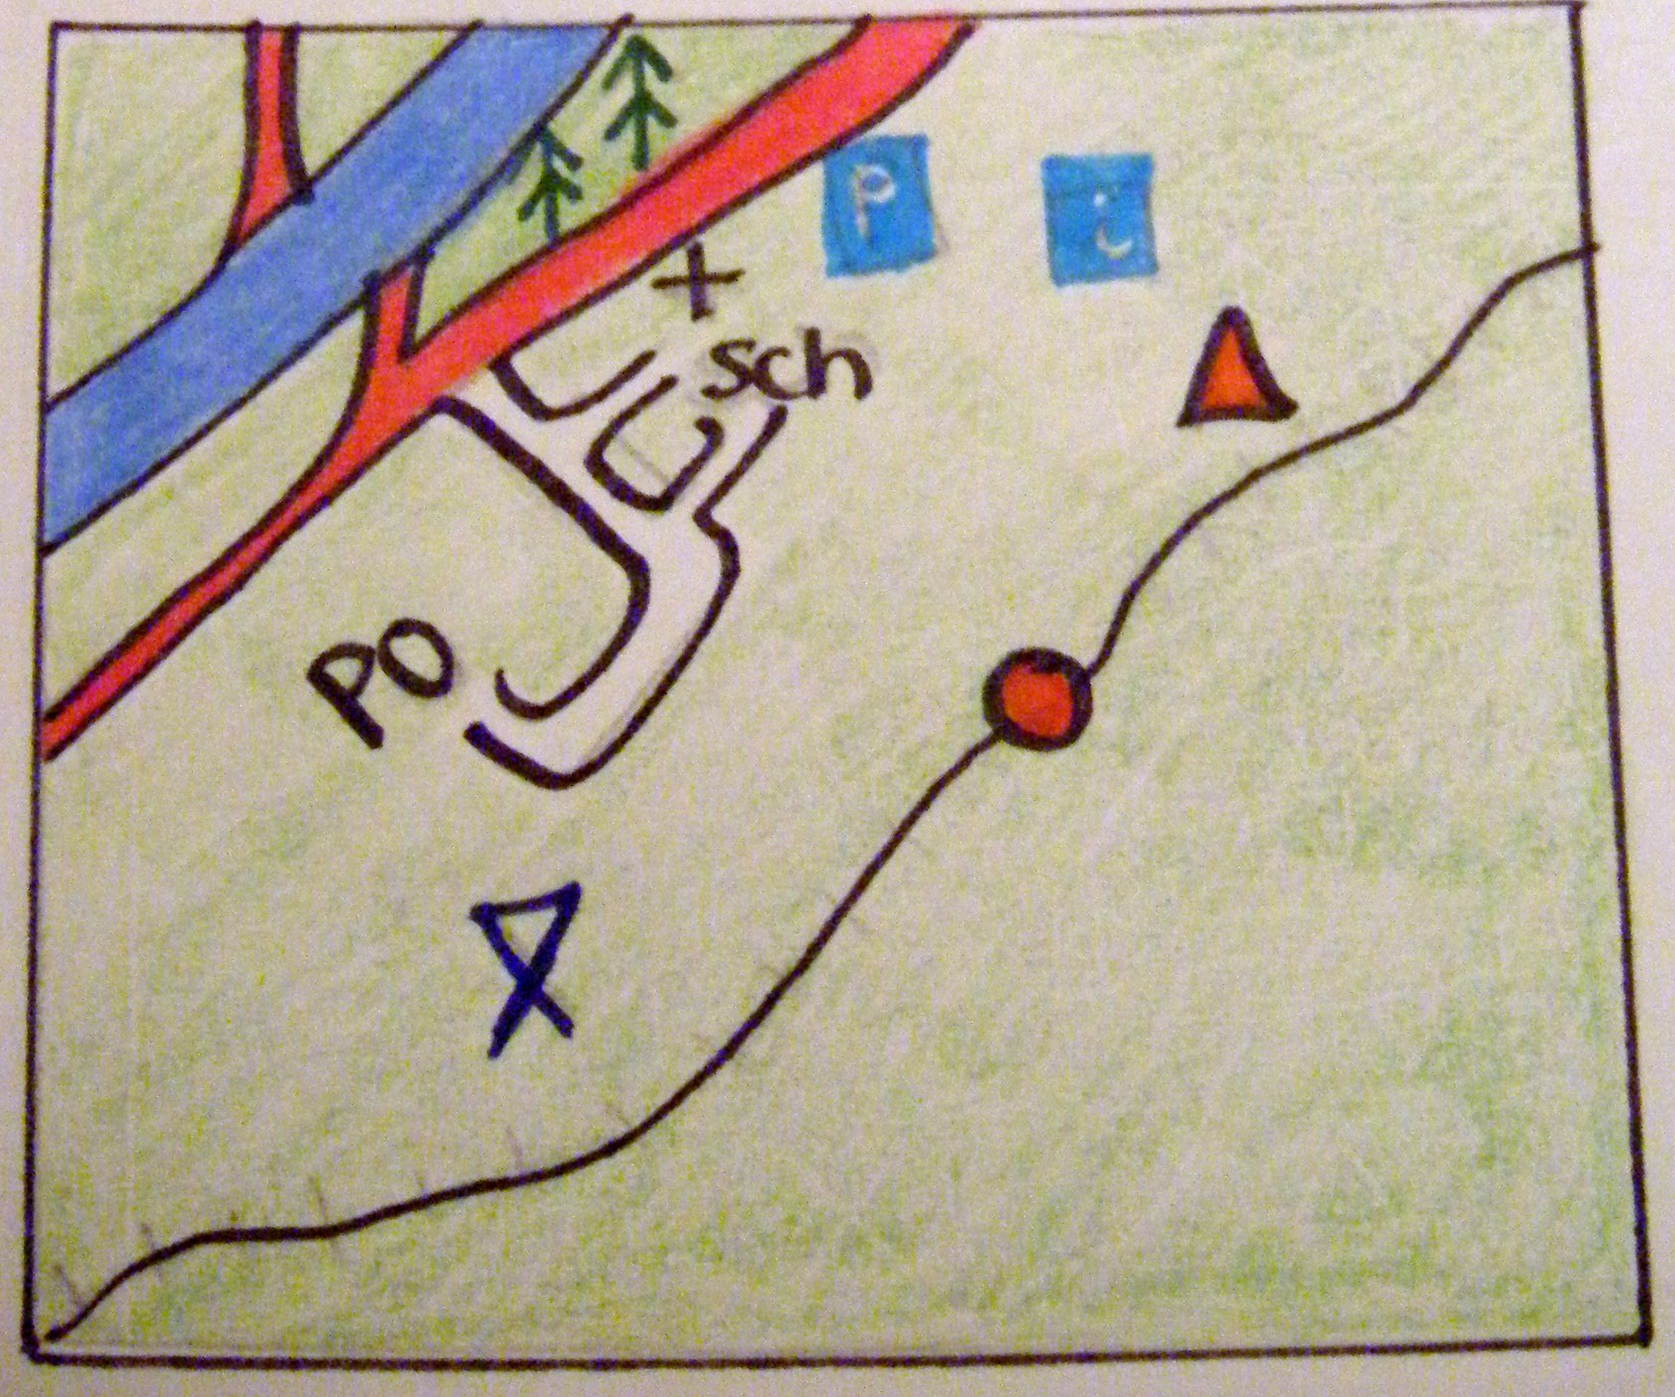
Notes:
Ask pupils if this map is better? Why? Should refer to: easier to read, colour, better idea of where features are located, etc.

Slide 3


Why do we use map symbols?

Slide 4
Map Symbols
Aim: To learn how to read and use map symbols.

Slide 5
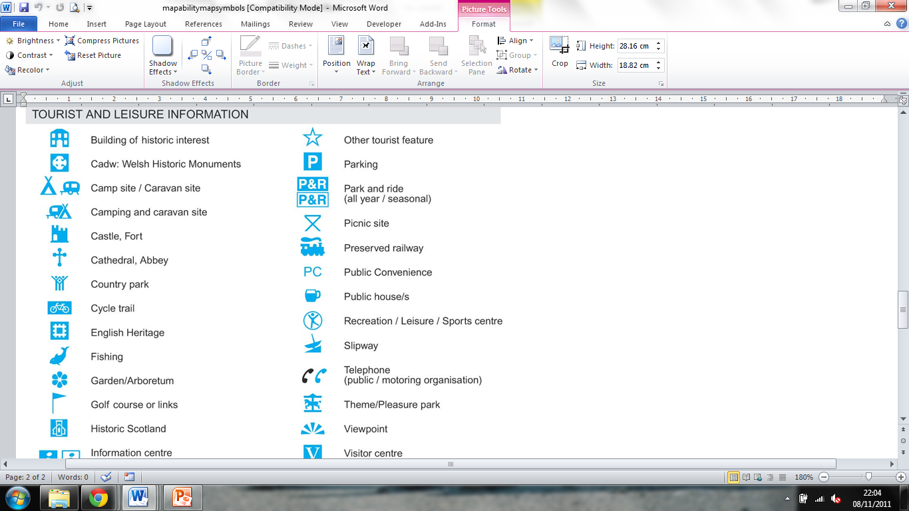
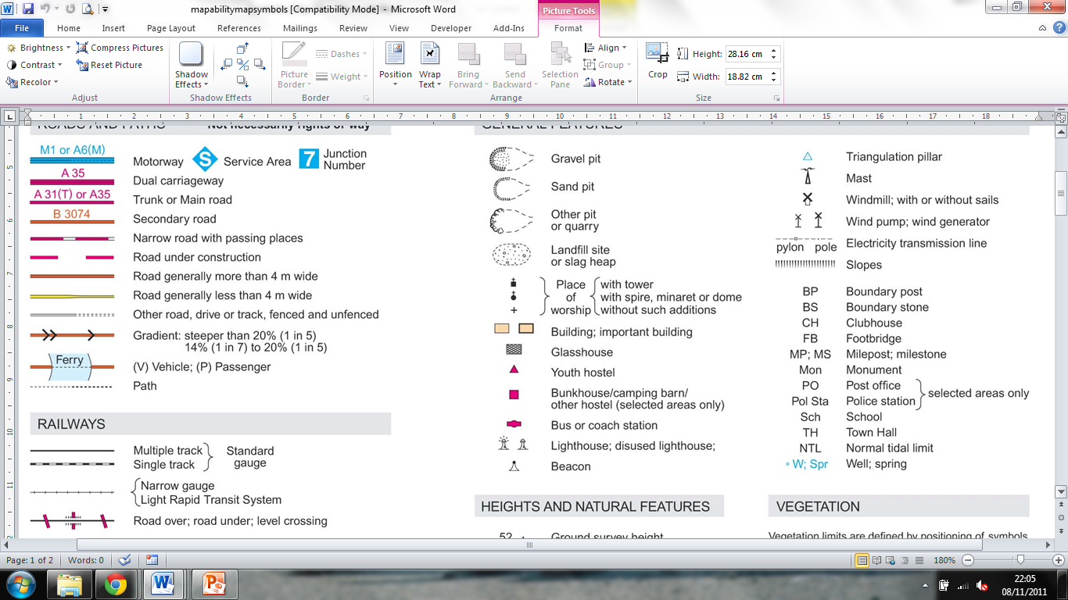
Different Types of Symbol
Line
Letters
Sch
Pictures
Shape
Coloured Areas

Slide 6
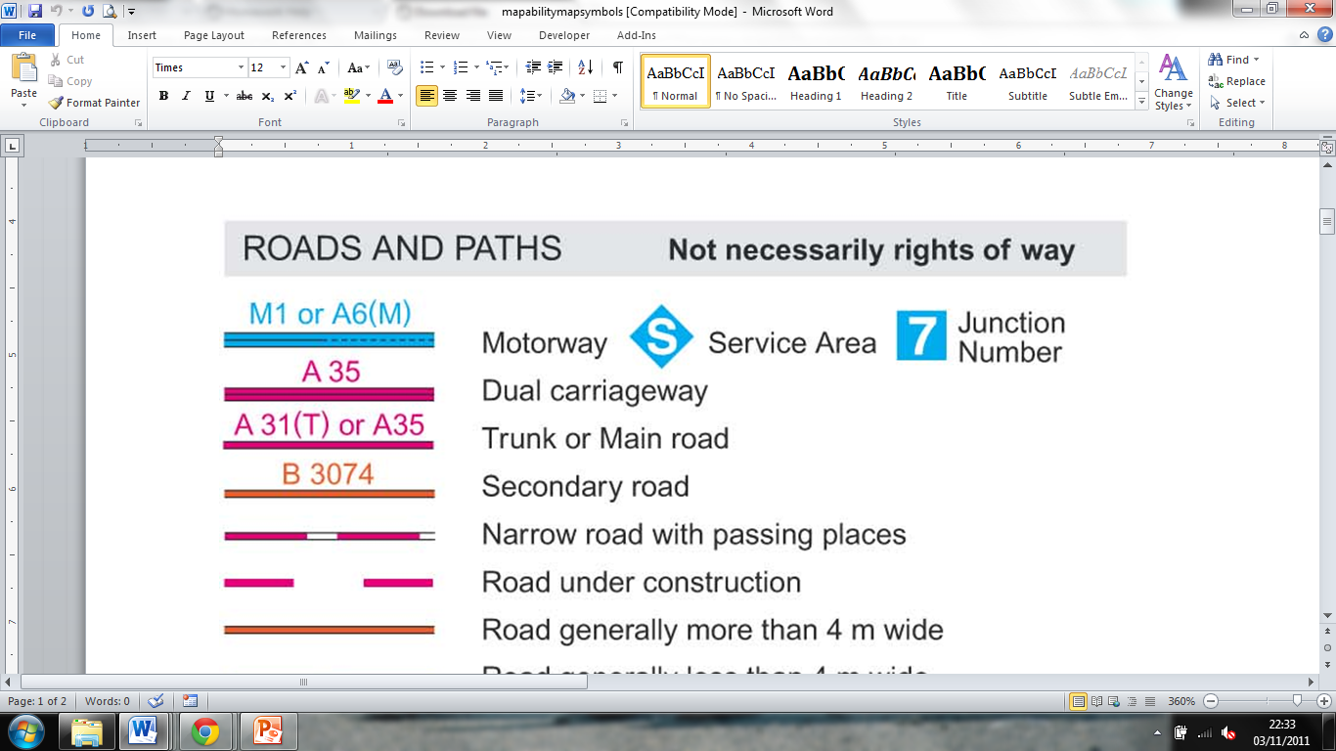
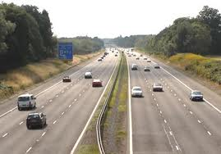

Slide 7
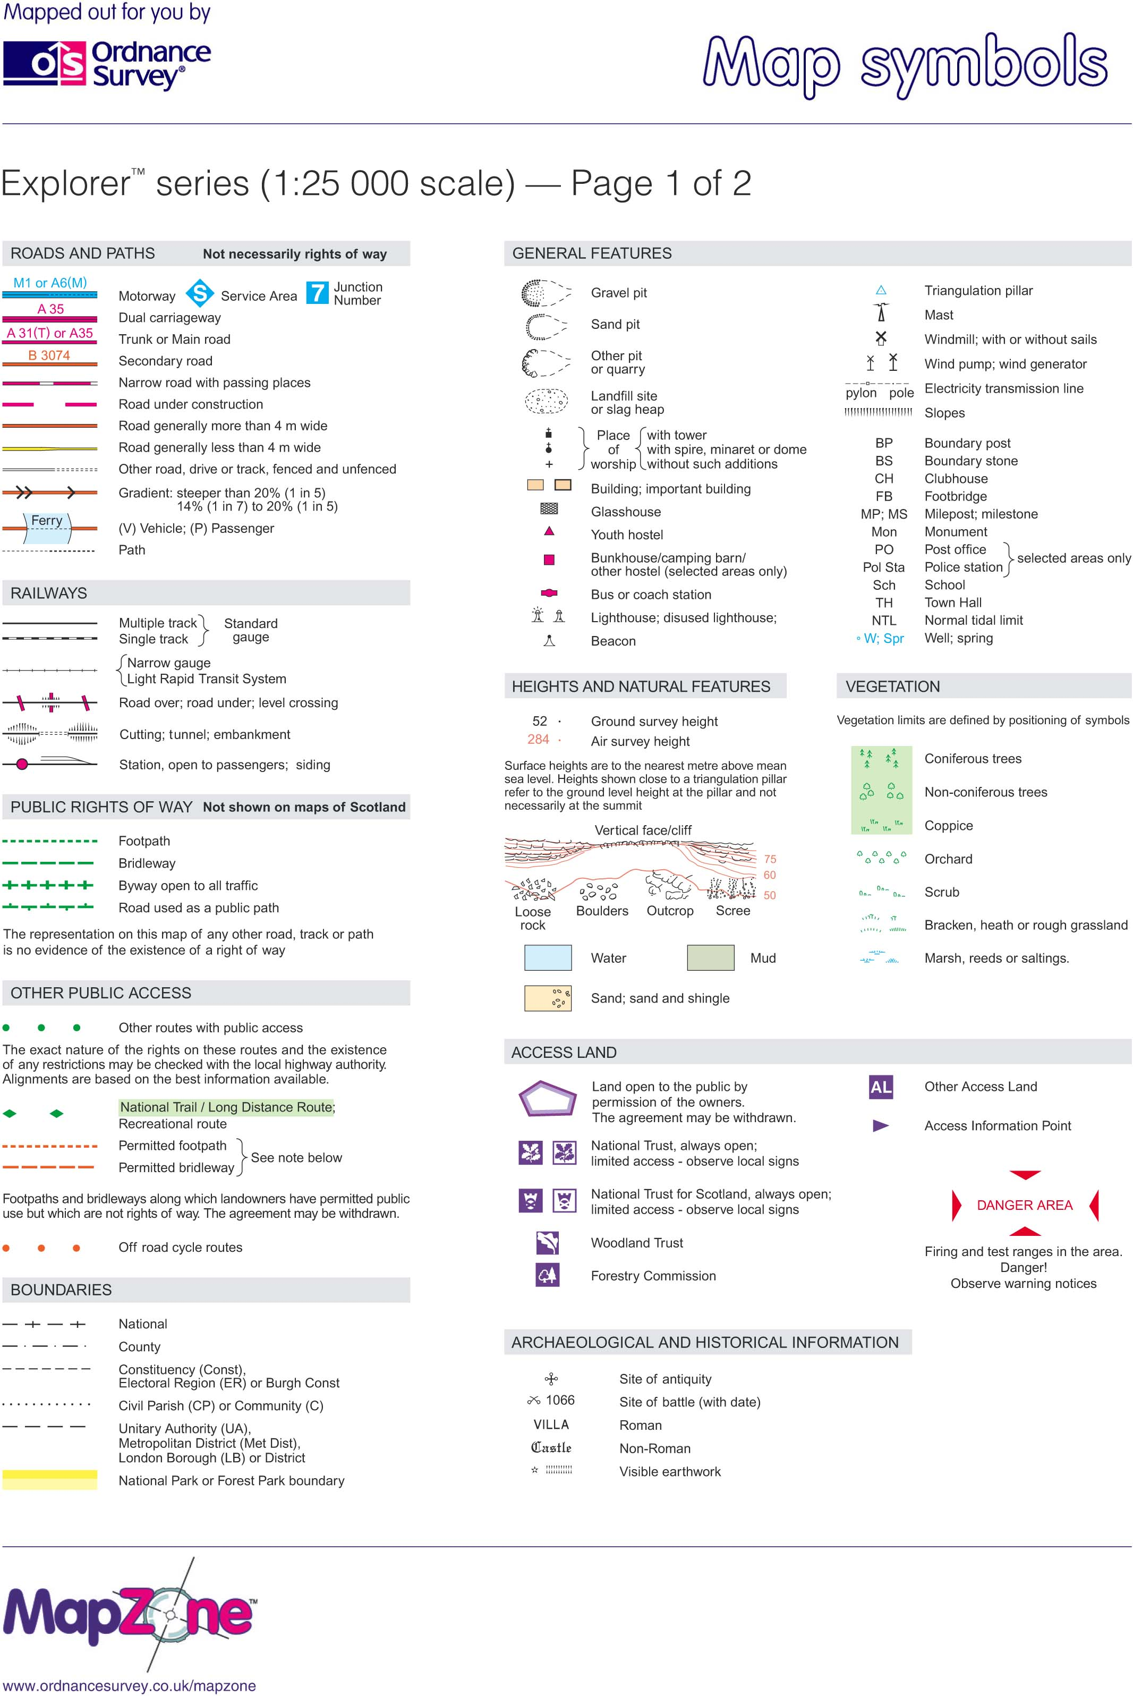
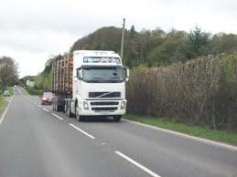

Slide 8
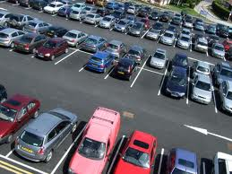
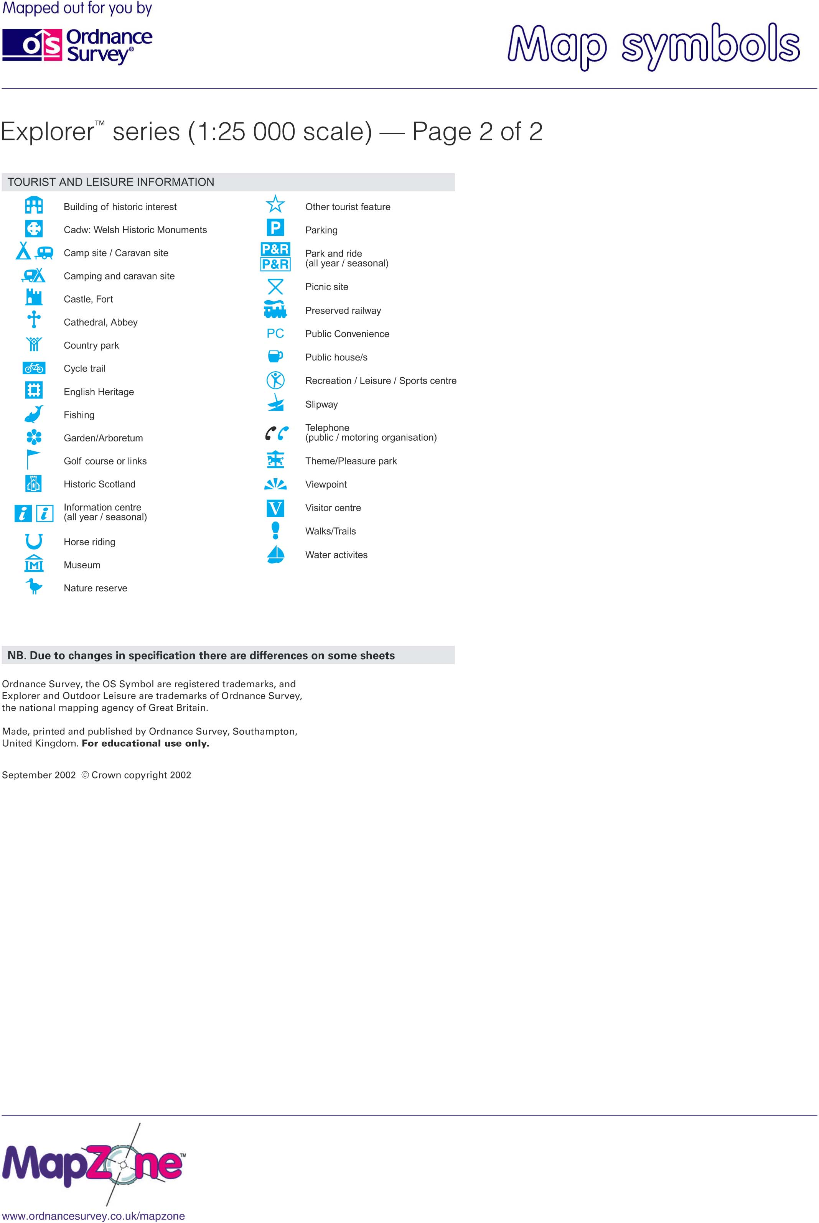

Slide 9
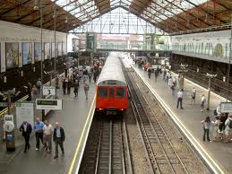

Slide 10
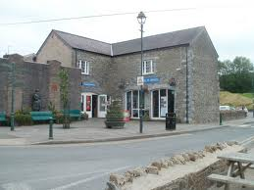

Slide 11


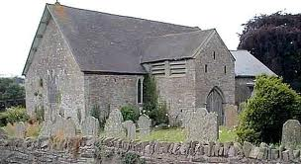

Slide 12
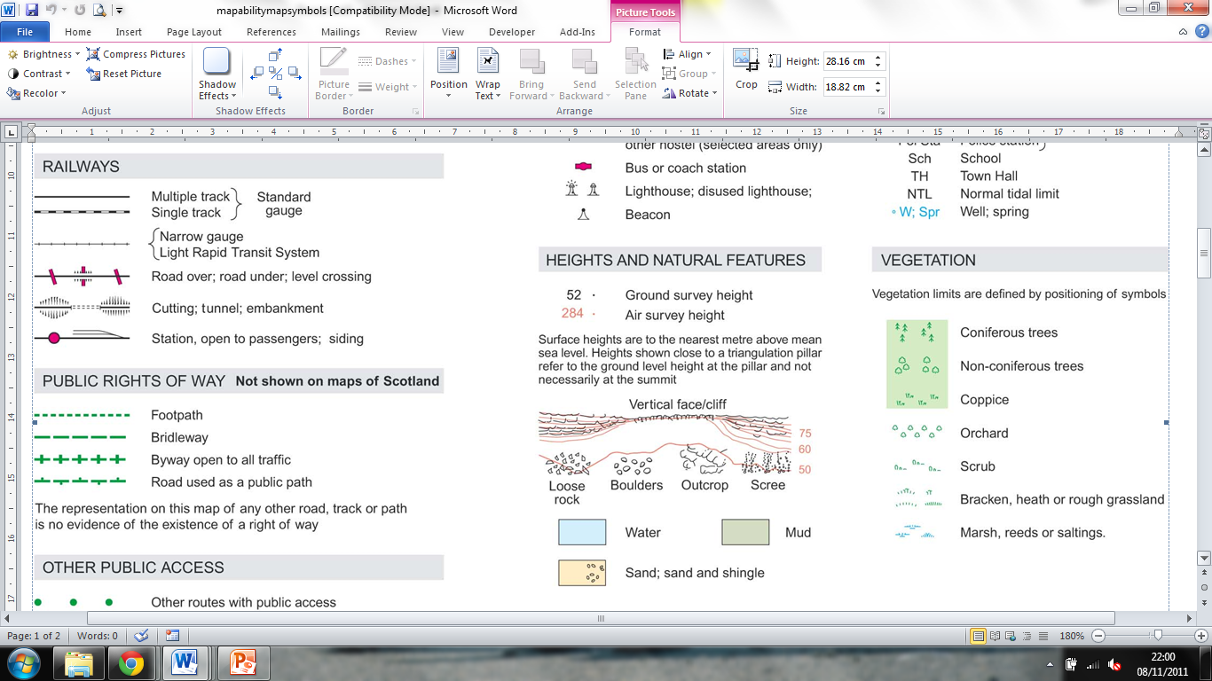


Slide 13
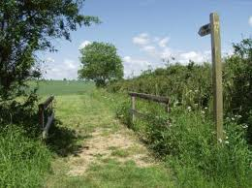
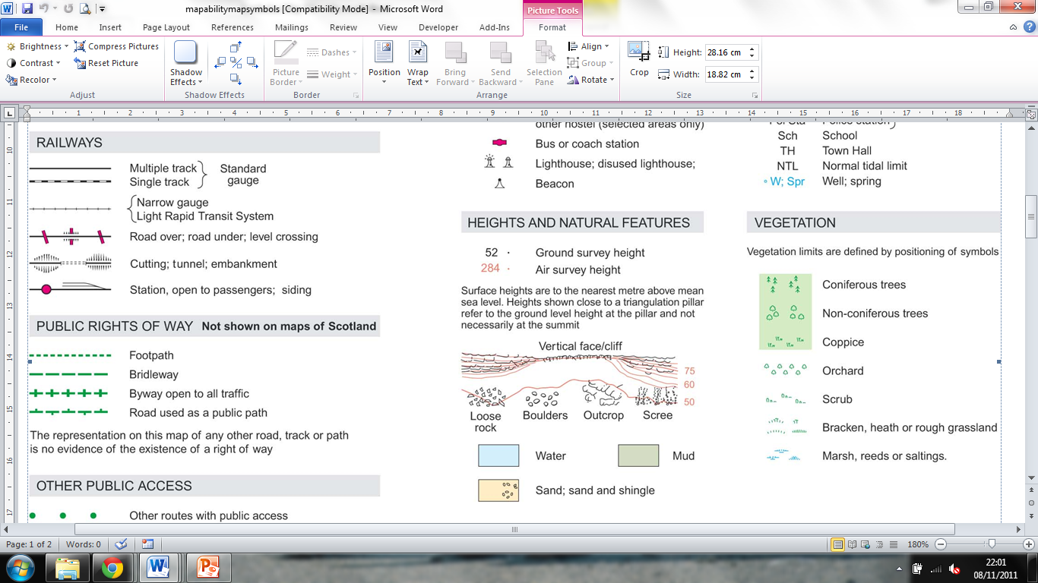

Slide 14

Sch

Slide 15

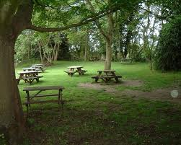

Slide 16


Slide 17
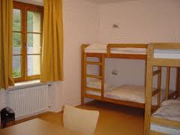

Slide 18
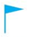


Slide 19
What makes a good map symbol?
A map symbol should be simple and clear.
A map symbol should show what the place is.
A map symbol should be easy to remember and recognise.
A map symbol should be one solid colour.
E.g. Bank:
£

Slide 20
Which is the best symbol? Why?
Which symbol would you make better? Pam?
Design your own symbols for:
a) Rugby stadium
b) Library
c) Cinema
d) Play park .

Slide 21
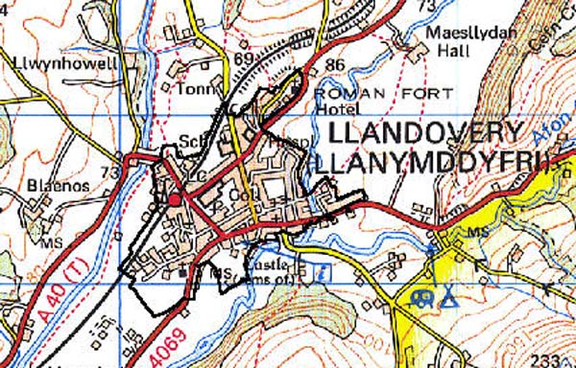
What is in Llandovery?

Slide 22
Worksheet Answers
Motorway
Road
Car Park
Train Station
Tourist Information
Church
Church with a tower
Church with a spire
Woodland
Footpath
School
Picnic Site
Camping & Caravanning Site
Youth Hostel
Golf Course

