Slide 1


Lesson Objective and I Can
To locate the scale on a map, to interpret the scale and to
use the scale to calculate the distance between two points.
I can locate and interpret the scale on a map.
I can use a ruler/measuring device to calculate the distance between two points.
Challenge: I can make a reasonable estimate of the time it will take to walk between two points.
Think back to the previous activity. Why are these skills
important? When might you need to use these skills?

Slide 2
What is scale?
What is scale?
Scale is what makes map drawing possible. It takes real
life things and reduces them in size many times so they
can be shown on a map.
Every map has a scale printed on the front and you
should always check this figure before you start reading
it. It will tell you how much smaller the area shown on
the map is compared to the same area in real life.

Slide 3
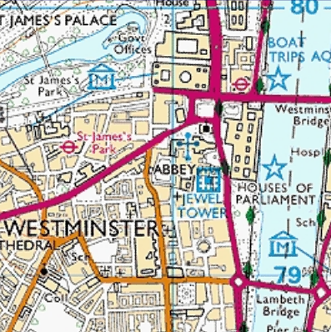
1:25,000
The map you have in front of you has a scale of 1:25,000.
This means that for every unit of measurement on the map, e.g. 1 centimetre, is the same as 25,000 of those units.
So 1 centimetre on the map is
actually the same as 25,000 centimetres in reality.

Slide 4
1:25,000
1) 3 cm on the 1:25000 map.
2) 5 cm on the 1:25000 map.
3) 10 cm on the 1:25000 map.
4) 12.5 cm on the 1:25000 map.
5) 10 cm on a 1:12500 map.
Challenge
Can you convert your
answer into metres? Can you
convert your answer into
kilometres?
2) 175,000cm in reality is how
many cm on the scale?
3) 212,500cm in reality is how
many cm on the scale?
Using a calculator I would
like you to calculate the
actual distances as
represented on a 1:25,000
map.
Example: 2 cm on the map
is (2 x 25,000) 50,000cm
in reality.
Write question and answer
in your book.

Slide 5
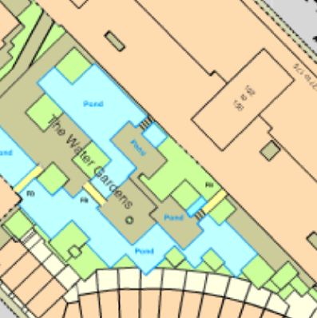
Maps of a different scale
Ordnance Survey produces
maps drawn to many
different scales, depending
on what people want to use
them for.
Large scale maps are better
for showing individual
buildings in detail because
they only cover a small area
of land.

Slide 6
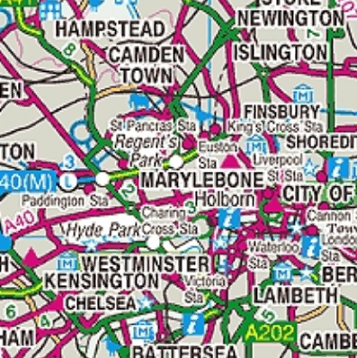
Maps of a different scale
Small scale maps are ideal
for travelling either by car
or walking because they
cover large areas of land.
It might help you to
remember that the larger
the number in the scale,
the smaller the scale of
the map will be.

Slide 7
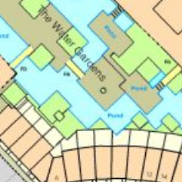
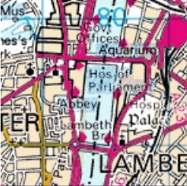
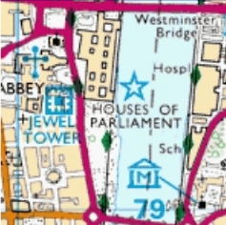
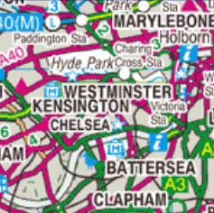
1:1250 OS MasterMap
Ideal for architects
1:25 000 OS Explorer
Ideal for outdoor
activities
1:50 000 Landranger®
Ideal for planning a day
out
1:250 000 OS Road Map
Ideal for motorists, and
long journeys

