Slide 1

Primary English Resource

Slide 2
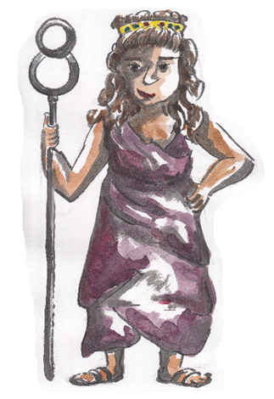
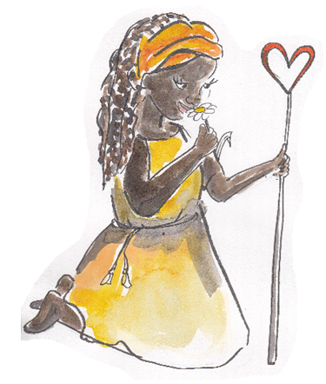
Punctuating Direct Speech
Roman Myths
Leave my son alone.
No! He is a Trojan and I despise all Trojans.

Slide 3

Punctuating Speech
Speech bubbles can show us what a character is saying.
Leave my son alone.
The words said are called direct speech.
“Leave my son alone,”
said Venus.
Bubbles take up too much room so we use speech marks.
Speech marks work in pairs to hug the direct speech.
We report who is speaking using a reporting clause.
Speech marks are also called inverted commas.

Slide 4
Punctuating Speech
Venus
Juno
Leave my son alone.
“Leave my son alone,” said Venus.
“No! He is a Trojan and I despise all Trojans,” replied Juno.
No! He is a Trojan and I despise all Trojans.
EXAMPLE
Write this conversation as punctuated speech.
Remember to hug the direct speech with speech marks
and add reporting clauses.

Slide 5
Punctuating Speech – capital letters open direct speech
Direct speech begins with a capital letter, even if it is in the middle of a sentence.
Venus asked, “Why do you despise the Trojans so much?”
Juno explained, “They are the enemies of my beloved Greeks.”
It is the beginning of the speaker’s sentence so a capital letter is used.

Slide 6
Punctuating Speech – commas separate clauses
Direct speech and reporting clauses are usually separated by a comma.
“I will protect my son,” said Venus.
Juno sighed, “I will have to destroy him another time.”
The comma is placed at the end of the first clause.
The speech marks follow the comma.

Slide 7
Punctuating Speech – exclamations and questions
If the speech ends in a ! or ? we do not need a comma after the speech.
“Why do you love the Greeks so much?” asked Venus.
“I am coming for you!” Juno yelled.
The punctuation is placed inside the speech marks.
The punctuation belongs to the spoken words – they tell you how to say them.

Slide 8
Punctuating Speech – a new line shows a change of speaker
Leave my son alone.
“Leave my son alone,” said Venus.
No! He is a Trojan and I despise all Trojans.
“No! He is a Trojan and I despise all Trojans” replied Juno.
“I will protect my son,” warned Venus.
I will protect my son.
Juno groaned, “I will have to destroy him another time”
I will have to destroy him another time.
We show each change of speaker by starting a new line.
This makes it clear when the speaker changes.

Slide 9
Punctuating Speech – Your Turn
Write some new dialogue for
Venus and Juno.
“I can destroy you,” said Venus.
Hug the words spoken with speech marks
Start the speakers’ words with a capital letter
Separate the speech and reporting clause with a comma
Start a new line to show the speaker has changed
Juno muttered, “I’d like to see you try.”
“I am more powerful than you think,” snapped Venus.
“Show me!” laughed Juno.

