Slide 2


Let’s Refresh – What’s an Adverb?
We use adverbs when we want to describe verbs (doing words).
This gives us more information about the situation.
An adverb helps us to understand the how, when, where, why, how often or how much the action is performed.

Slide 3
How to play
In this game, you will read each sentence.
In each sentence, there is at least one adverb.
Some sentences have up to three adverbs, but not always.

Slide 4
How to play
If you click the correct answer, a green tick will appear on screen.
If you don’t click the correct answer, the screen will not change.
Have fun!

Slide 5


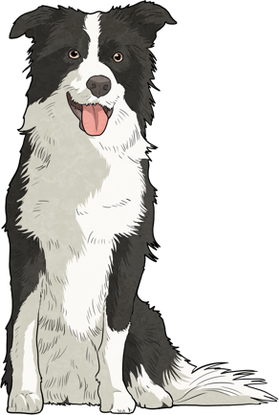
Spot the Adverb
Next Slide
The dog ran
briskly
indoors.
Correct!
✓

Slide 6


Spot the Adverb
Next Slide
The children did their schoolwork
quietly.
Correct!
✓

Slide 7
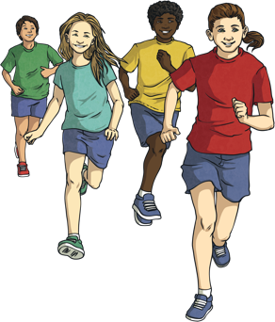
Spot the Adverb
Next Slide
The children ran to the park.
quickly
Correct!
✓

Slide 8
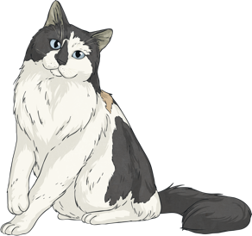
Spot the Adverb
Next Slide
The cat crawled the tree.
cautiously
behind
Correct!
✓

Slide 9

Spot the Adverb
Next Slide
The boy picked the flowers and gave them to his mother.
gracefully
yesterday
lovingly
Correct!
✓

Slide 10
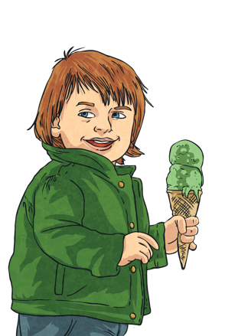
Spot the Adverb
Next Slide
The girl ate all of the vanilla ice-cream
greedily.
Correct!
✓

Slide 11
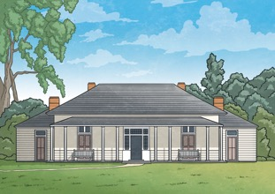
Spot the Adverb
Next Slide
The old lady leaves her house.
rarely
Correct!
✓

Slide 12
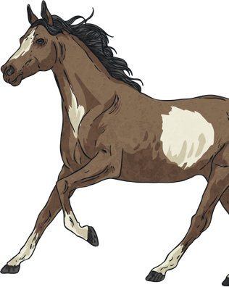
Spot the Adverb
Next Slide
The horse jumps the fence.
rarely
over
Correct!
✓

Slide 13
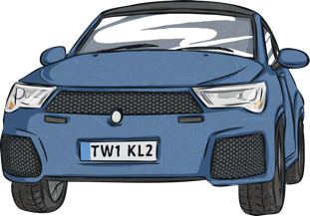
Spot the Adverb
Next Slide
The car breaks down in winter.
always
Correct!
✓

Slide 14
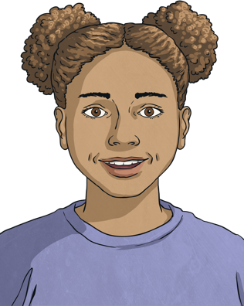
Spot the Adverb
Next Slide
The girl skipped when she won the game.
cheerfully
today
Correct!
✓

Slide 15
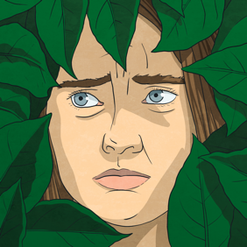
Spot the Adverb
Next Slide
The children hid when they were playing catch.
anxiously
Correct!
✓

Slide 16
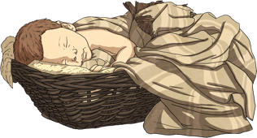
Spot the Adverb
Next Slide
The baby slept because the other children were quiet
peacefully
yesterday.
Correct!
✓

Slide 17
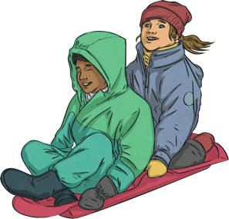
Spot the Adverb
Next Slide
The children love to play even when the weather is cold.
outside every day,
bitterly
Correct!
✓

