Slide 1
Writing Captions

Slide 2
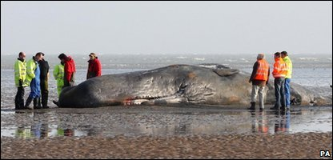
Stranded whale dies on Kent beach
Headline
Investigators looking at the sperm whale that dies after being washed up at Pegwell Bay in Kent.
Caption

Slide 3
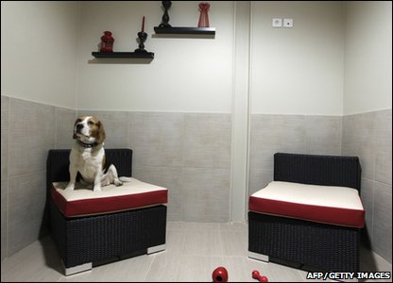
Hotel offers dogs paw-fect break!
A dog sits on an armchair in a room at France’s first luxury hotel for dogs.

Slide 4
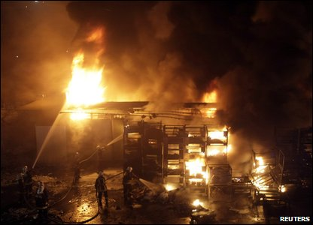
What could the caption be?
Who is involved? Where is this happening? What is going on?
(You will have to make up some of these facts!)

Slide 5
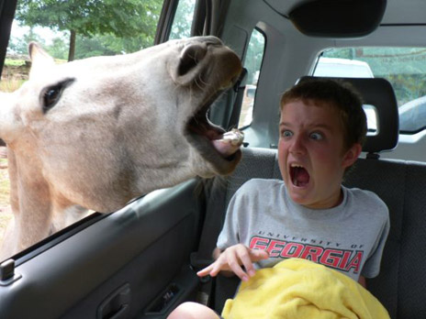
What could the caption be?
Who is involved? Where is this happening? What is going on?
(You will have to make up some of these facts!)

Slide 6
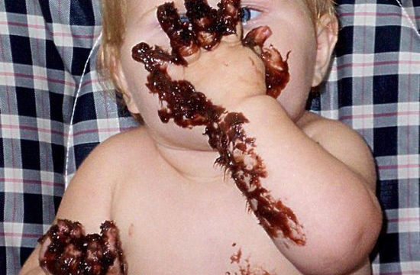
What could the caption be?
Who is involved? Where is this happening? What is going on?
(You will have to make up some of these facts!)

Slide 7
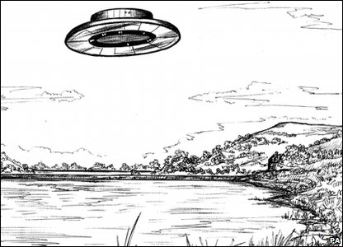
What could the caption be?
Where is this happening? What is going on? When is this? Who drew this?
(You will have to make up some of these facts!)

Slide 8
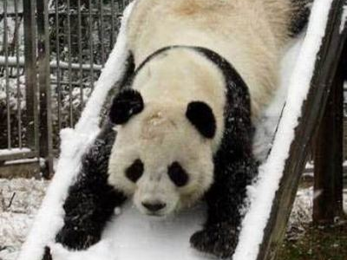
What could the caption be?
Who is involved? Where is this happening? What is going on?
(You will have to make up some of these facts!)

Slide 9
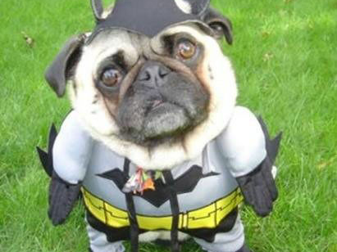
What could the caption be?
Who is involved? Where is this happening? What is going on?
(You will have to make up some of these facts!)

