Slide 1
SPEECH MARKS
ALSO KNOWN AS INVERTED COMMAS OR QUOTATION MARKS

Slide 2
WHAT ARE SPEECH MARKS AND WHY DO WE USE THEM?
Speech marks are punctuation marks that show what somebody has said.
They are also called inverted commas, because they are commas that are inverted or reversed to go around the spoken words or dialogue.

Slide 3
HOW DO WE USE SPEECH MARKS?
Put “ ” around what words the speaker says.
A new speech sentence starts with a capital letter (even if it is the middle of another sentence).
Separate what was said from the speaker with a comma unless there is already a ? or an !
Start a new paragraph if a sentence has a new speaker saying something.

Slide 4


Speech marks tell us exactly what was said.
“Moo,” bellowed the brown cow.

Slide 5

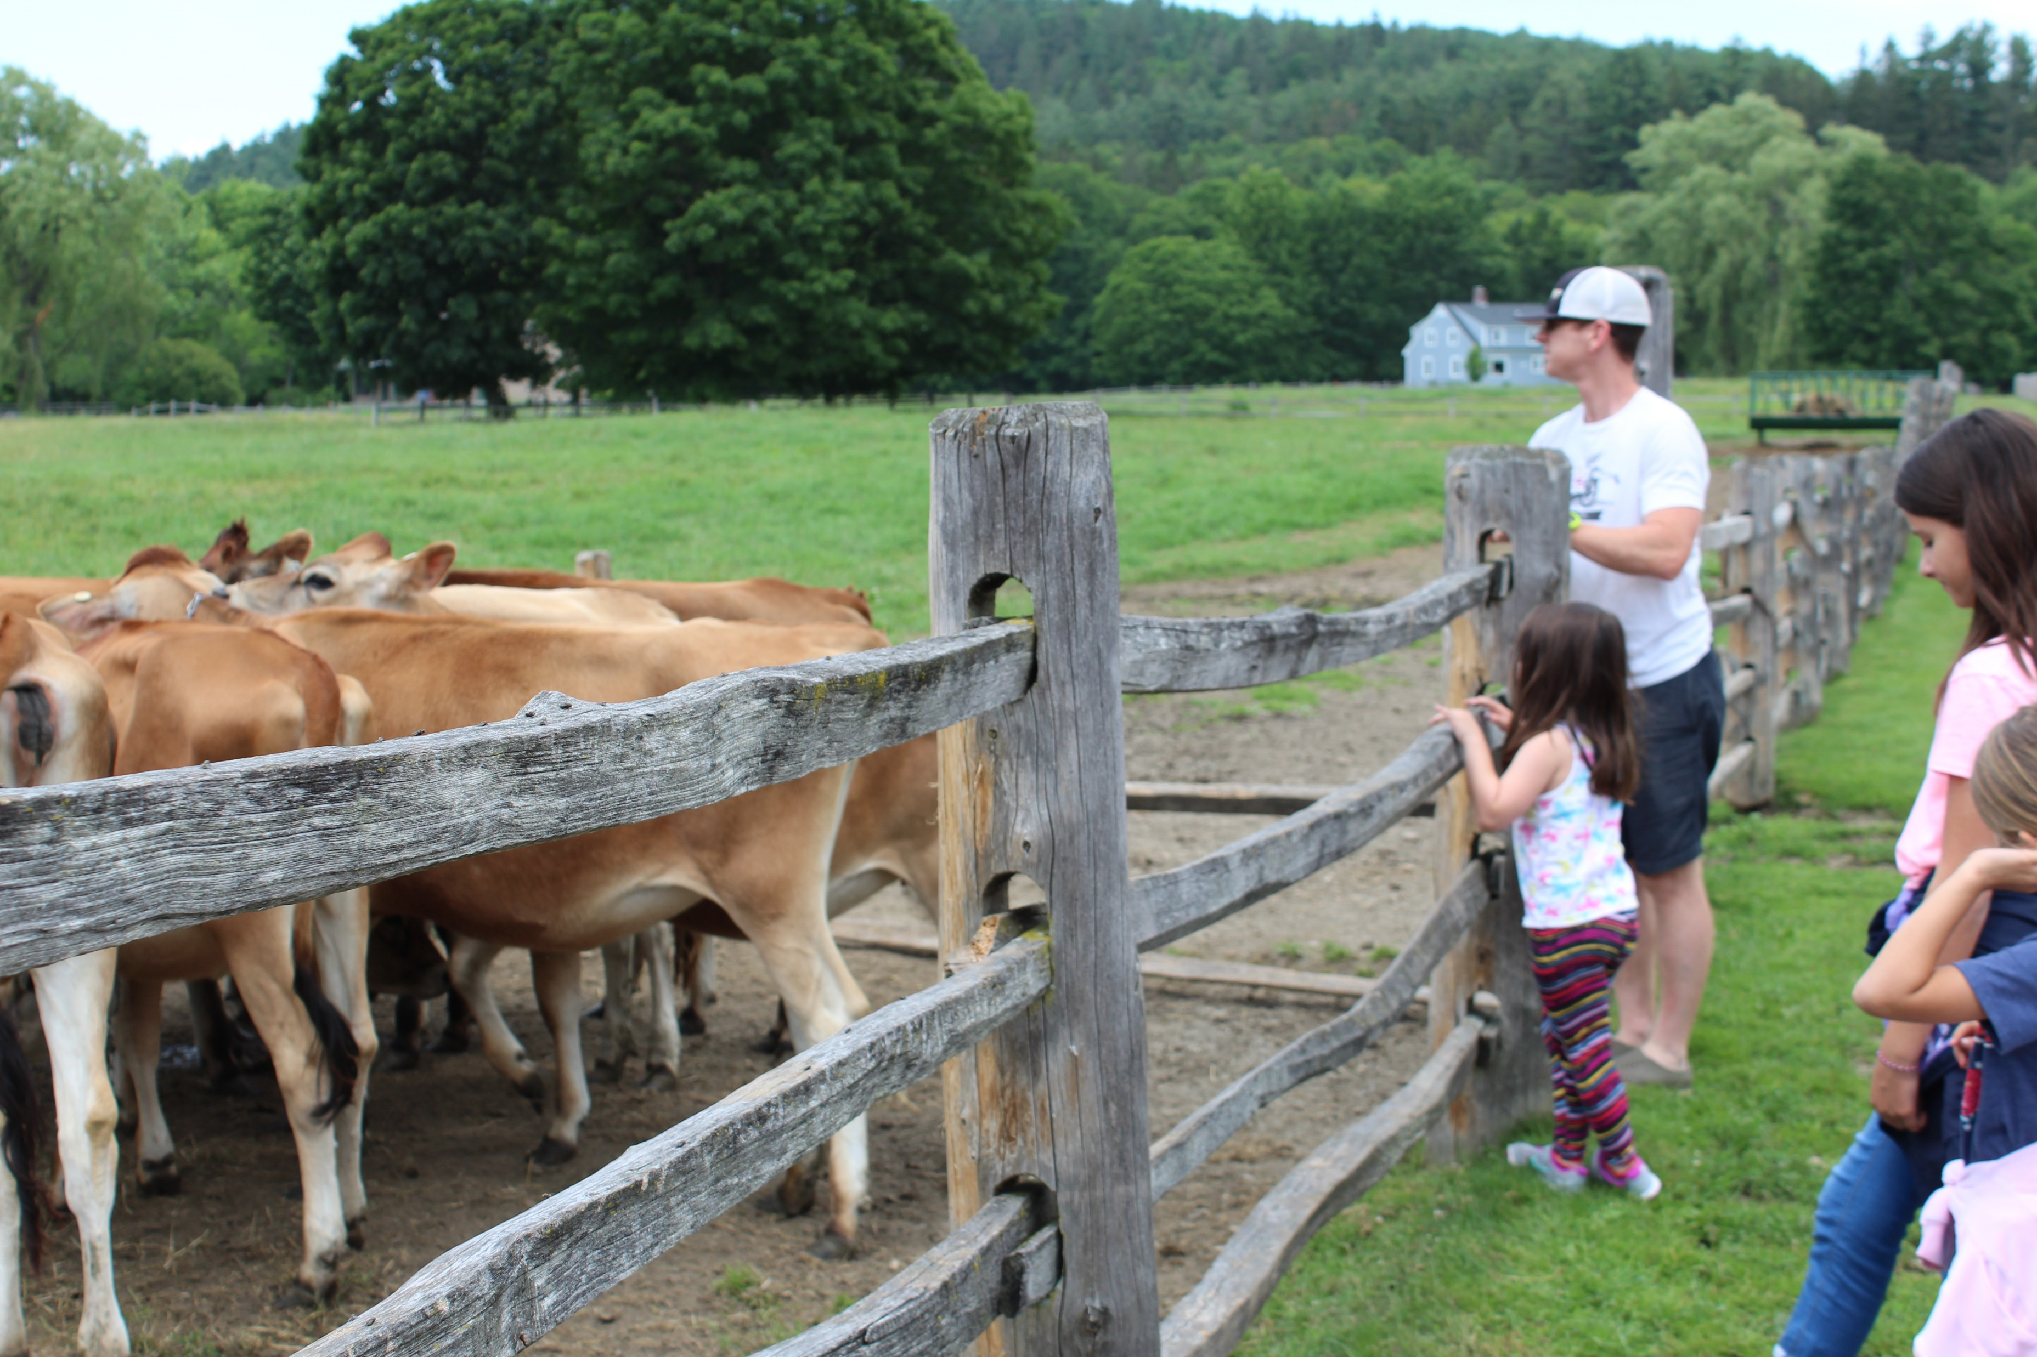
“Can we go in and pet them, Dad?” asked Julie.
Julie’s father whispered, “It’s not safe to go in a pet them, Julie.”

Slide 6
Try these ones yourself! See slide 3 for help.
Get out of the way the man shouted.
You may not go out to play until you clean your room said mom.
The librarian whispered you need to speak softly when you are in the library.

Slide 7
Jim and Dan should be here by now said Josh. Don’t worry responded Sue, I bet they are with Liz. No they aren’t! snapped Josh.
Don’t forget the rules from slide 3. Each new speaker gets a new line!
“Jim and Dan should be here by now,” said Josh.
“Don’t worry,” responded Sue, “I bet they are with Liz.”
“ No they aren’t!” snapped Josh. “Liz is with Kate.”

Slide 8
Try this paragraph taken from George’s Marvelous Medicine by Roald Dahl.
You’re late she snapped. I don’t think I am, Grandma replied George. Don’t interrupt me in the middle of a sentence! she shouted. But you’d finished your sentence, Grandma replied George. There you go again! she cried. Always interrupting and arguing. You really are a tiresome little boy. What’s the time? It’s exactly eleven o’clock, Grandma said George. You’re lying as usual. Stop talking so much and give me my medicine. Shake the bottle first. Then pour it into the spoon and make sure it’s a whole spoonful snarled Grandma. Are you going to gulp it all down in one go? George asked her. Or will you sip it? What I do is none of your business the old woman said. Fill the spoon.

Slide 9
Answer for slide 8
“You’re late,” she snapped.
“I don’t think I am, Grandma,” replied George.
“Don’t interrupt me in the middle of a sentence!” she shouted.
“But you’d finished your sentence, Grandma,” replied George.
“There you go again!” she cried. “Always interrupting and arguing. You really are a tiresome little boy. What’s the time?”
“It’s exactly eleven o’clock, Grandma,” said George.
“You’re lying as usual. Stop talking so much and give me my medicine. Shake the bottle first. Then pour it into the spoon and make sure it’s a whole spoonful,” snarled Grandma.
“Are you going to gulp it all down in one go?” George asked her. “Or will you sip it?”
“What I do is none of your business,” the old woman said. “Fill the spoon.”

Slide 10
I can: | Place a check beside each thing you are confident you can do!
Put “ ” around what words the speaker says.
A new speech sentence starts with a capital letter (even if it is the middle of another sentence).
Separate what was said from speaker with a comma unless there is already a ? or an !
Start a new paragraph if a sentence has a new speaker saying something.
Challenge: Start a new paragraph if the narrative/story continues after speech.

