Slide 2
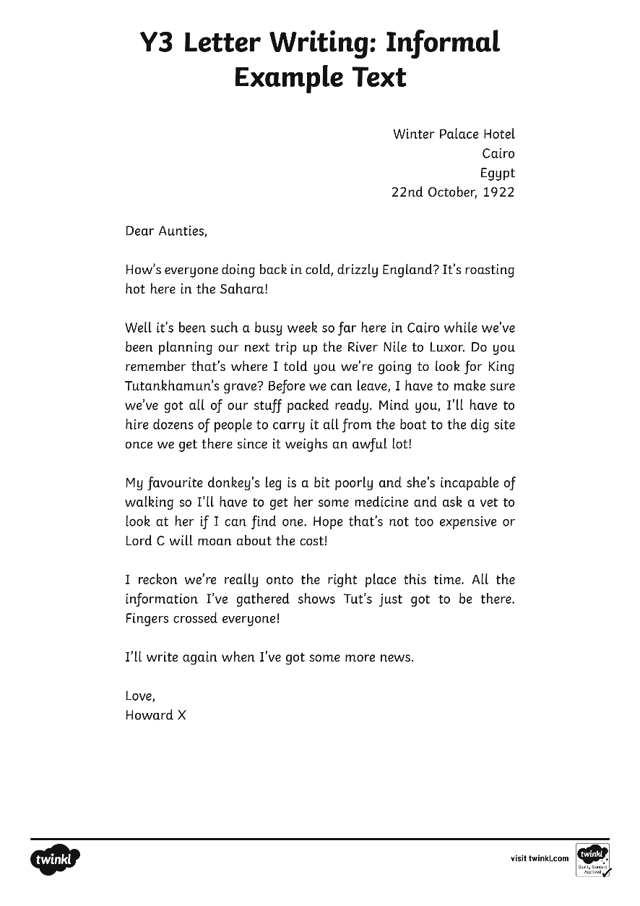
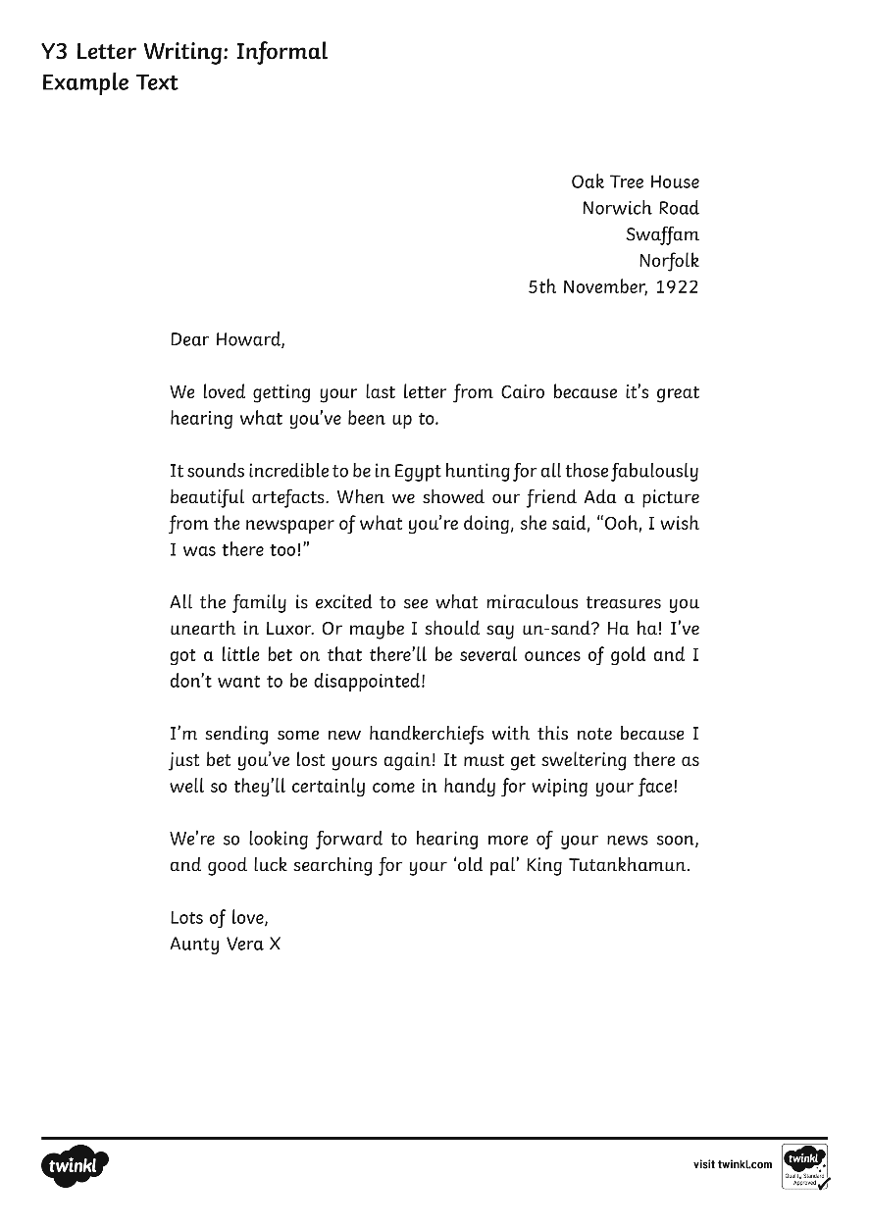

Slide 3
Winter Palace Hotel
Cairo
Egypt
22nd October, 1922
Dear Aunties,
How’s everyone doing back in cold, drizzly England? It’s roasting hot here in the Sahara!
Well it’s been such a busy week so far here in Cairo while we’ve been planning our next trip up the River Nile to Luxor. Do you remember that’s where I told you we’re going to look for King Tutankhamun’s grave? Before we can leave, I have to make sure we’ve got all of our stuff packed ready. Mind you, I’ll have to hire dozens of people to carry it all from the boat to the dig site once we get there since it weighs an awful lot!

Slide 4
My favourite donkey’s leg is a bit poorly and she’s incapable of walking so I’ll have to get her some medicine and ask a vet to look at her if I can find one. Hope that’s not too expensive or Lord C will moan about the cost!
I reckon we’re really onto the right place this time. All the information I’ve gathered shows Tut’s just got to be there. Fingers crossed everyone!
I’ll write again when I’ve got some more news.
Love,
Howard X

Slide 5
Oak Tree House
Norwich Road
Swaffam
Norfolk
5th November, 1922
Dear Howard,
We loved getting your last letter from Cairo because it’s great hearing what you’ve been up to.
It sounds incredible to be in Egypt hunting for all those fabulously beautiful artefacts. When we showed our friend Ada a picture from the newspaper of what you’re doing, she said, “Ooh, I wish I was there too!”

Slide 6
All the family is excited to see what miraculous treasures you unearth in Luxor. Or maybe I should say un-sand? Ha ha! I’ve got a little bet on that there’ll be several ounces of gold and I don’t want to be disappointed!
I’m sending some new handkerchiefs with this note because I just bet you’ve lost yours again! It must get sweltering there as well so they’ll certainly come in handy for wiping your face!
We’re so looking forward to hearing more of your news soon, and good luck searching for your ‘old pal’ King Tutankhamun.
Lots of love,
Aunty Vera X

