Slide 1

Primary Resource

Slide 2




Year 2
Measurement

Slide 3
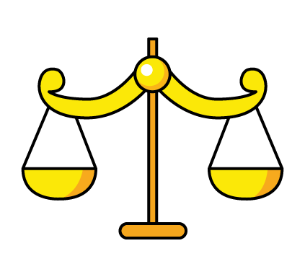



One pear weighs 10 cubes.
How many cubes will balance one pineapple? 20
Explain how you know. 4 pears = 40 cubes = 2 pineapples.
We halve the cubes because we only need one pineapple. (Half of 40 is 20).

Slide 4
Always, Sometimes or Never true?
The larger the box, the heavier it is.
Sometimes.
It would depend on factors such as material and thickness of material.
We would also have to consider whether the box is empty or not.

Slide 5



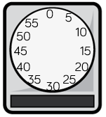
Which is heavier, the red or the green beanbag?
Red
Explain why.
Because we need 2 greens to match the same mass as a red.

Slide 6

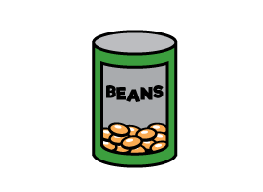
The weighs 25 g.
The weighs 30 g. (Because they both total 55g).

Slide 7
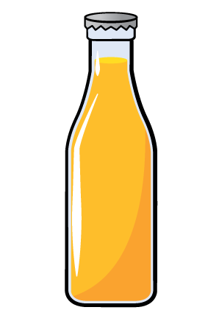
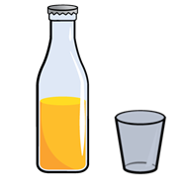
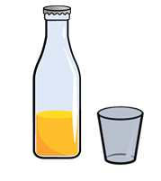
Whitney had two full bottles of juice.
She poured some juice into two glasses.
A B
Which glass has the most juice in?
Which has the least juice in?
Explain how you know.

Slide 8


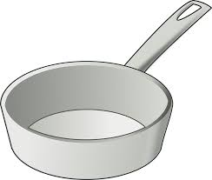
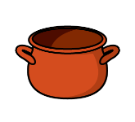

$=$
$=$
$=$
How many does the hold? 40

Slide 9
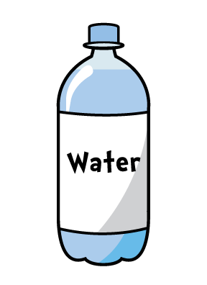
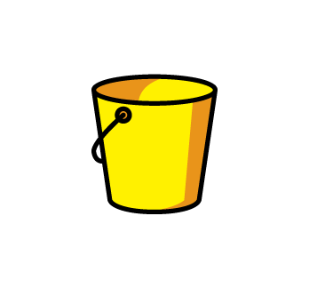
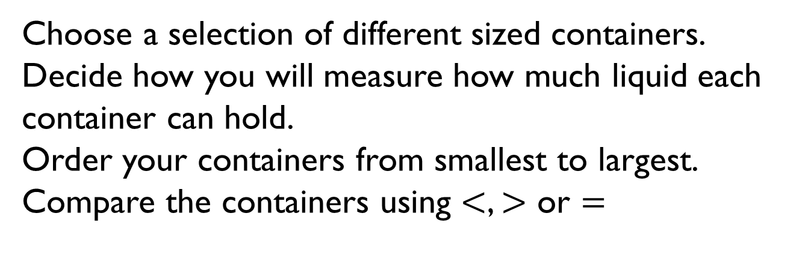
Choose a selection of different sized containers.
Decide how you will measure how much liquid each container can hold.
Order your containers from smallest to largest.
Compare the containers using $<$, $>$ or $=$

Slide 10
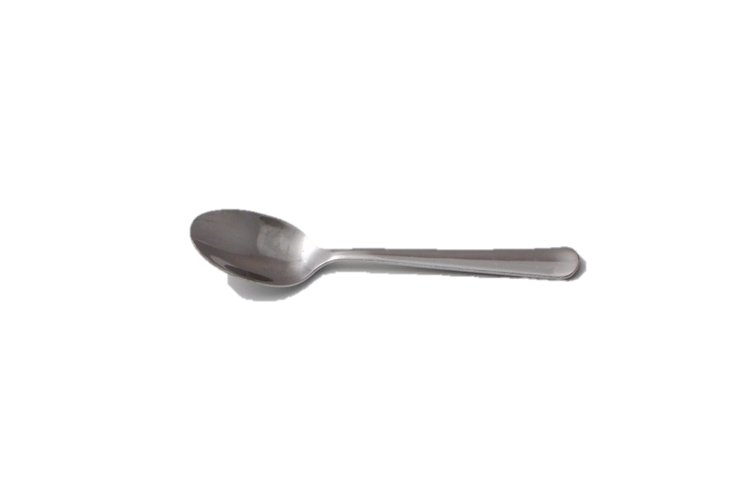
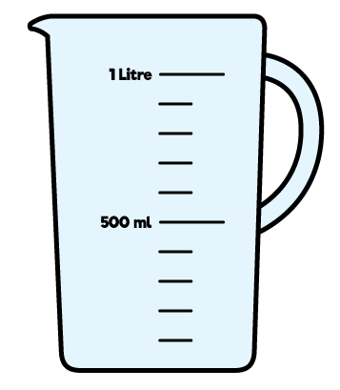
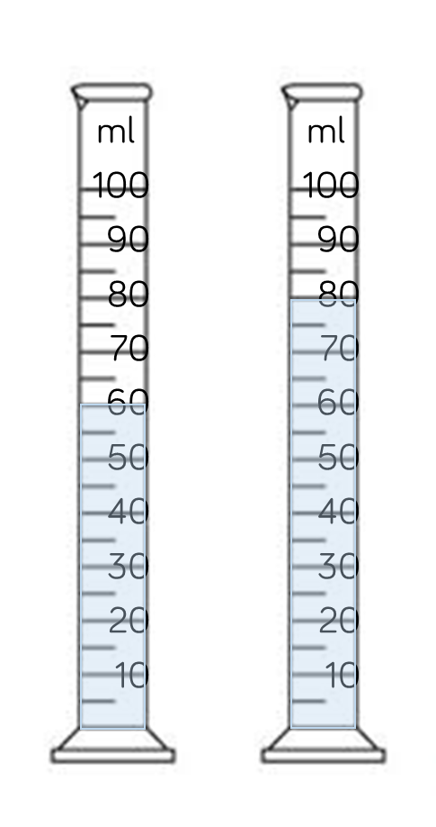
A holds 5 ml of liquid.
How many of liquid are there in each container?
A B
A = 12
B = 16
100 ml
100 ml
50 ml
50 ml

Slide 11
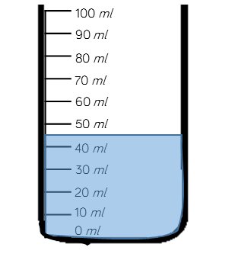
Estimate the amount of water in the container.
45ml
Explain why you have given your answer. The line comes half way between 40ml and 50ml.
100 ml
100 ml
50 ml
50 ml

Slide 12
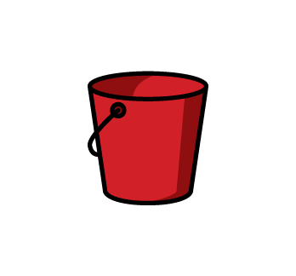
Mo puts 4 litres of water in bucket A.
He then pours 3 litres from bucket A into bucket B.
A B
Which sentence is correct?
There is more in bucket A.
There is less in bucket A.
There are equal amounts in each bucket.
Explain why. Because bucket A now has 1 litre; bucket B now has 3 litres.

Slide 13
Mollie took the temperature at 12 p.m. and again at 5 p.m.
There was a difference of 7°C
What could the temperatures be?
Possible answers:
1°C and 8°C
2°C and 9°C
3°C and 10°C
4°C and 11°C
etc

Slide 14
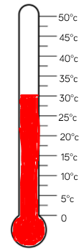
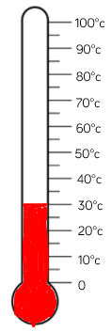
What is the same and what is different about the thermometers/temperatures?
They both show the same temperature (30°C) but the scale on each thermometer is different.

