Slide 1

Primary Resource

Slide 2




Year 2
Fractions

Slide 3

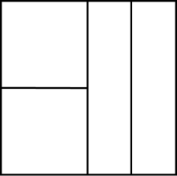
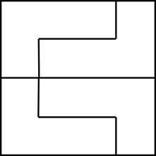
Three children are splitting a square into equal parts.
Who has split the square into equal parts?
Explain why.
Teddy
Alex
Mo

Slide 4




How many different ways can you put these beanbags into equal groups?

Slide 5



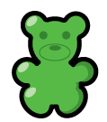

Which is the odd one out?
Explain your answer.
$$\frac{1}{2}$$
One half

Slide 6
Rosie says the shaded part of the shape does not show a half because there are four parts, not two equal parts.
Do you agree? Explain why.

Slide 7
Dora is asked to shade half of her shape.
This is what she shades.
Is she correct? Explain why.

Slide 8





Annie has some gummy bears.
She circles half of them.
How many gummy bears did she have at the start?

Slide 9

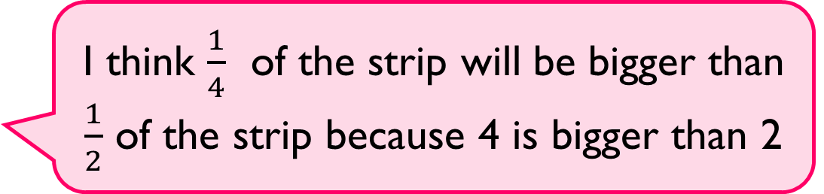
Alex is folding two identical paper strips.
Use paper strips to prove Alex is incorrect.
I think $\frac{1}{4}$ of the strip will be bigger than $\frac{1}{2}$ of the strip because 4 is bigger than 2

Slide 10

True or False?
$\frac{1}{4}$ of the shape is shaded.
Explain your answer.

Slide 11




Who has more? Explain why.
I have $\frac{1}{4}$ of £8
Rosie
I have $\frac{1}{2}$ of £6
Whitney

Slide 12


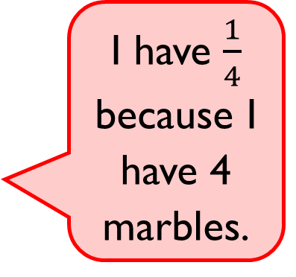
Eva says,
Do you agree? Explain why.
I have $\frac{1}{4}$ because I have 4 marbles.

Slide 13
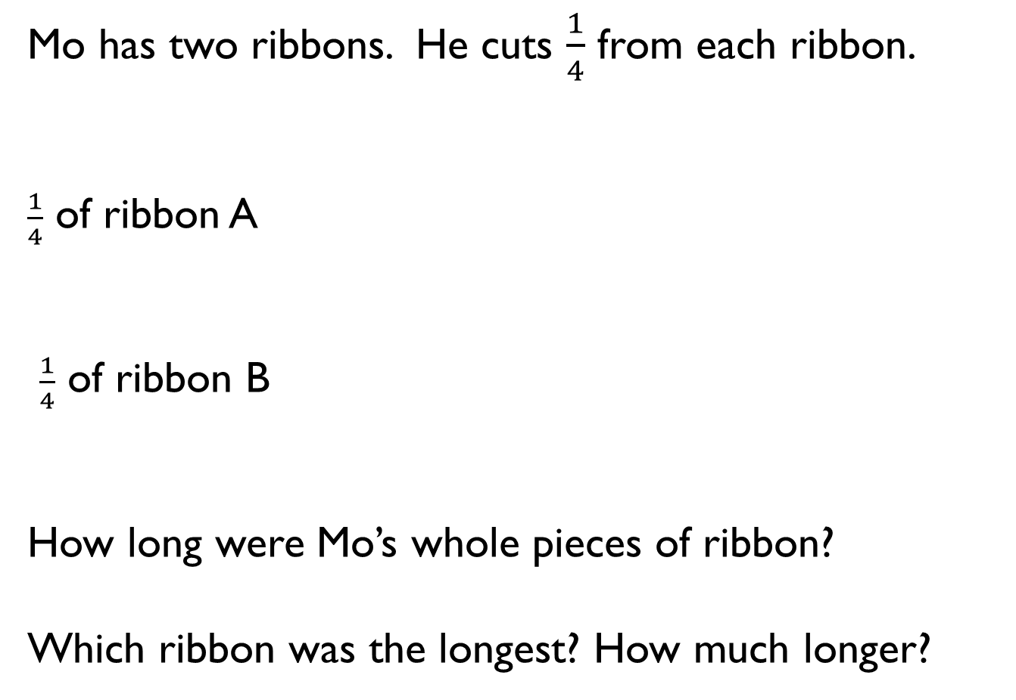
Mo has two ribbons. He cuts $\frac{1}{4}$ from each ribbon.
$\frac{1}{4}$ of ribbon A
$\frac{1}{4}$ of ribbon B
How long were Mo’s whole pieces of ribbon?
Which ribbon was the longest? How much longer?
5 cm
4 cm

Slide 14

Dora says,
Do you agree? Explain your reasoning.
I have one third of a pizza because I have one slice and there are three slices left.

