Slide 1

Primary Resource

Slide 2




Year 2
Fractions

Slide 3

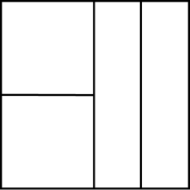
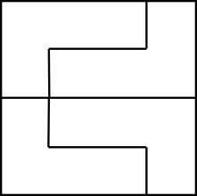
Three children are splitting a square into equal parts.
Who has split the square into equal parts? Teddy, Mo
Explain why. All parts are the same size.
Teddy
Alex
Mo

Slide 4




How many different ways can you put these beanbags into equal groups?
1 group of 12, 2 groups of 6, 3 groups of 4, 4 groups of 3, 6 groups of 2, 12 groups of 1 (6 ways)

Slide 5



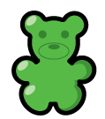

Which is the odd one out? The red and white flag.
Explain your answer. The parts are not equal.
$$\frac{1}{2}$$
One half

Slide 6
Rosie says the shaded part of the shape does not show a half because there are four parts, not two equal parts.
Do you agree? Explain why. It is a half because if you swapped the top white with the bottom pink, you would see that there is an equal amount of white and pink.

Slide 7
Dora is asked to shade half of her shape.
This is what she shades.
Is she correct? Yes
Explain why. Because 6 out of the
12 have been shaded, and all
squares are equal in size.

Slide 8





Annie has some gummy bears.
She circles half of them.
How many gummy bears did she have at the start? 16

Slide 9

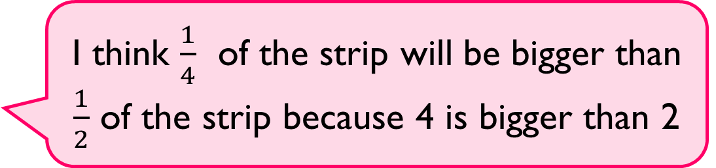
Alex is folding two identical paper strips.
Use paper strips to prove Alex is incorrect.
She is incorrect because we need 4 quarters to make the whole strip; we only need 2 halves to make the whole strip.
I think $\frac{1}{4}$ of the strip will be bigger than $\frac{1}{2}$ of the strip because 4 is bigger than 2

Slide 10

True or False?
$\frac{1}{4}$ of the shape is shaded. True
Explain your answer. 4 small triangles complete the large triangle.

Slide 11


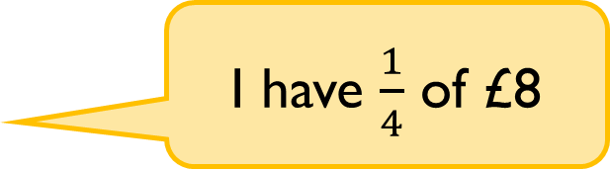

Who has more? Whitney
Explain why. ¼ of 8 = 2 ½ of 6 = 3
I have $\frac{1}{4}$ of £8
Rosie
I have $\frac{1}{2}$ of £6
Whitney

Slide 12


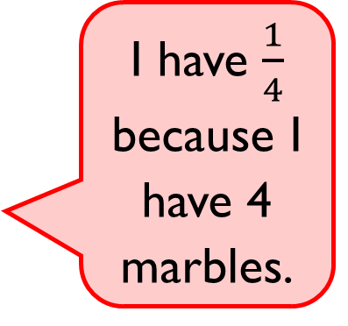
Eva says,
Do you agree? No Explain why. She hasn’t split all of the marbles into 4 equal groups and then circled 1 of these groups.
I have $\frac{1}{4}$ because I have 4 marbles.

Slide 13
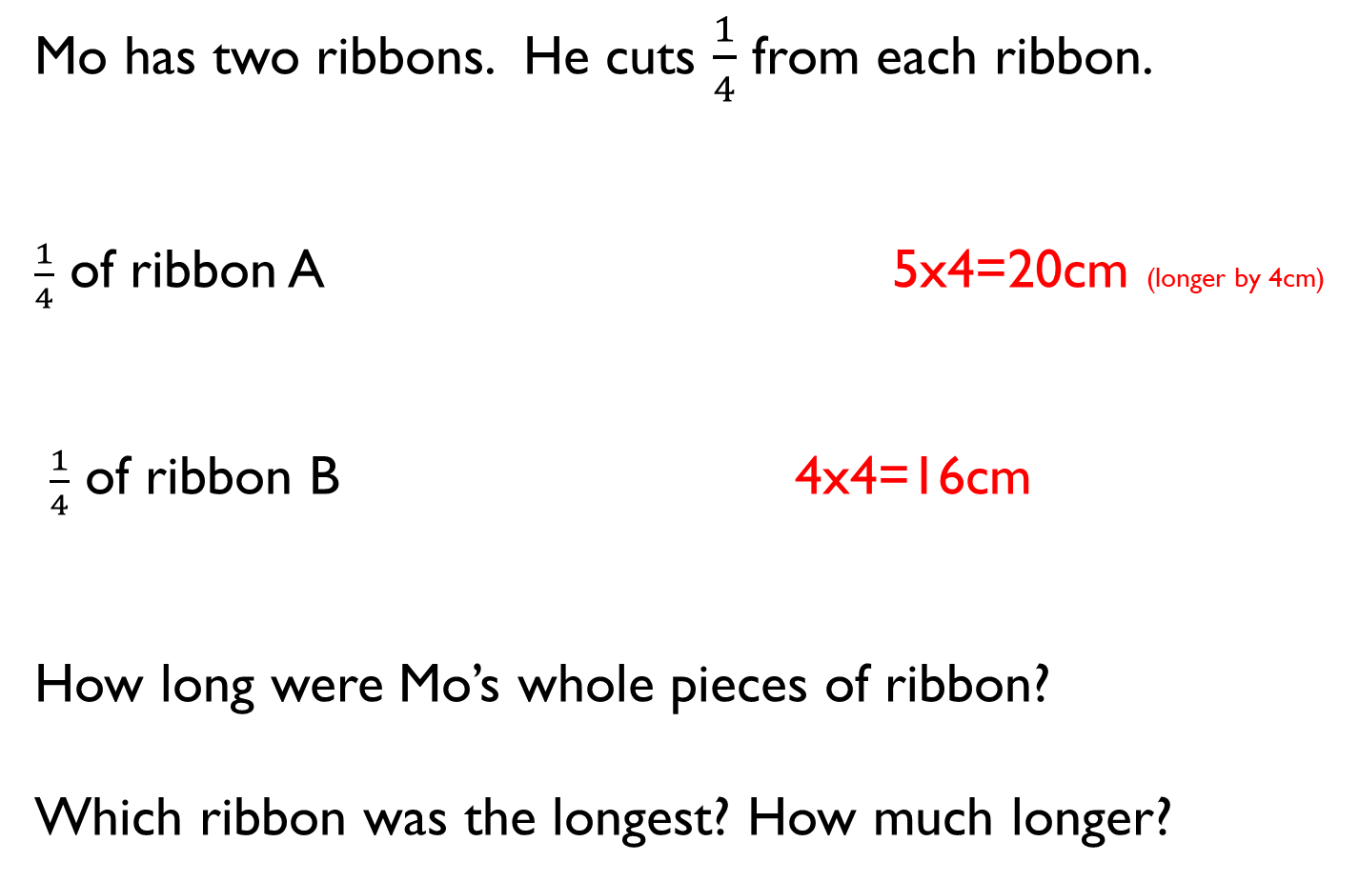
Mo has two ribbons. He cuts $\frac{1}{4}$ from each ribbon.
$\frac{1}{4}$ of ribbon A 5x4=20cm (longer by 4cm)
$\frac{1}{4}$ of ribbon B 4x4=16cm
How long were Mo’s whole pieces of ribbon?
Which ribbon was the longest? How much longer?
5 cm
4 cm

Slide 14

Dora says,
Do you agree? No. Explain your reasoning. To have a third, you need to have 1 piece with 2 pieces left. (1+2=3). All pieces must be the same size.
I have one third of a pizza because I have one slice and there are three slices left.

