Slide 1
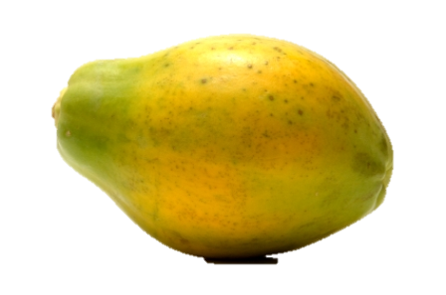
The papaya that spoke

Slide 2
Once upon a time there was a farmer
who lived in a village.

Slide 3

One day he felt hungry
so he went out to pick a papaya.

Slide 4
To his amazement, the papaya spoke.
Hands off!

Slide 5
Was that you?
The farmer looked at his dog.

Slide 6
No.
It was the papaya.

Slide 7
AAAAARGH!

Slide 8
As fast as his legs could carry him,
until he came to a market,
he ran and he ran and he ran
where he met a fisherman selling fish.

Slide 9
Why are you running so fast when the sun is shining so bright?

Slide 10
First a papaya spoke to me and next my dog!

Slide 11
That’s impossible.

Slide 12
Oh, no it isn’t.

Slide 13
AAAAARGH!

Slide 14
As fast as his legs could carry him,
until he came to a field,
he ran and he ran and he ran
where he met a shepherd with his goats.

Slide 15
Why are you running so fast when the sun is shining so bright?

Slide 16
First a papaya spoke to me, next a dog and after that a fish!

Slide 17
That’s impossible.

Slide 18
Oh, no it isn’t.

Slide 19
AAAAARGH!

Slide 20
As fast as his legs could carry him,
until he came to a village,
he ran and he ran and he ran
where he met the King sitting on his wooden rocking chair.

Slide 21
Why are you running so fast when the sun is shining so bright?

Slide 22
First a papaya spoke to me, next a dog, after that a fish and finally a goat!

Slide 23
That’s impossible.

Slide 24
Get out of here, you foolish man.

Slide 25
So the poor farmer walked home with his head hung down.

Slide 26
The King rocked back and forth,
back and forth,
back and forth.

Slide 27
How silly of him to imagine that things can talk.

Slide 28
There was a long silence.

Slide 29
Quite so – whoever heard of a talking papaya?

Slide 30
The end

