Slide 1

Resource

Slide 2
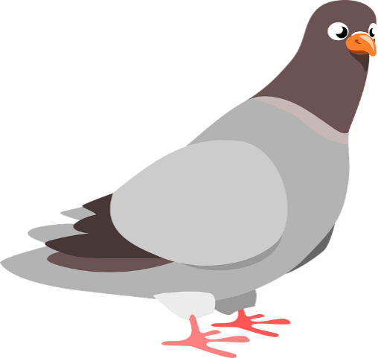
Sentence Punctuation
Don’t Let the Pigeon…

Slide 3

Does this sentence make sense?
Hop on one leg.
Yes it does!
It also begins with a capital letter and ends with a full stop.
Can you see the finger spaces between each word?

Slide 4
Does this sentence make sense?
spot on jog the
No it does not!
The words are not in the right order.
It does not begin with a capital letter or end with a full stop.
How can we make correct?

Slide 5
Does this sentence make sense?
Jog on the spot.
Now I get it!

Slide 6
Does this sentence make sense?
Jump up high.
Yes it does!
It also begins with a capital letter and ends with a full stop.
Can you see the finger spaces between each word?

Slide 7
Does this sentence make sense?
skipinacircle
No it does not!
There are no spaces between the words. It is hard to read.
It does not begin with a capital letter or end with a full stop.
How can we make correct?

Slide 8
Does this sentence make sense?
Skip in a circle.
That’s better!

Slide 9
Does this sentence make sense?
Run on the spot.
Yes it does!
It also begins with a capital letter and ends with a full stop.
Can you see the finger spaces between each word?

Slide 10
Is this sentence correct?
stamp your feet
No!
It does not begin with a capital letter or end with a full stop.
How can we make correct?

Slide 11
Is this sentence correct?
Stamp your feet.
That is a sentence now!

Slide 12
Does this sentence make sense?
Turn around slowly.
Yes it does!
It also begins with a capital letter and ends with a full stop.
Can you see the finger spaces between each word?

Slide 13
Is this sentence correct?
look all around
No!
It does not begin with a capital letter or end with a full stop.
How can we make correct?

Slide 14
Is this sentence correct?
Look all around.
Perfect!

Slide 15
Does this sentence make sense?
Smile at your friends.
Yes it does!
It also begins with a capital letter and ends with a full stop.
Can you see the finger spaces between each word?

Slide 16
Which word tells you what to do?
Hop on one leg.
Jog on the spot.
Jump up high.
Skip in a circle.
Run on the spot.
Stamp your feet.
Turn around slowly.
Look all around.
Smile at your friends.
What different instruction can you think of?

