Slide 2

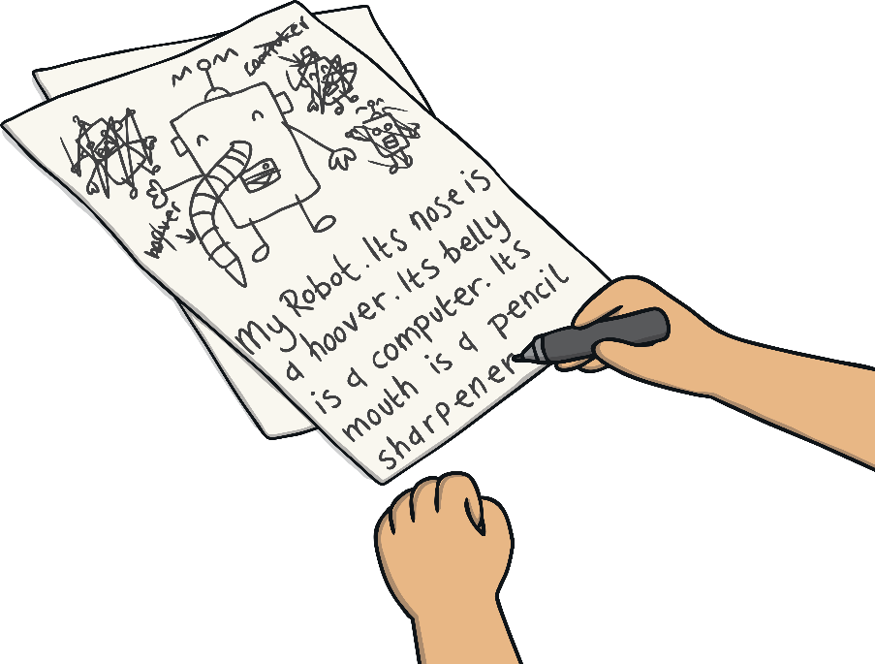
What is Paraphrasing?
Paraphrasing means to tell the meaning of something spoken or written using your own words.

Slide 3







Steps to Paraphrasing
To paraphrase properly you will need to follow these steps.
Step 1: Read the text.
Step 2: Cover the text.
Step 3: Explain the ideas aloud using your own words.
You can repeat steps 1-2 before coming back to this step if you need to.
Step 4: Write the main ideas in your own words.
Step 5: Refer back to the original text to make sure you have kept the idea the same but have used different words.

Slide 4
Example of Paraphrasing
“Don’t forget that you need to pack your pyjamas, as well as your toothbrush and hairbrush for your sleep over at Grandad and Grandma’s house tomorrow night.”
You can change the above statement to read:
“Pack your pyjamas, toothbrush and hairbrush for your sleep over at Grandad and Grandma’s house tomorrow night.”

Slide 5
Checklist for Paraphrasing
Ask yourself these questions when you are paraphrasing.
Have I read the text?
Have I covered the text?
Can I explain the ideas aloud in my own words?
Have I written the main ideas of the text in my own words?
Does my text make sense?
Does my text include the same ideas?
Is my text shorter than the original text?
If you have followed all of these steps you are a paraphrasing professor!

Slide 6

Paraphrase It!
Don’t forget your checklist!
Read the following and then let’s paraphrase it together.
Example:
There are only a few people who can speak Spanish.
Have I read the text?
Have I covered the text?
Can I explain the ideas aloud in my own words?
Have I written the main ideas of the text in my own words?
Does my text make sense?
Does my text include the same ideas?
Is my text shorter than the original text?

Slide 7
Paraphrase It!
Don’t forget your checklist!
Read the following and then let’s paraphrase it together.
Example:
The last time he went to see his cousin’s house was six months ago.
Have I read the text?
Have I covered the text?
Can I explain the ideas aloud in my own words?
Have I written the main ideas of the text in my own words?
Does my text make sense?
Does my text include the same ideas?
Is my text shorter than the original text?

Slide 8
Paraphrase It!
Don’t forget your checklist!
Read the following and then let’s paraphrase it together.
Example:
She stayed up late because she needed to finish off her assignment which was due the next day.
Have I read the text?
Have I covered the text?
Can I explain the ideas aloud in my own words?
Have I written the main ideas of the text in my own words?
Does my text make sense?
Does my text include the same ideas?
Is my text shorter than the original text?

Slide 9
Paraphrase It!
Don’t forget your checklist!
Read the following and then let’s paraphrase it together.
Example:
You will be late for swimming unless you leave now.
Have I read the text?
Have I covered the text?
Can I explain the ideas aloud in my own words?
Have I written the main ideas of the text in my own words?
Does my text make sense?
Does my text include the same ideas?
Is my text shorter than the original text?

Slide 10
Paraphrase It!
Don’t forget your checklist!
Read the following and then let’s paraphrase it together.
Example:
As soon as I reached the bus stop the bus arrived.
Have I read the text?
Have I covered the text?
Can I explain the ideas aloud in my own words?
Have I written the main ideas of the text in my own words?
Does my text make sense?
Does my text include the same ideas?
Is my text shorter than the original text?

