Slide 1


How to Stay Safe Online
Online Safety

Slide 2

It helps us to find information that will help us with our home learning.
We can share files and pictures with other people very easily.
We can communicate with others that we are never likely to meet face to face.

Slide 3

Unfortunately, nothing we see or do online is ever completely private.

Slide 4

Key messages
We must be careful about the information we share online.
We should not be sharing...
full names
home addresses
school details (if relevant)
phone numbers or email addresses

Slide 5
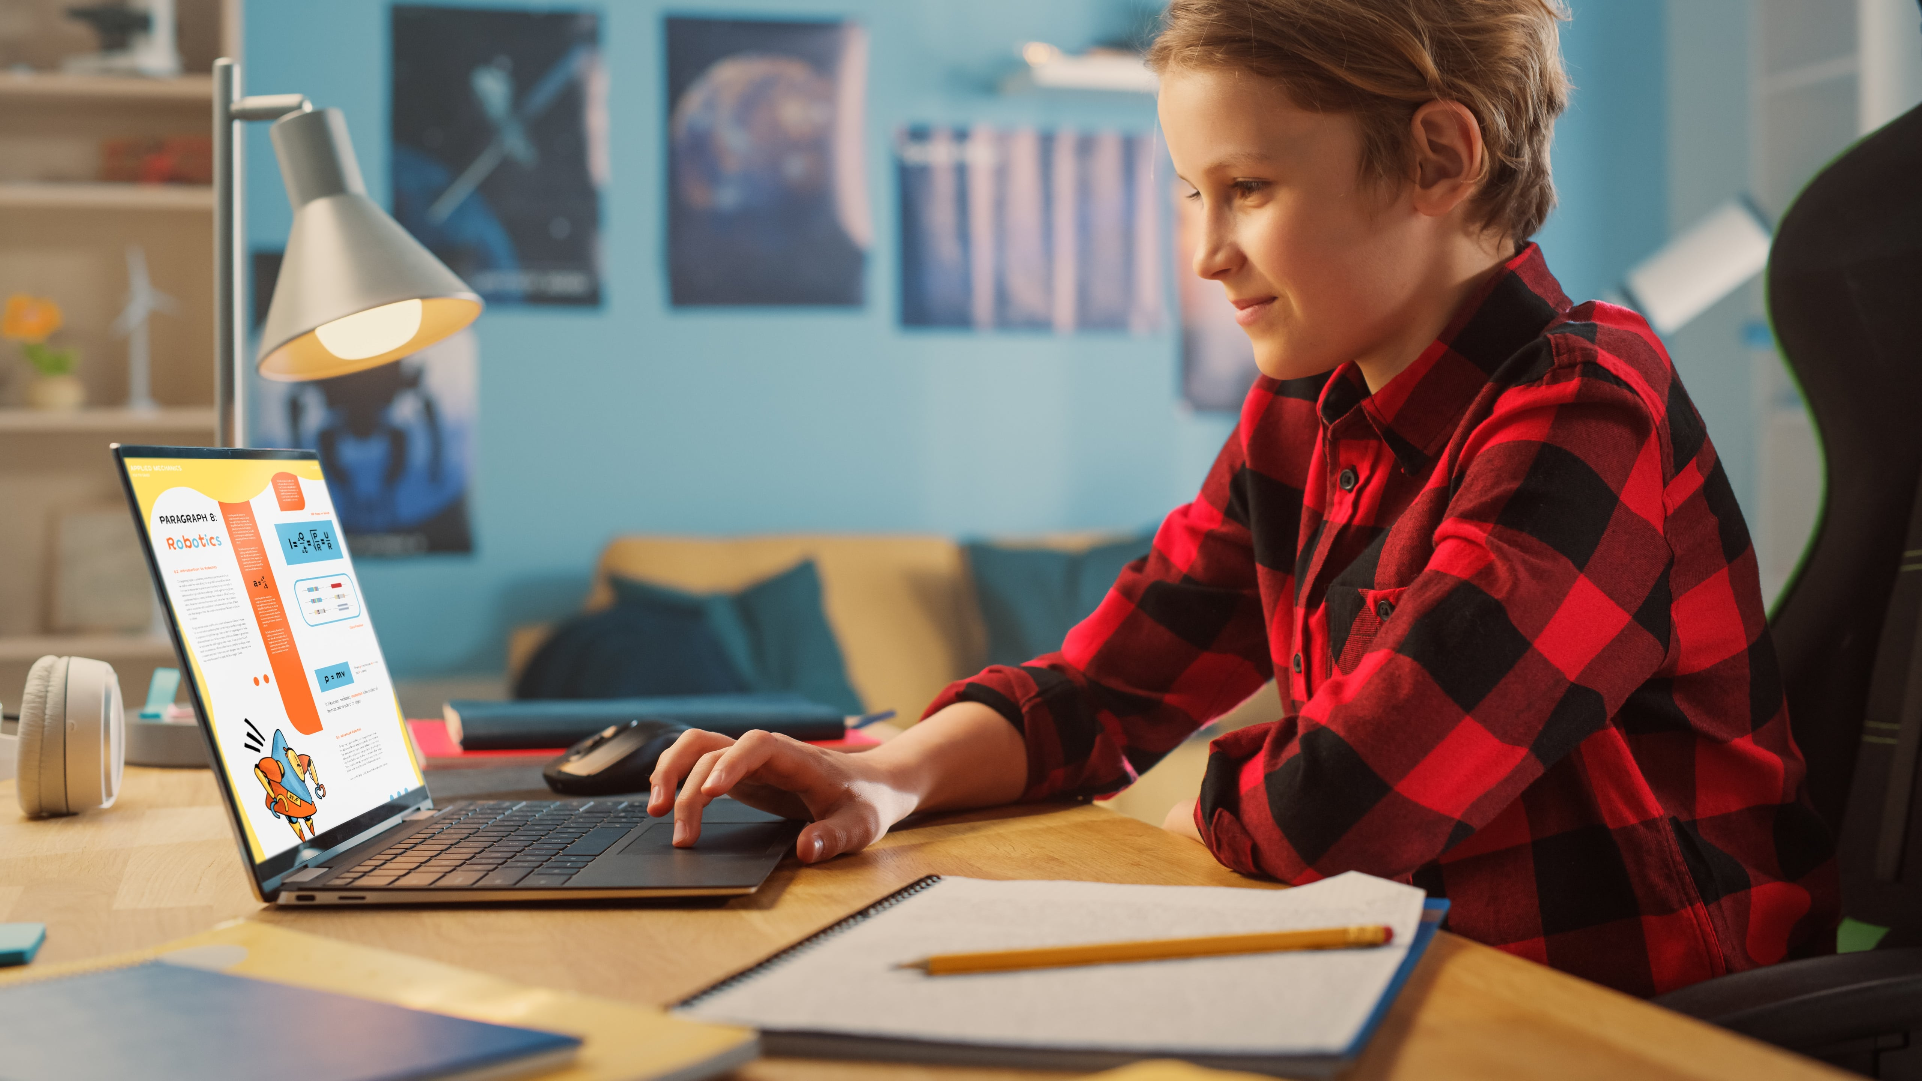
Key messages
We must be careful about the information we share online.
We should not be sharing…
personal photographs

Slide 6
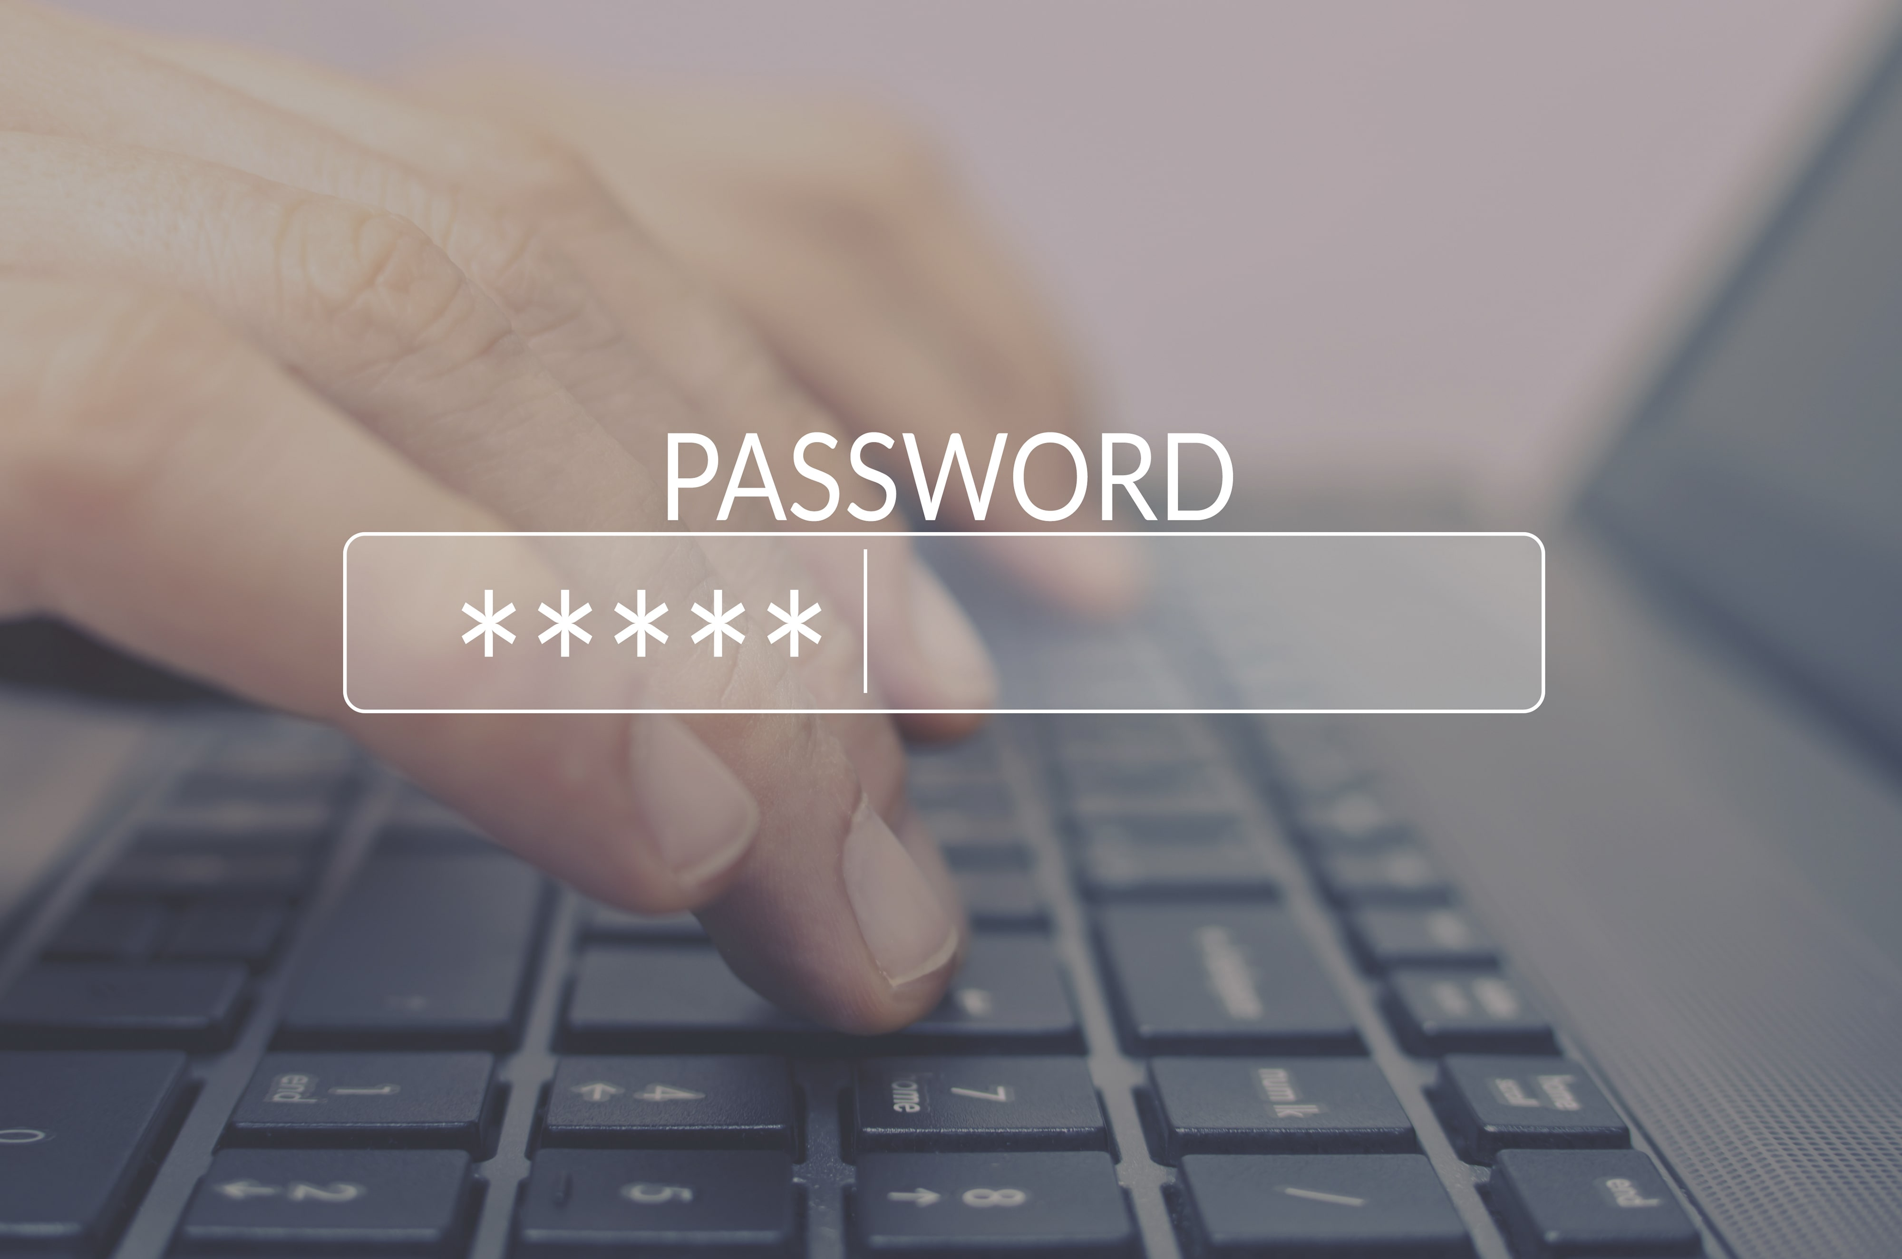
Key messages
We must keep passwords private.
Passwords may contain…
a mixture of upper/lower-case letters and/or numbers
special characters (# @ %)
a word or phrase with a special meaning

Slide 7

Key messages
We must be careful about downloading files from sources we do not know well or trust.
If in doubt, ask!

Slide 8
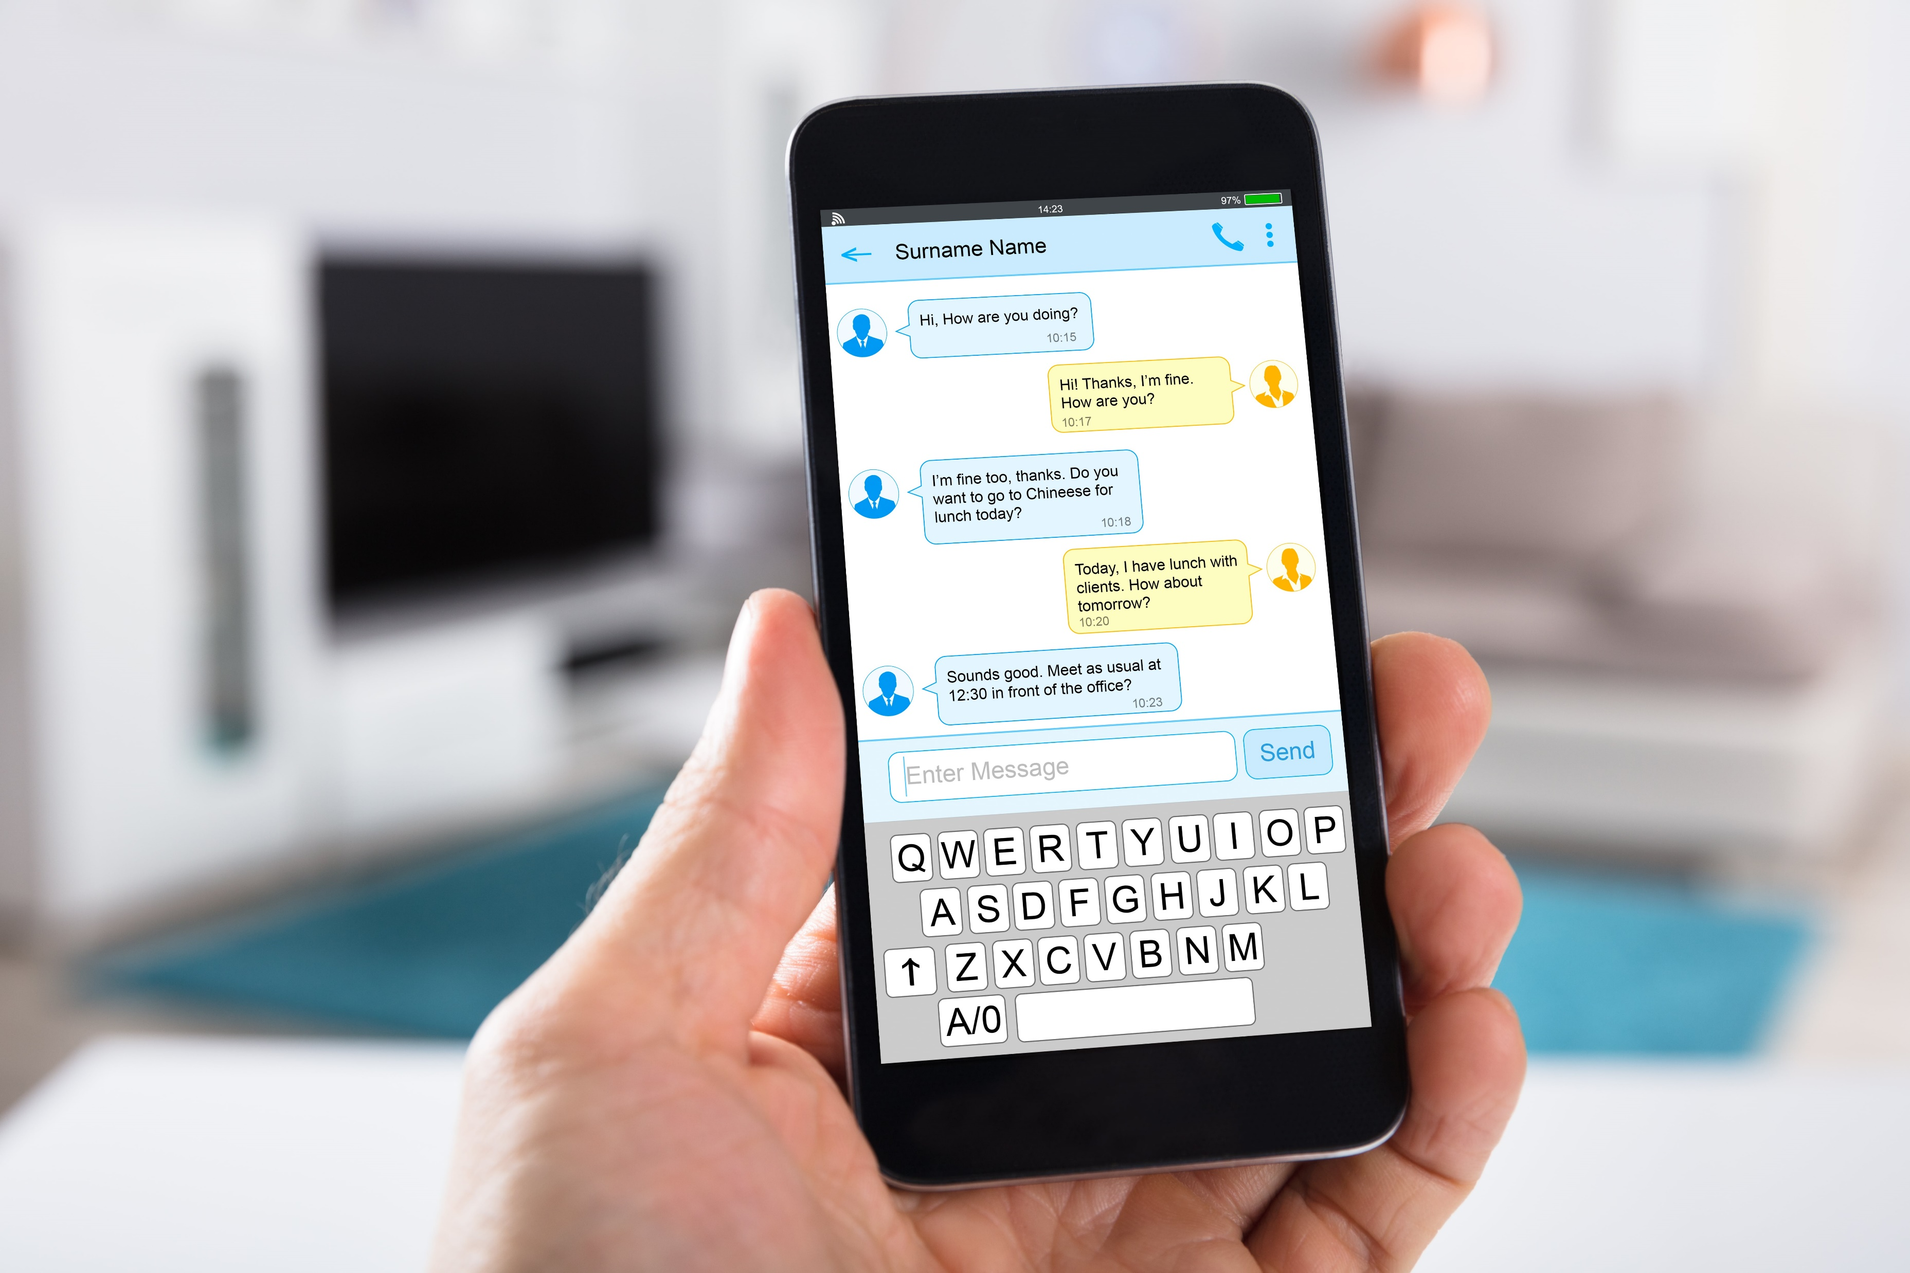
Key messages
It is a good idea to show an adult the messages you receive.

Slide 9
Key messages
Think about sending messages or posting anything online.
Don’t post anything that you that you wouldn’t want adults or other children to read.
Be respectful and considerate to others. Don’t post anything you wouldn’t want to receive yourself.

Slide 10

If in doubt, ask!

Slide 11


Above all, enjoy being a safe Internet user!
https://www.childline.org.uk/info-advice/bullying-abuse-safety/online-mobile-safety/staying-safe-online/

