Slide 1


How to Stay Safe Online
Online Safety

Slide 2

It is a fantastic research tool for school work and other projects.
It can promote collaboration with others through file/picture sharing.
It is a popular forum for online gaming.

Slide 3

Unfortunately, nothing we see or do online is ever completely private.

Slide 4

Key messages
We must ask permission before using the Internet and accessing new sites.

Slide 5

Key messages
We must be careful about the information we share online.
We should not be sharing...
full names
home addresses
school details (if relevant)
phone numbers or email addresses

Slide 6
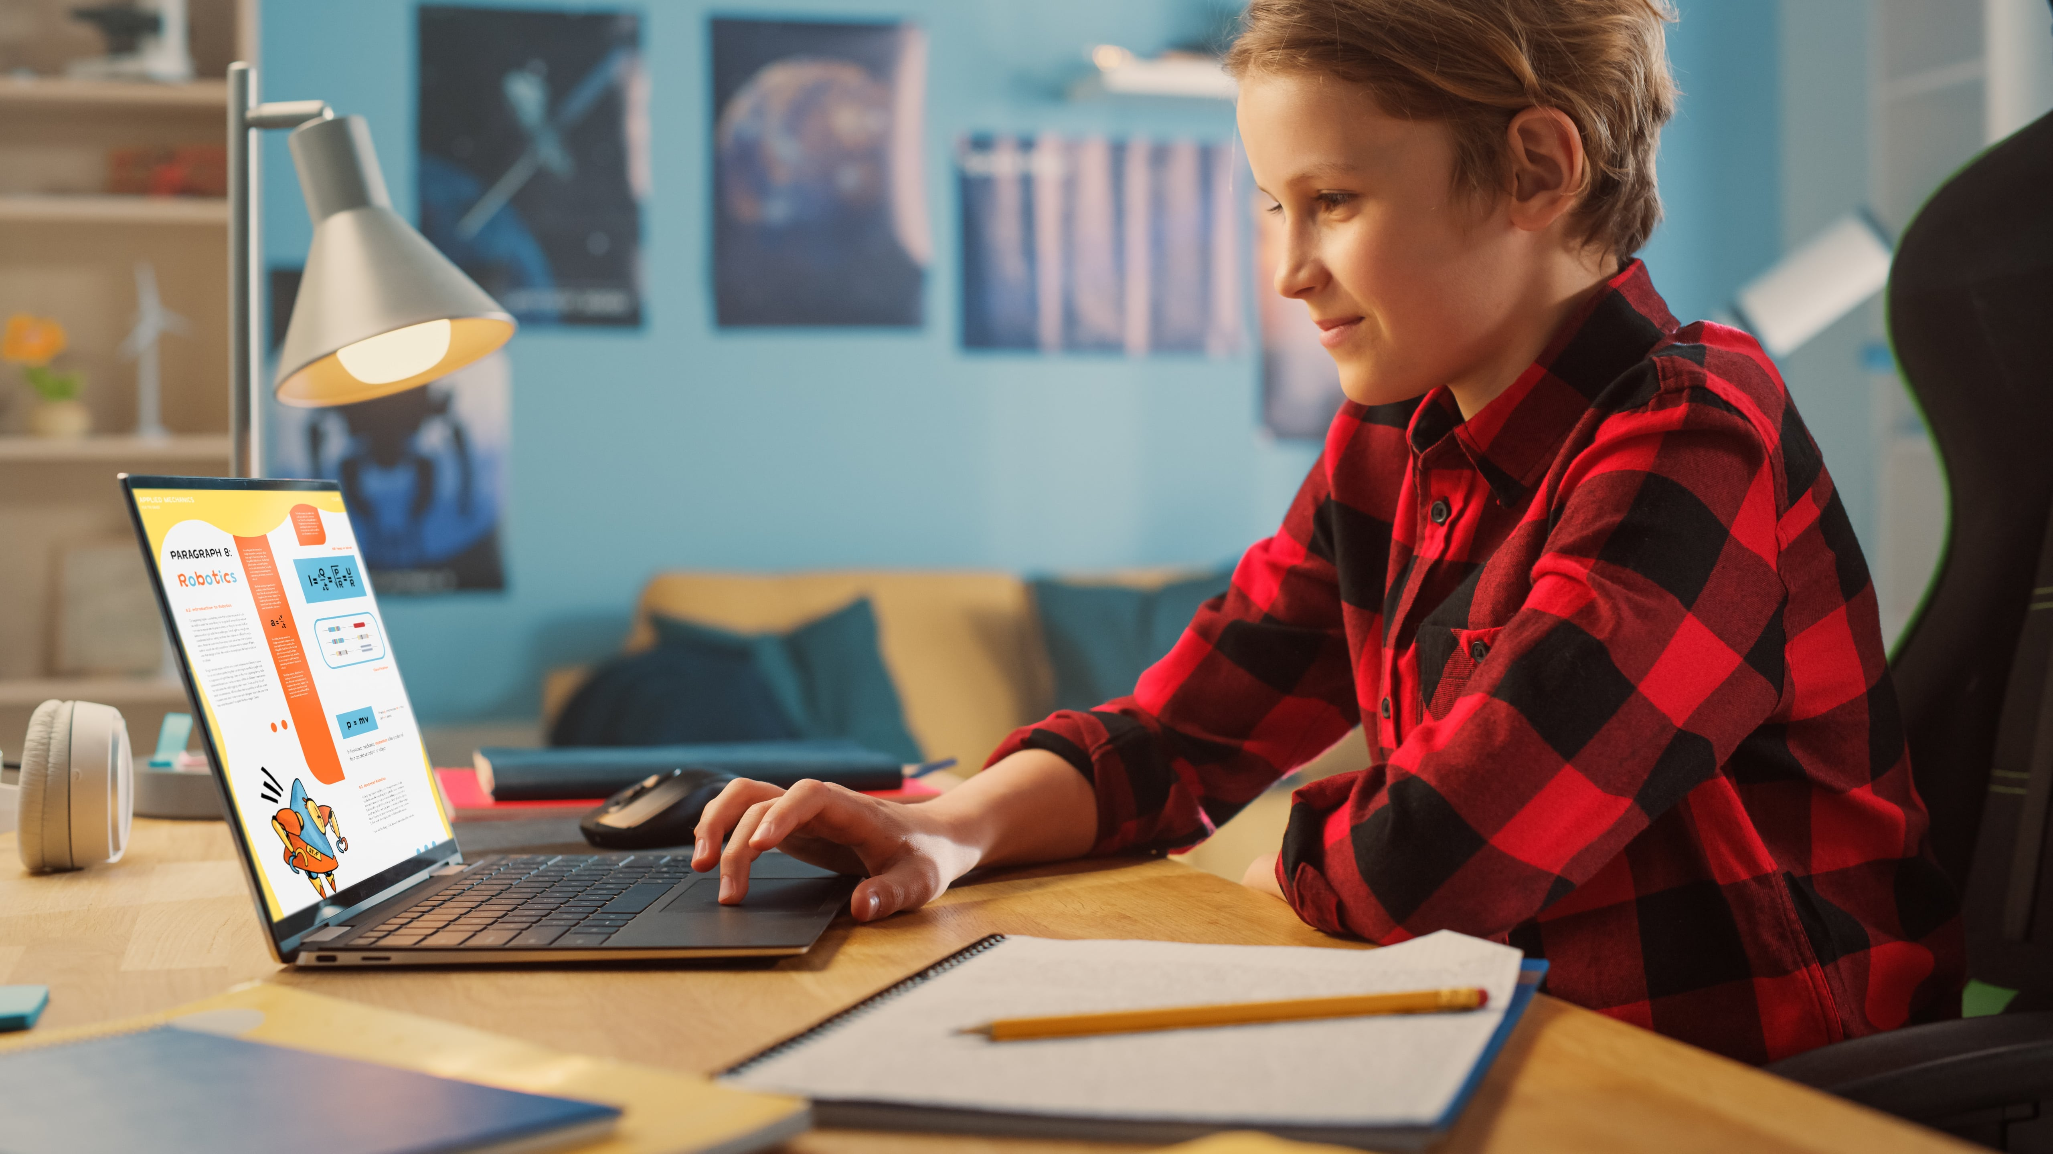
Key messages
We must be careful about the information we share online.
We should not be sharing…
personal photographs

Slide 7
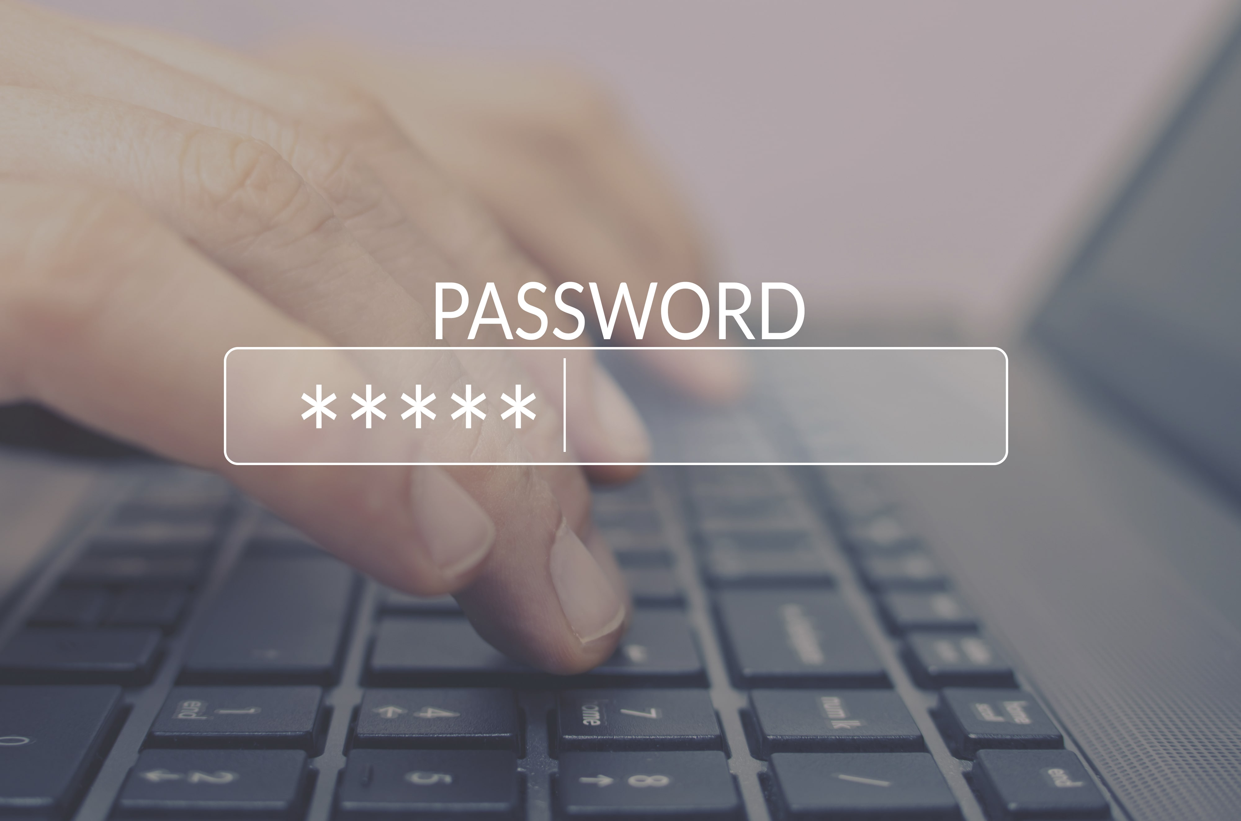
Key messages
We must keep passwords private.
Passwords may contain…
a mixture of upper/lower-case letters and/or numbers
special characters (# @ %)
a word or phrase with a special meaning

Slide 8

Key messages
We must be careful about downloading files from sources we do not know well or trust.

Slide 9
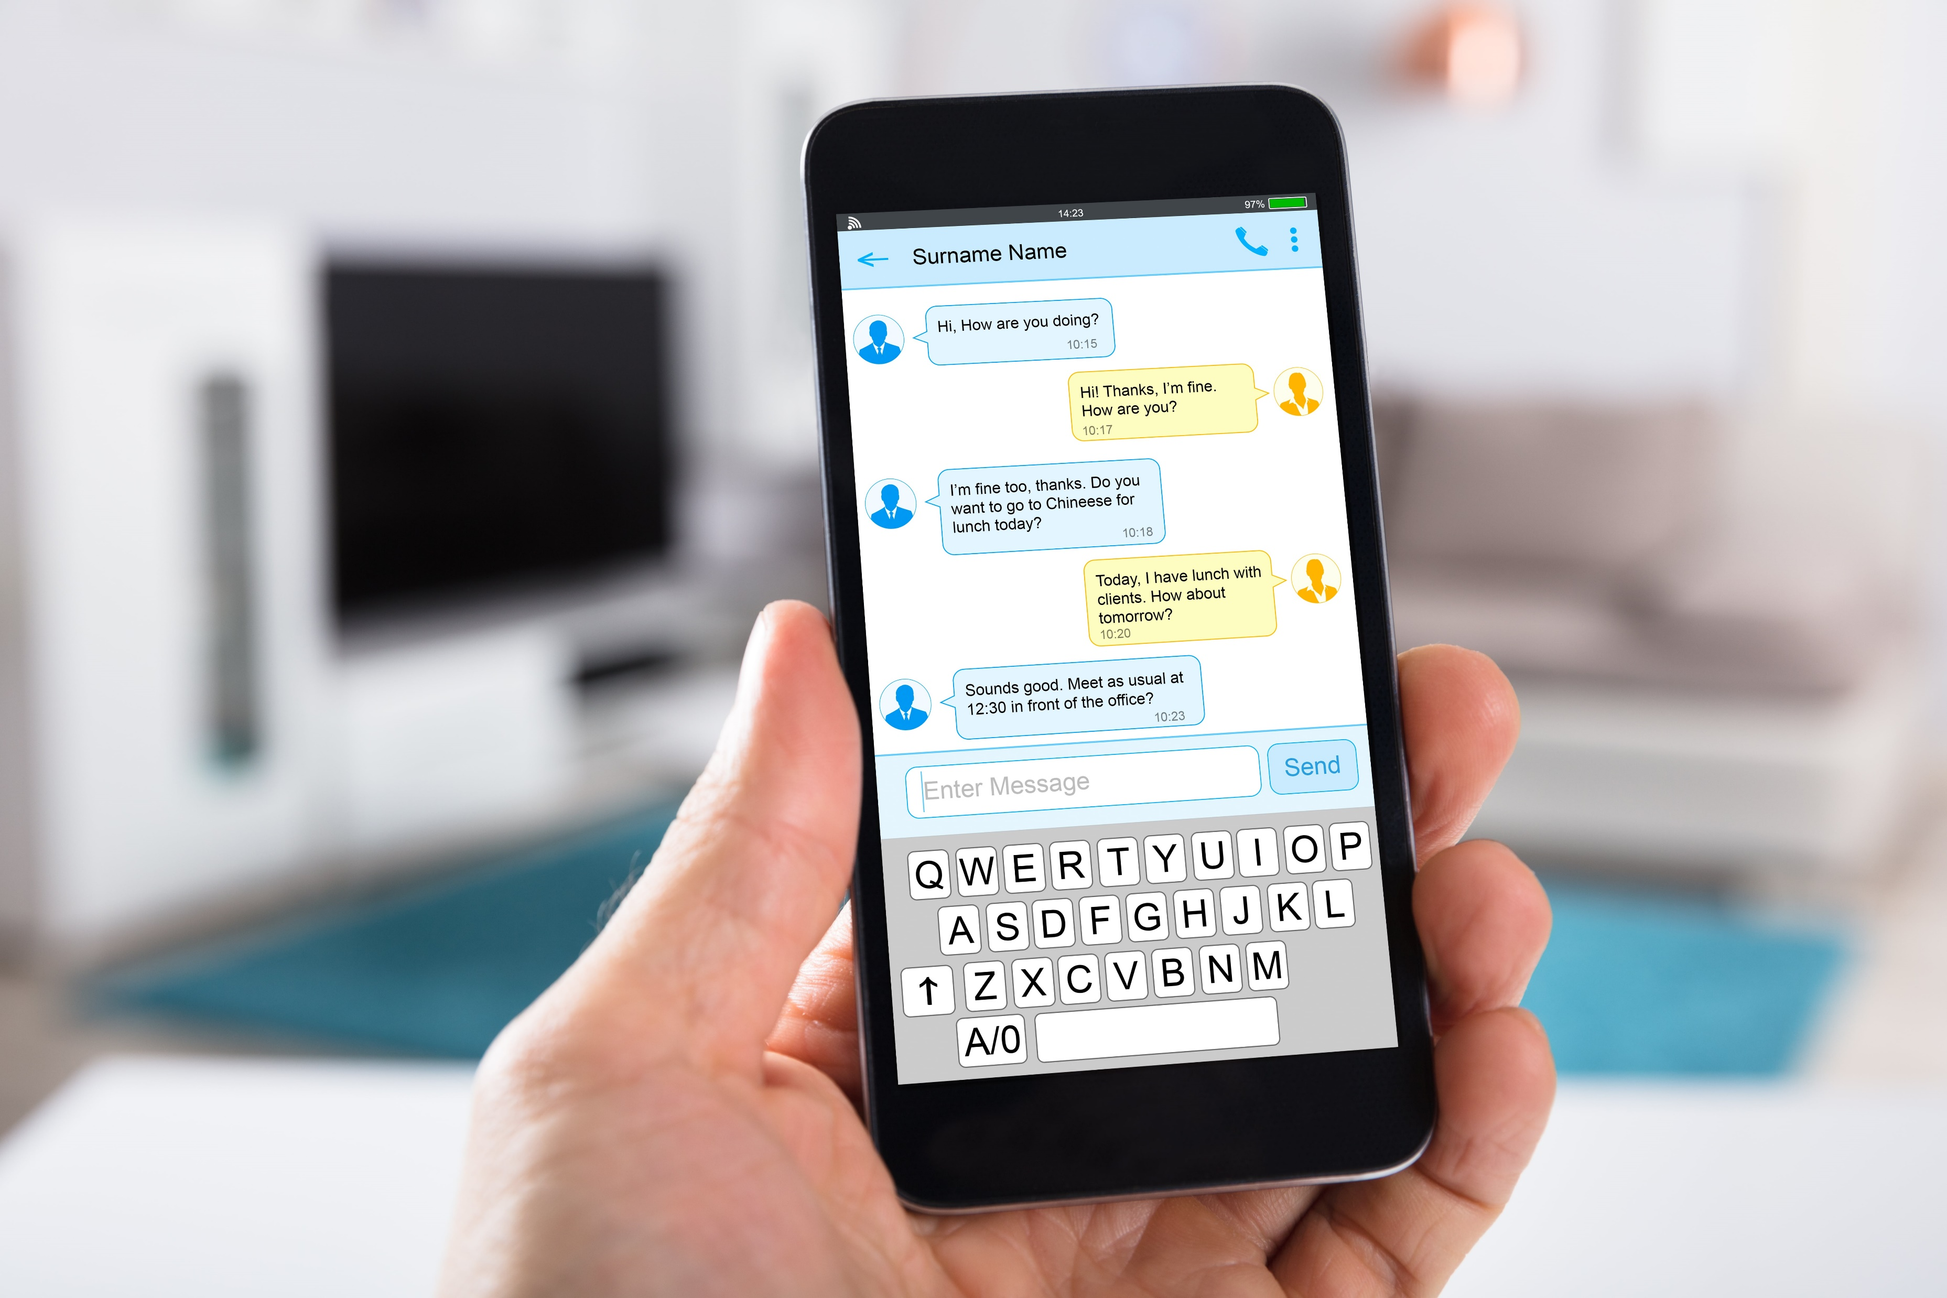
Key messages
We should show an adult any messages that are received.

Slide 10



Staying Safe Online
https://www.internetmatters.org/parental-controls/entertainment-search-engines/

Slide 11
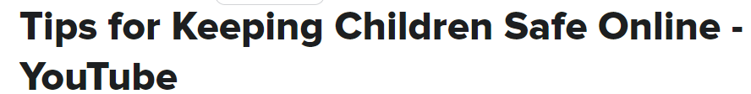
Staying Safe Online
https://www.thinkuknow.co.uk/parents/articles/keeping-your-under-five-safe-online/
https://bit.ly/3DlhVtd

